Slide 1
Victorian Era
Power and Politics

Slide 2
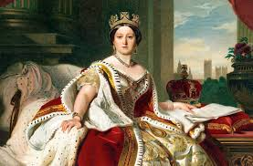
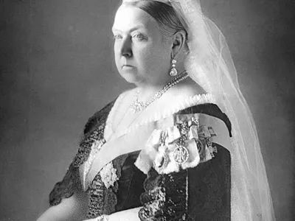
Her reign
-1837
- 1901
United Kingdom of Great Britain and Ireland

Slide 3
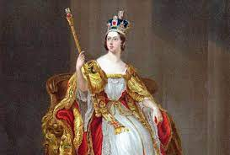
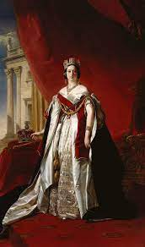
Her Policy
Non-interference in government affairs, respecting the role of Parliament.
the abolition of slavery and advocating for worker’s rights

Slide 4
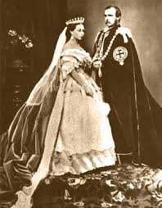
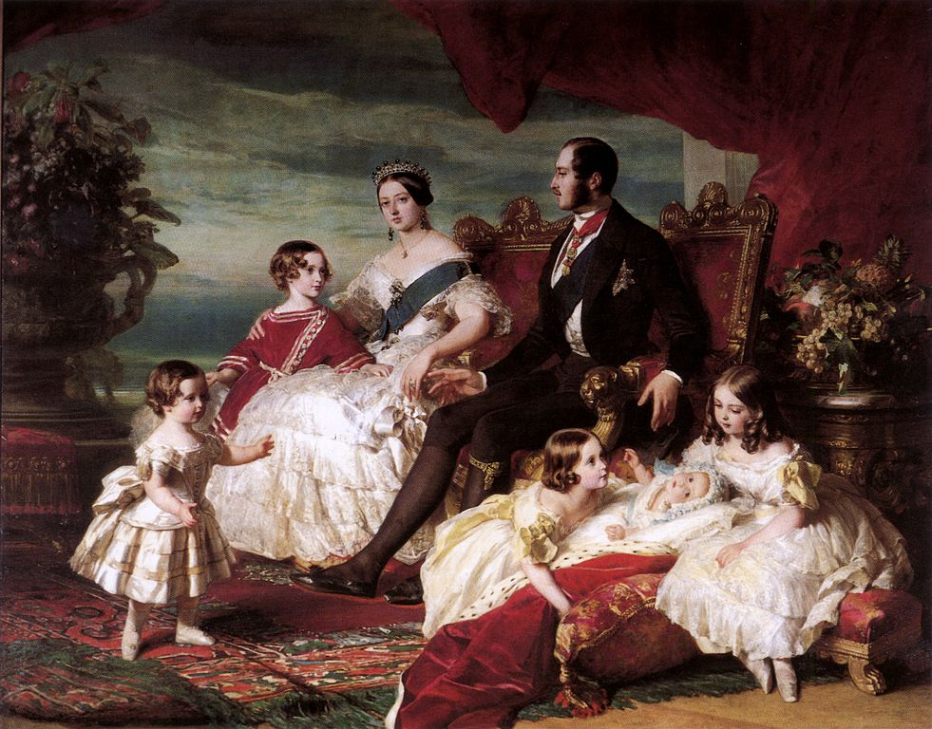
Her Family
-Prince Albert
She had 9 children with Prince Albert

Slide 5
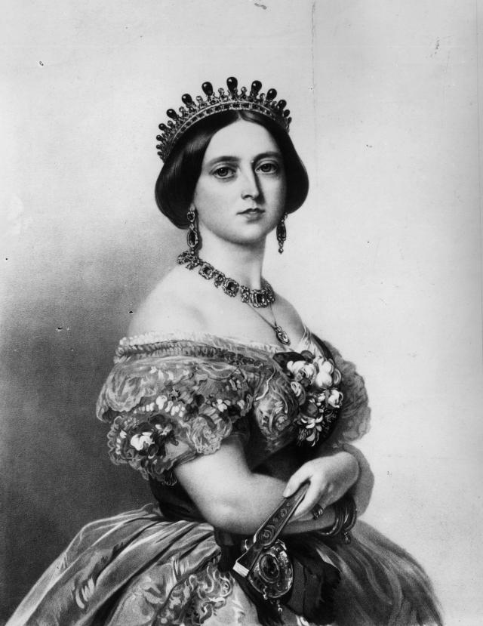
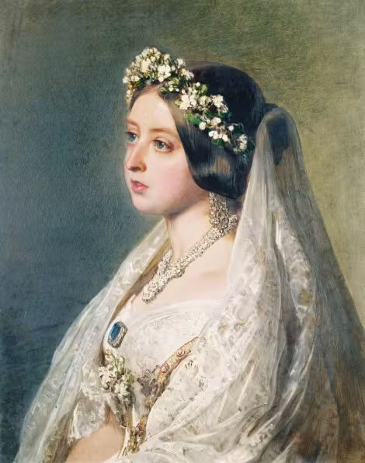

Slide 6
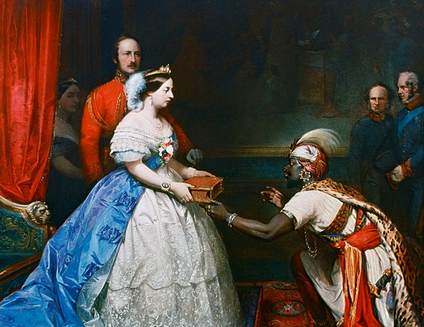
-1876
-Empress of India
-A strategic move

Slide 7
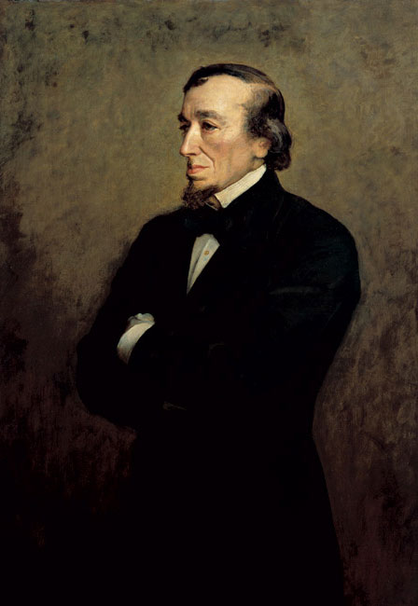
Who is Benjamin Disraeli ?
-British Politician
-Prime Minister
-An important advisor to the Queen

