Slide 1
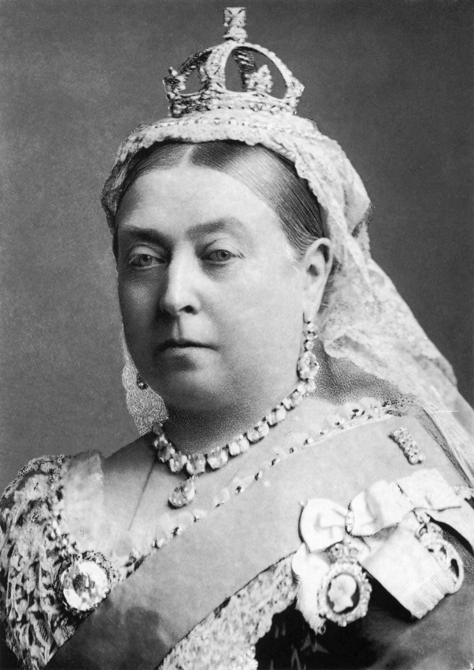
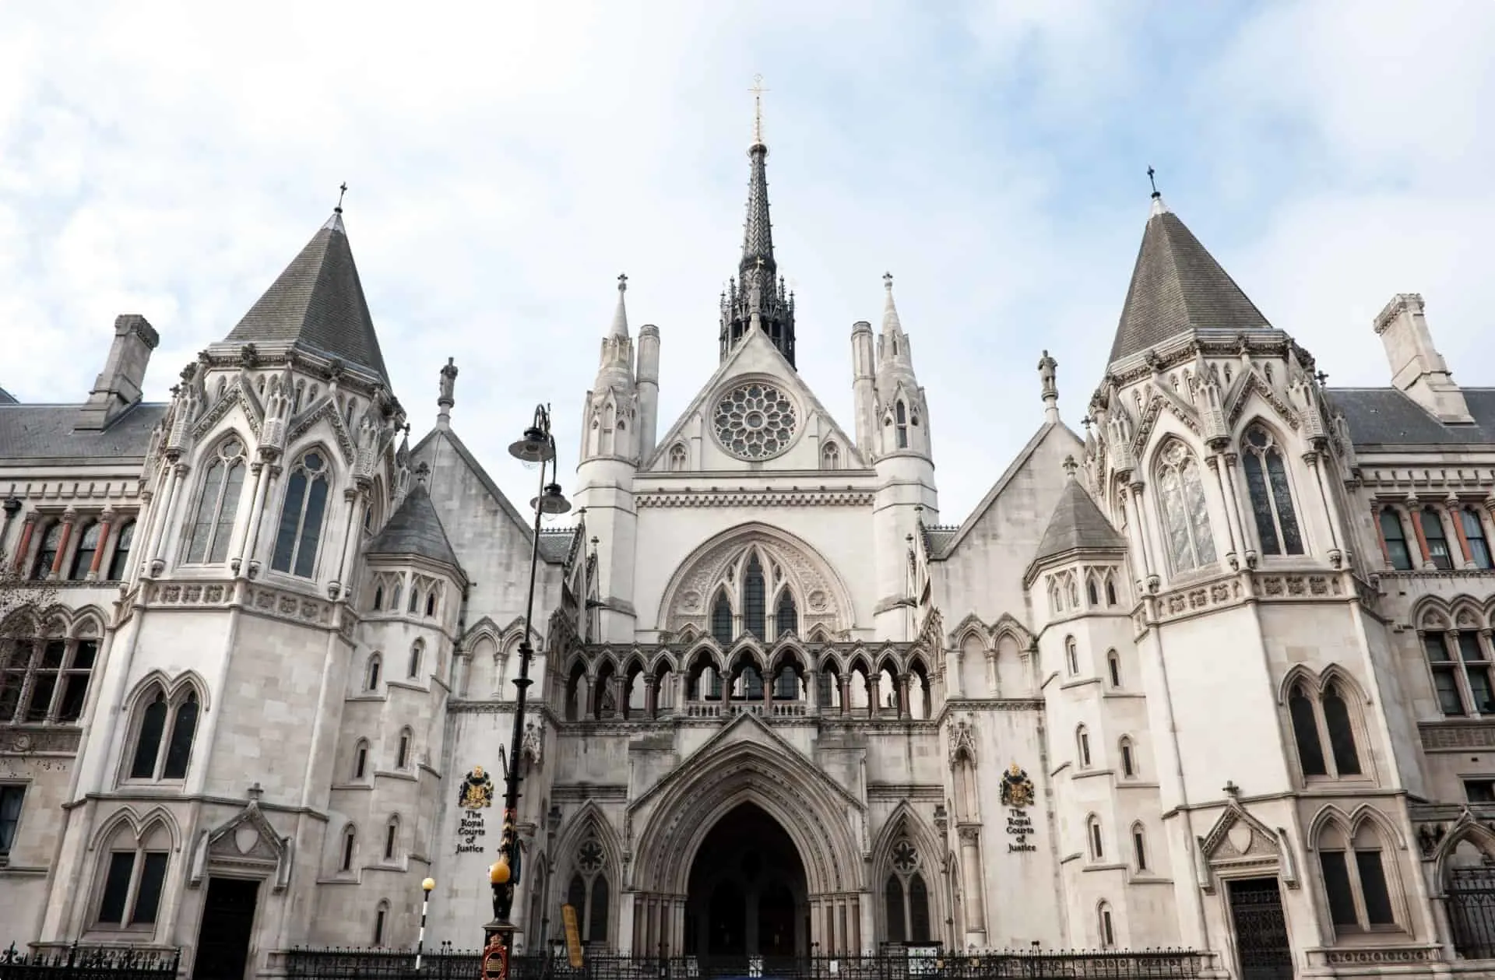
Victorian architecture

Slide 2
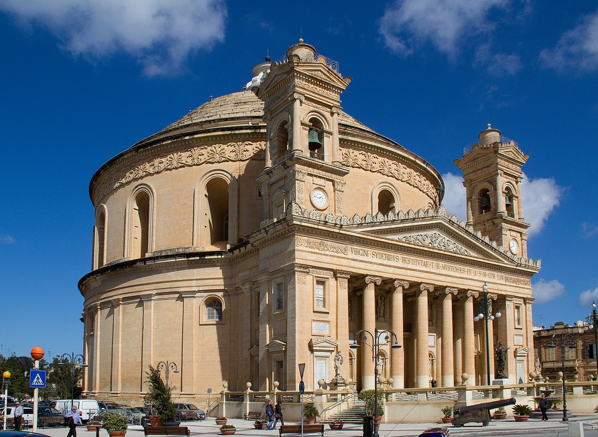
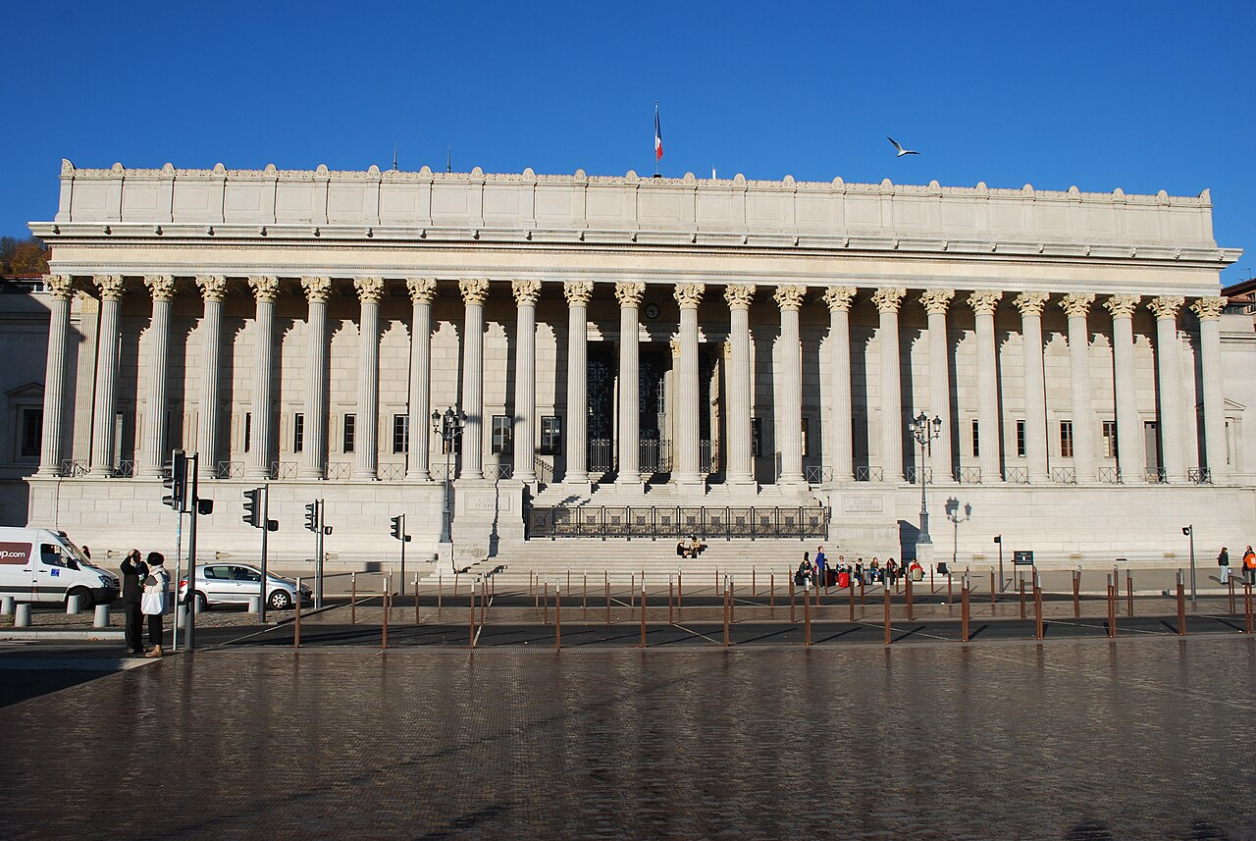
What did the architecture look like before the victorian reign ?
- Neoclassic
- inspiration of classic
- they reproduced the grec architecture

Slide 3
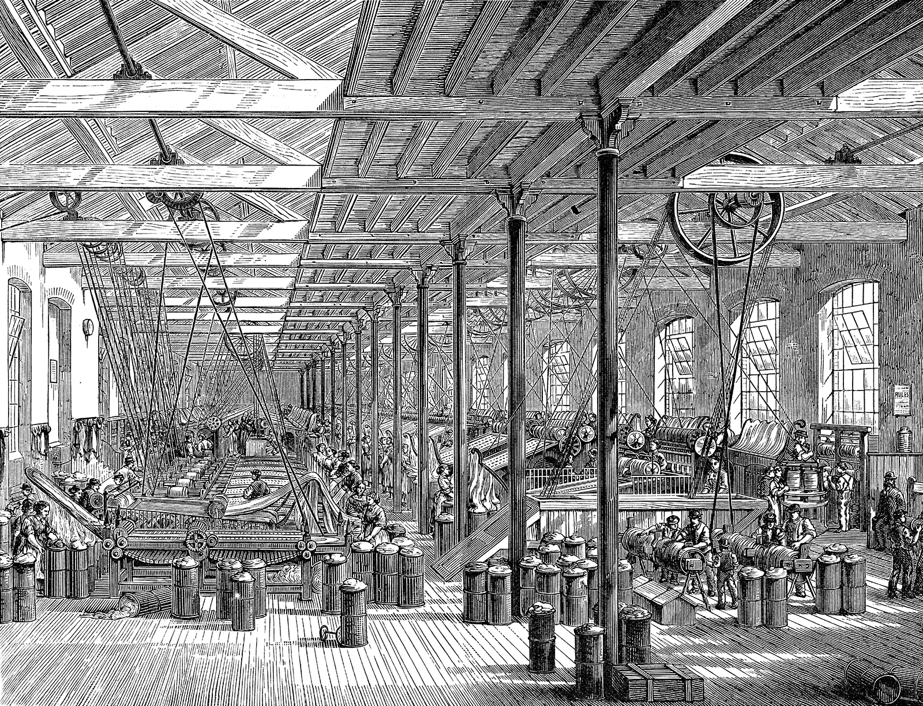
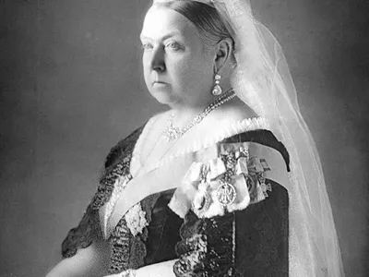
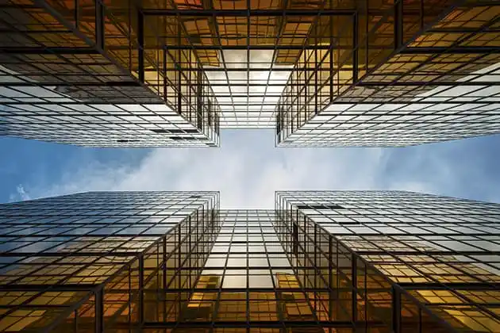
When did it appear and why ?
1837-1901
industrial revolution
New technology

Slide 4
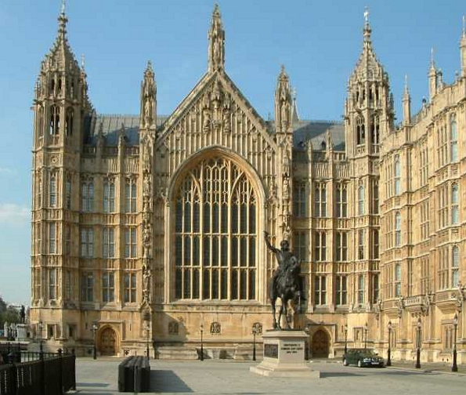
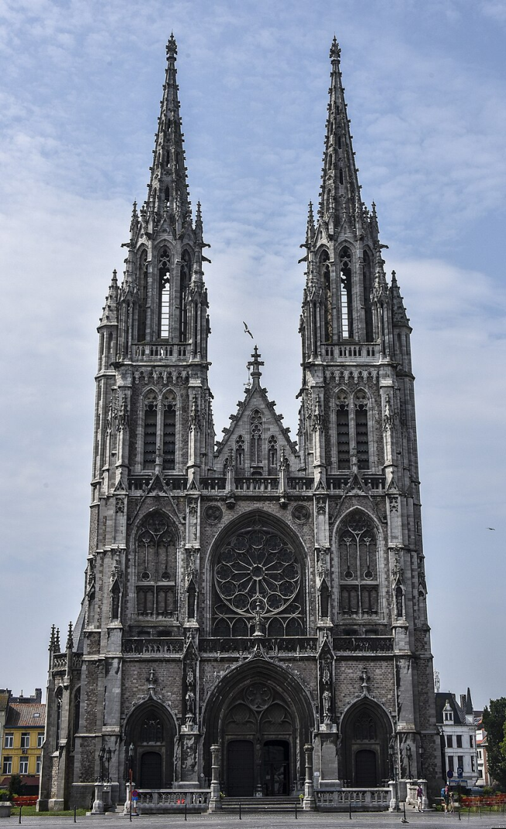
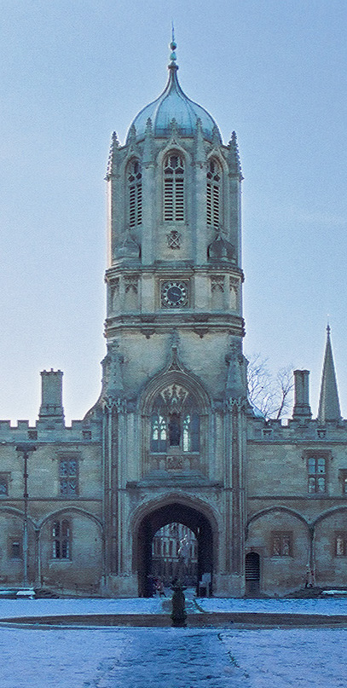
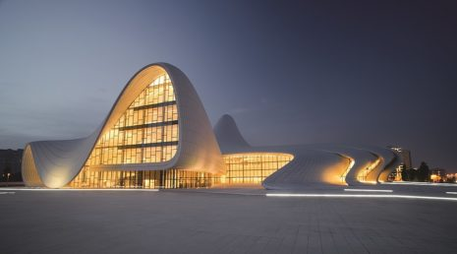
The gothic reveal
most iconic
symmetry style
It follows the neoclassic
Sint-Petrus-en-Pauluskerk
Tom tower
Palace of Westminster

Slide 5
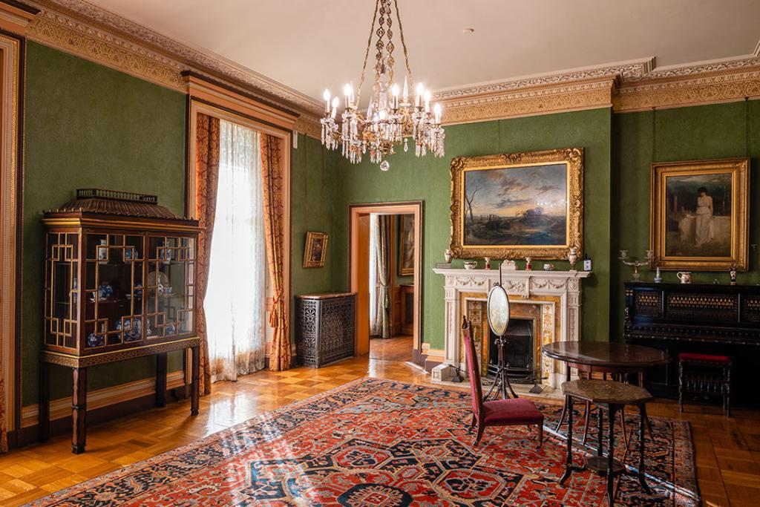
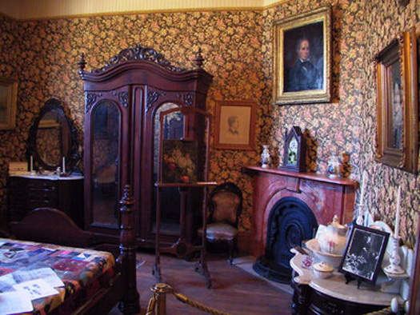
Decoration during the victorian reign
Heavy curtains , flowery wallpaper , carpets , ornaments , painting , plants

Slide 6
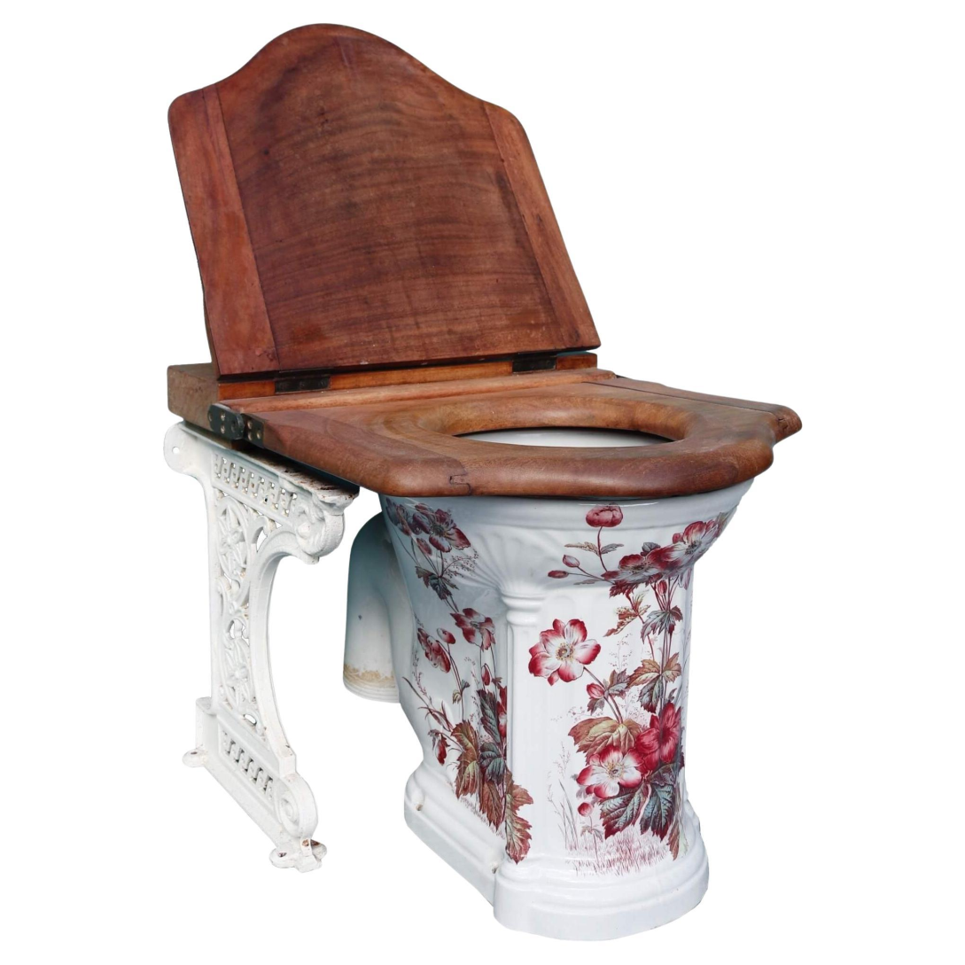
Fun fact

Slide 7
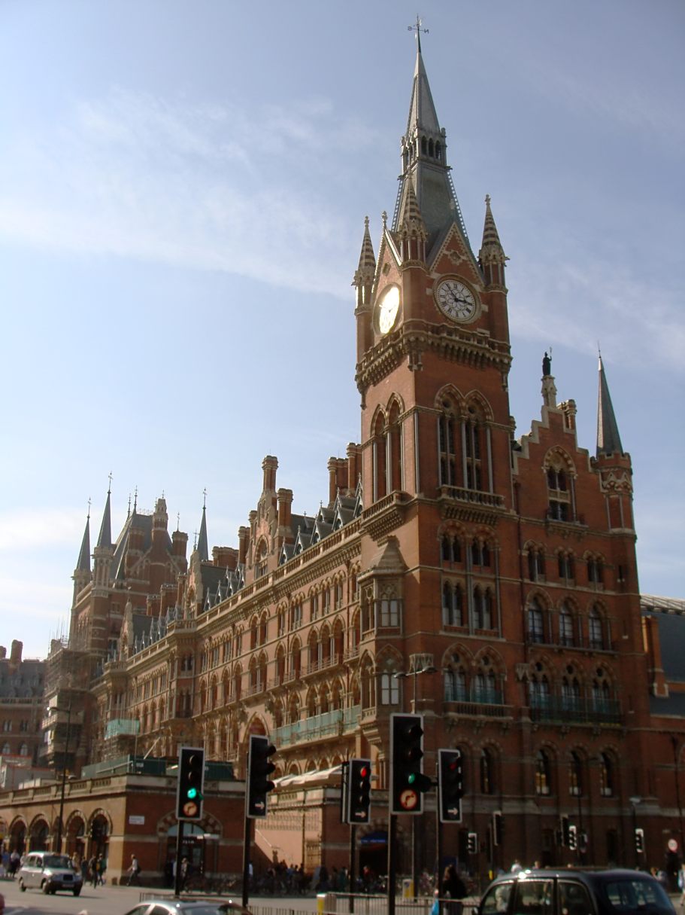
Conclusion

Slide 8
Avez vous tout compris ?
1 ) Why did the victorian architecture appear ?
2 ) Give the name of the main style
3 ) Give an example which makes this architecture unique
4 ) What was the best revolution of this century ?
5 ) Do Theses monuments still exist ?

