Slide 1
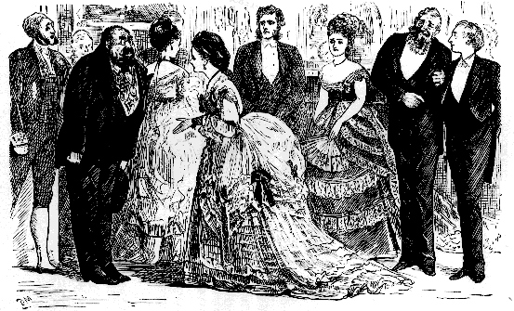
Victorian Religion

Slide 2
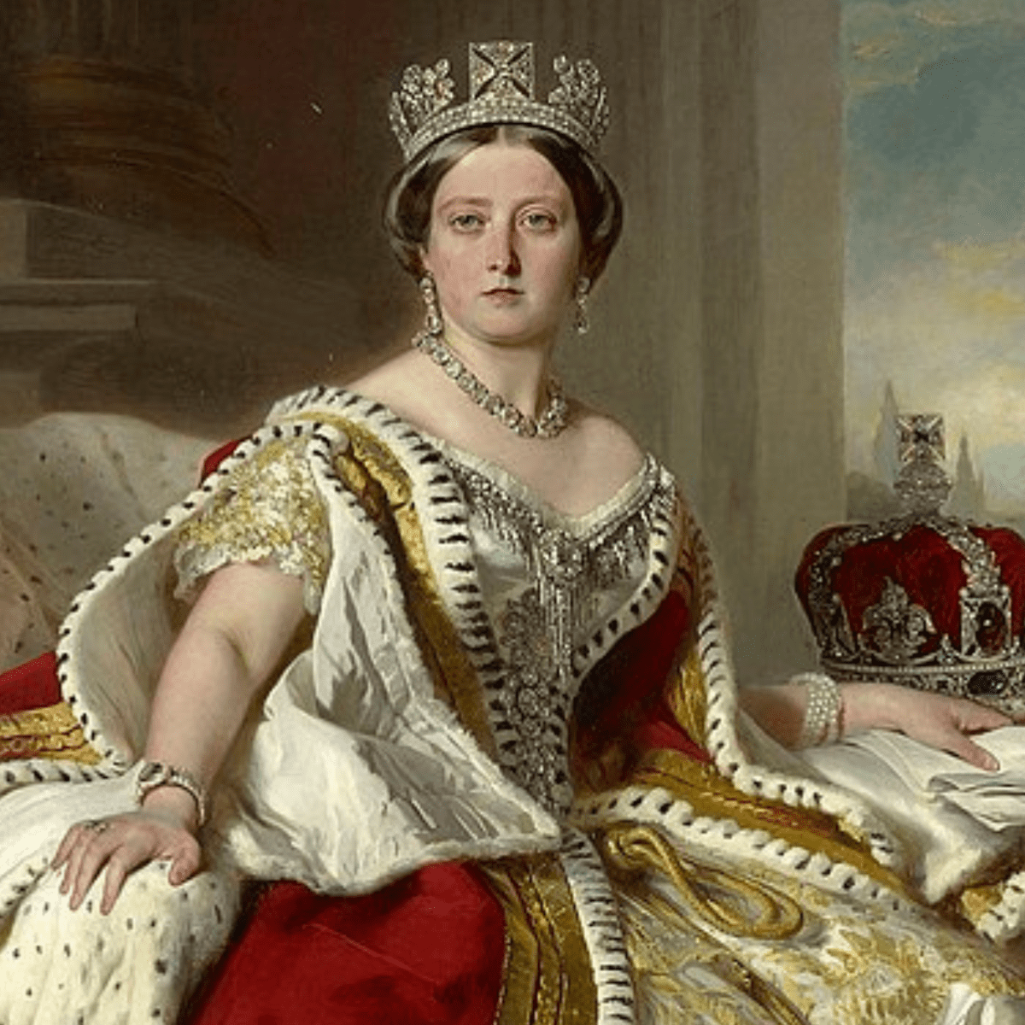
Victorian Religion
1837-1901
Social classes
Work, sexuality, laws
Queen Victoria (1819-1901)

Slide 3
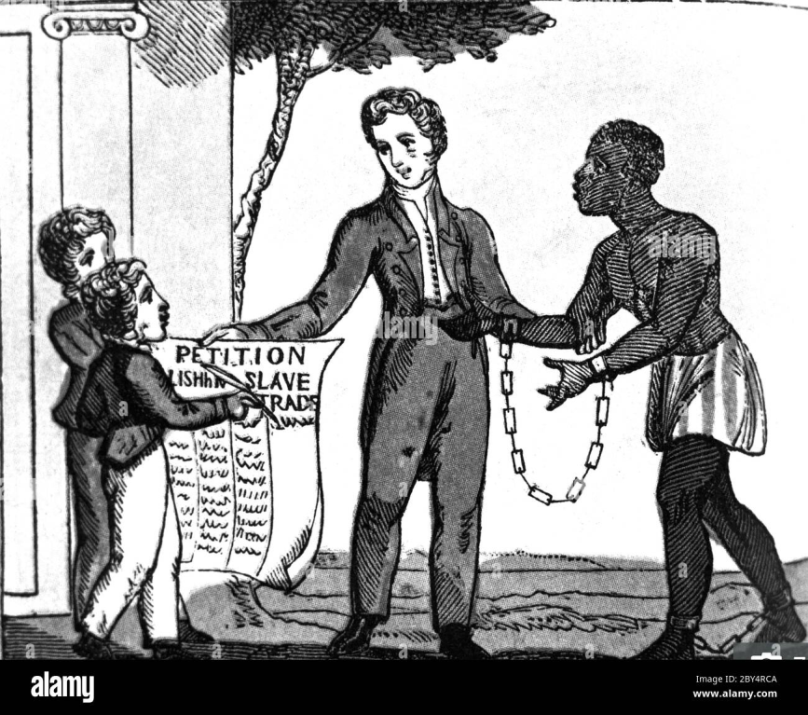
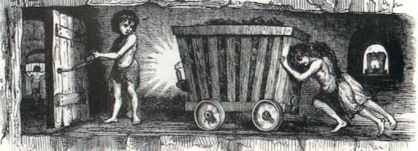

The major changes
Abolition of child labour
Abolition of slavery

Slide 4

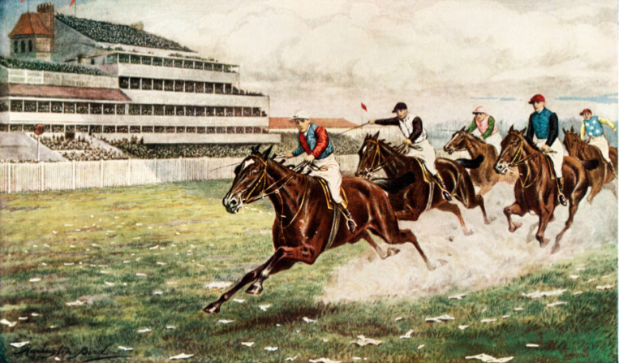
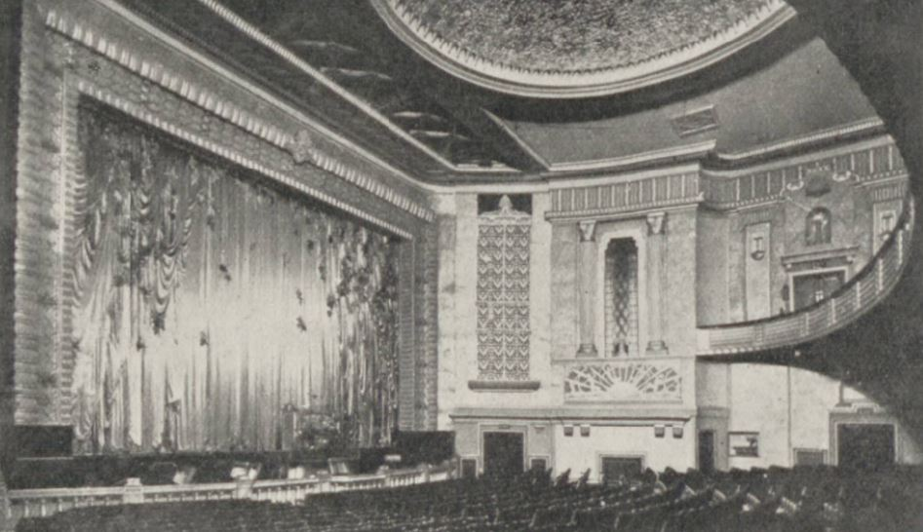
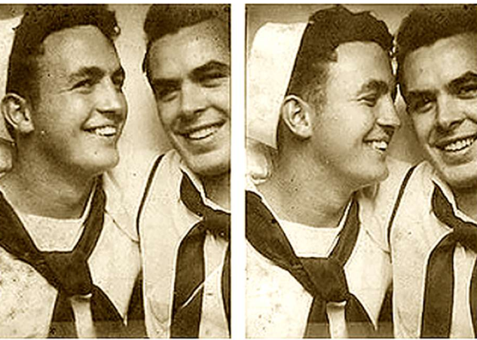
The Victorian morality
prostitution
Horse racing
obscene theaters
homosexuality

Slide 5
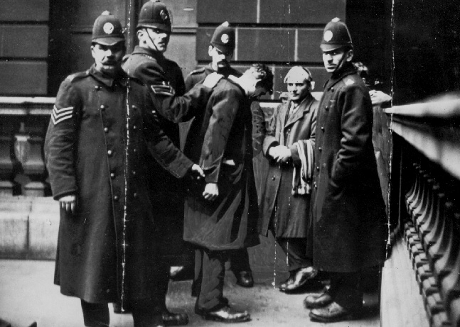
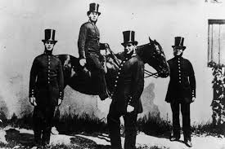
Social impact
Social reforms
fight against crime
development of the police

Slide 6
Conclusion
- Transformation of British society
- 19th century
- social reforms
Abolition slavery
Abolition of child labour
- Construction of modern society

