Slide 1
The British Empire

Slide 2
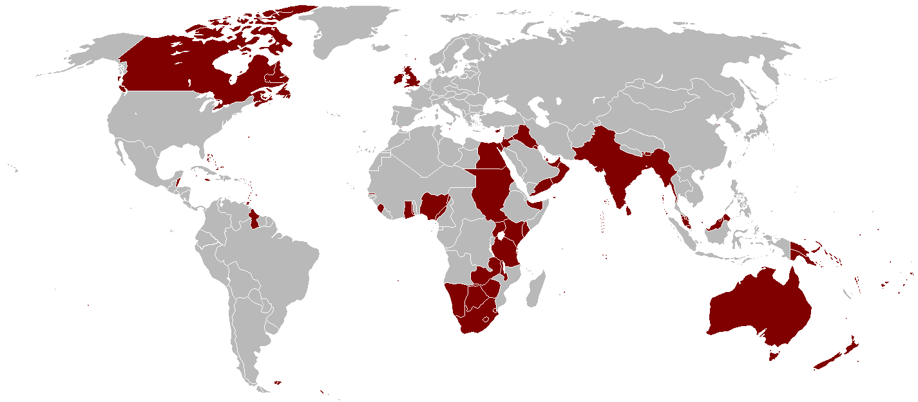
INTRODUCTION
1837 to 1901
Great expansion
Lasting consequences

Slide 3
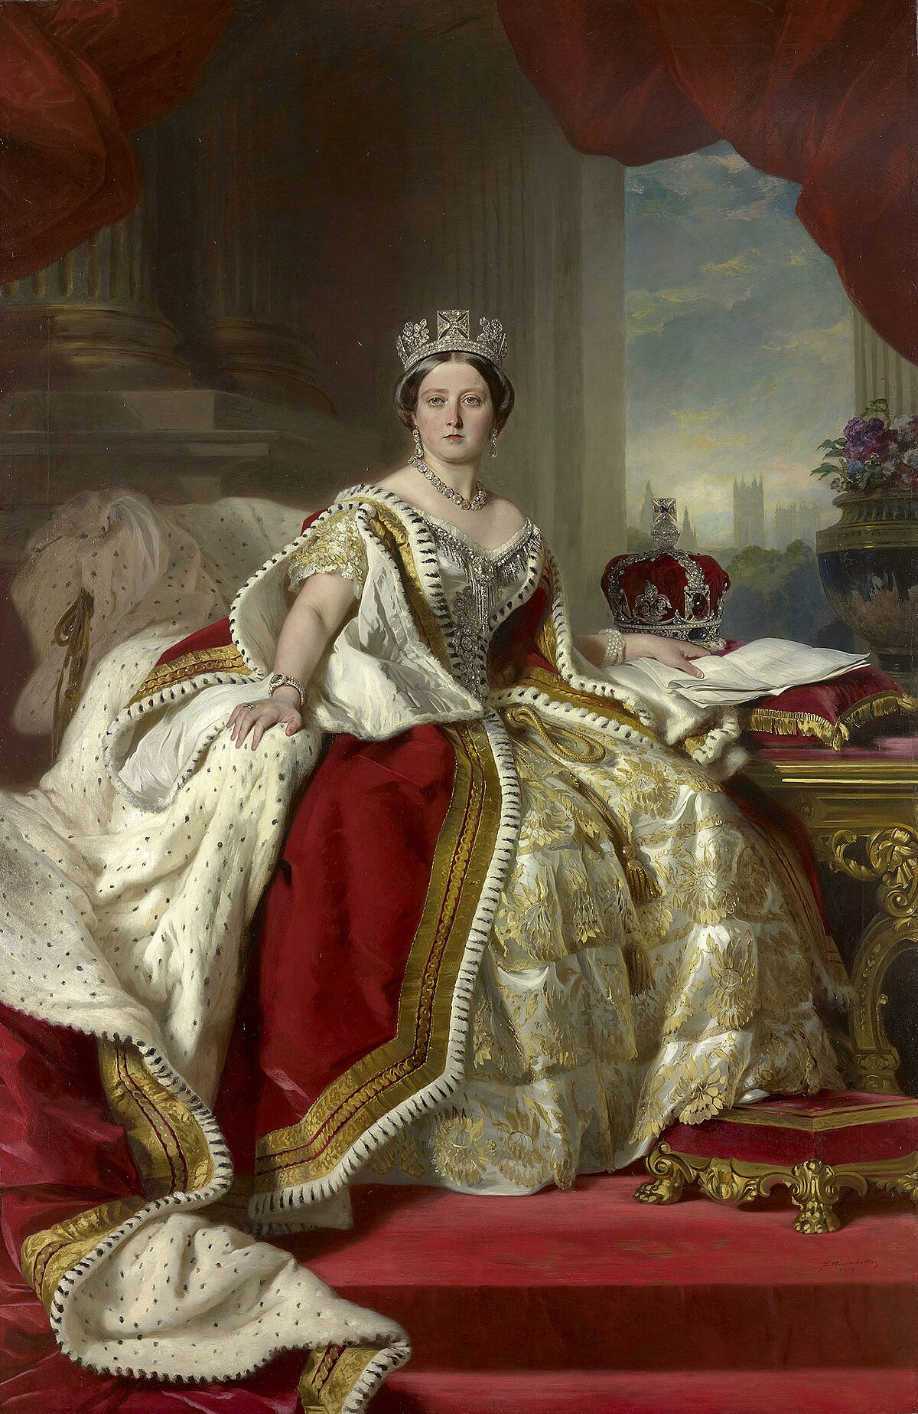
Queen Victoria
colonized
Iconic figure
Bringing benefits
civilizing

Slide 4
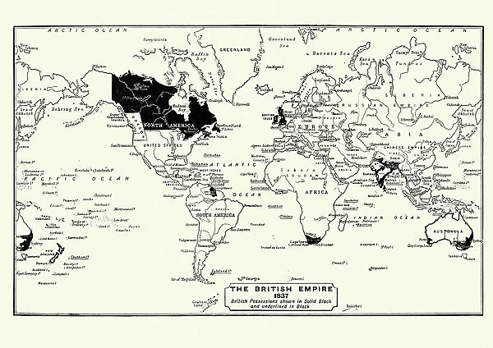
The Empire and its borders
strengthened
expanded
Involving conflicts
While territories

Slide 5
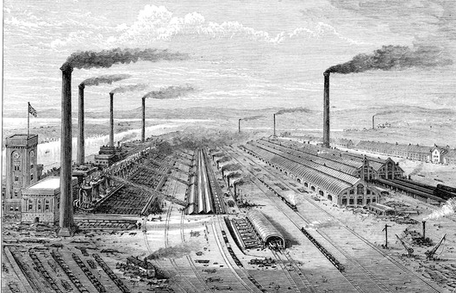
The Industrial Revolution
Immense wealth
markets
British economy
Essential materials

Slide 6
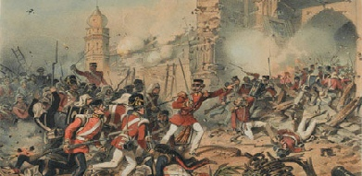
Revolts and tensions
domination
Legal systems
Revolts against
resistance

Slide 7
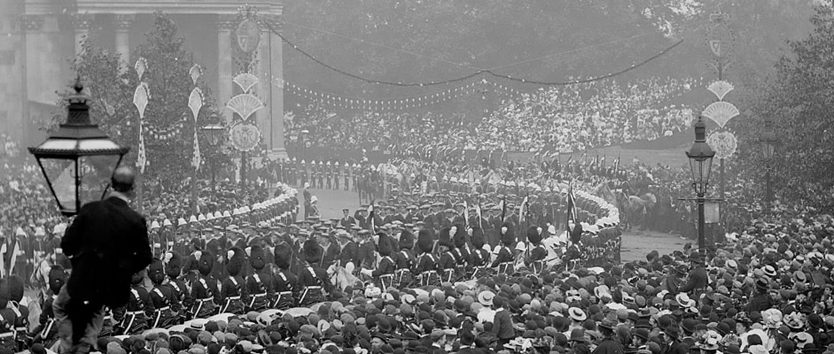
Consequences political
1947
Independence
ultimately
Movements for freedom

Slide 8
CONCLUSION
Lasting consequences
Immence expansion
Inequalities and conflicts
Respecting cultures

Slide 9
Questions
1- Why this period was significant ?
2- What continents was colonized ?
3- What marked the Victorian era ?
4- What did the Industrial Revolution transform ?
5- When did India become independent ?

