Slide 1
Queen Victoria
Alexandrina Victoria
Notes:
<numéro>

Slide 2
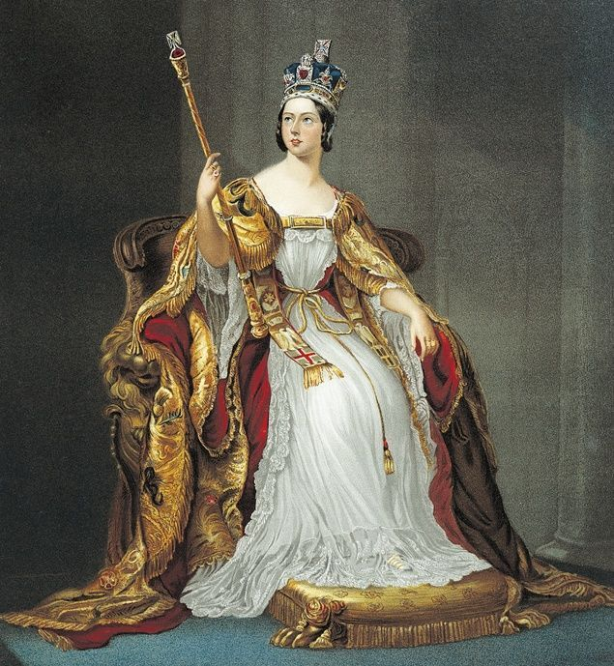
The Queen
UK, IL
King George III, German Princess
1901
63; 216d

Slide 3
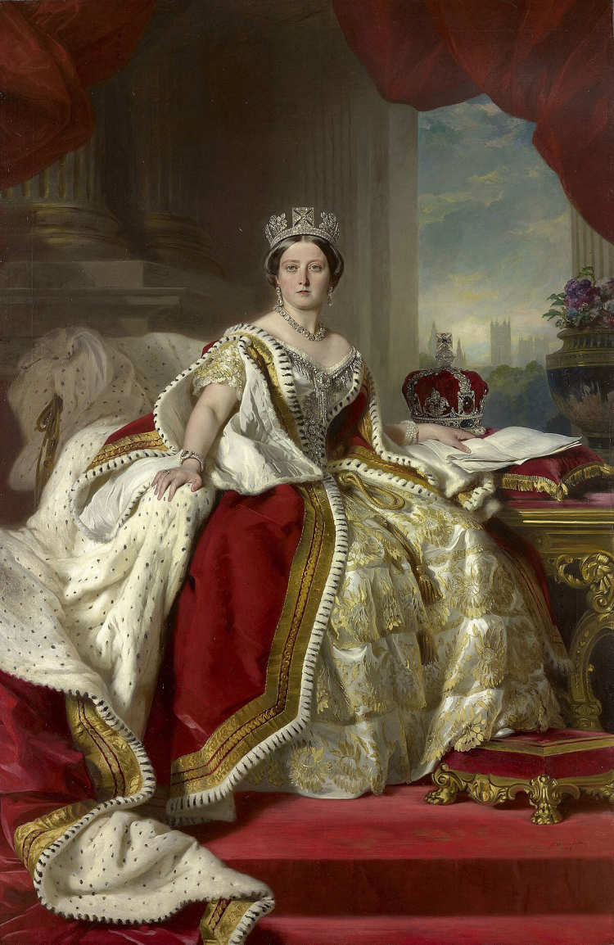
Reign
1837; 18
attemps assassination
29 may; John Francis; gun
Prince Albert; 1840
nine children
1845; potato blight; The famine Queen
died 1861

Slide 4
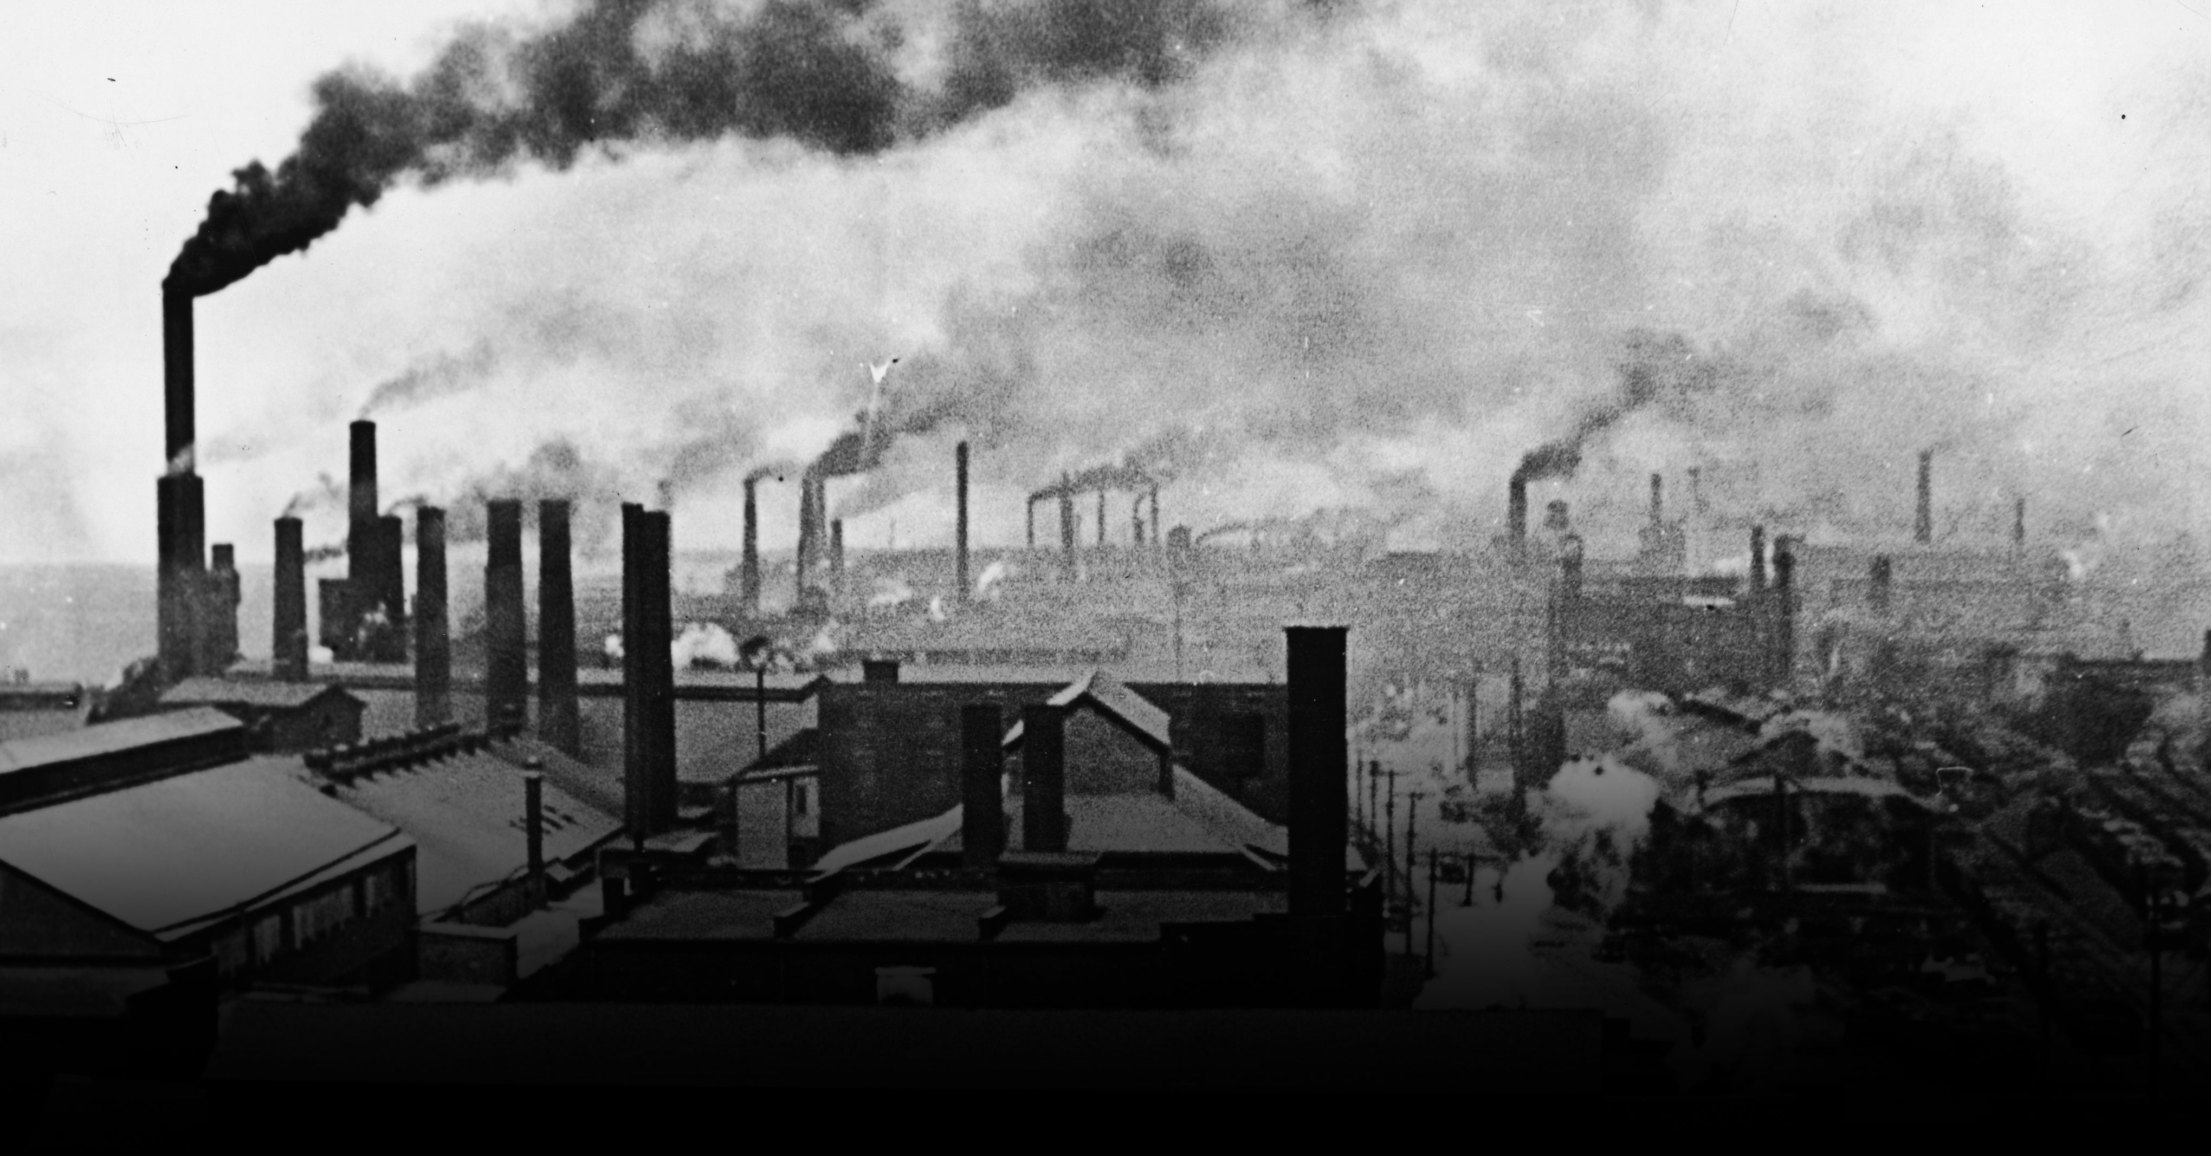
Industrial Revolution
Period of major changes
More than 200 years ago
The way products, made
People, make products, hand

Slide 5
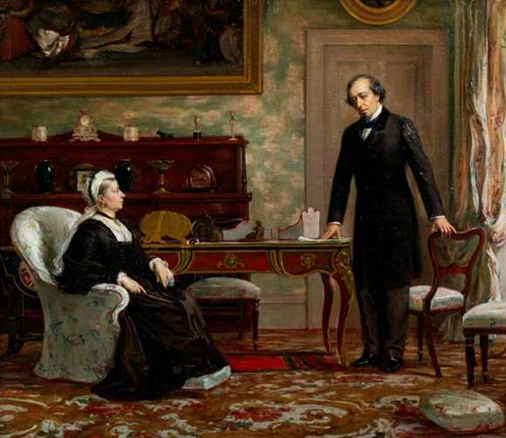
Political Power
technology advanced
People lost jobs
new machines

Slide 6
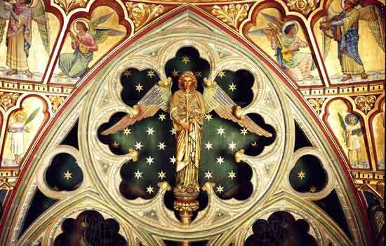
Religion
Change mentality
Abolition of slavery

Slide 7
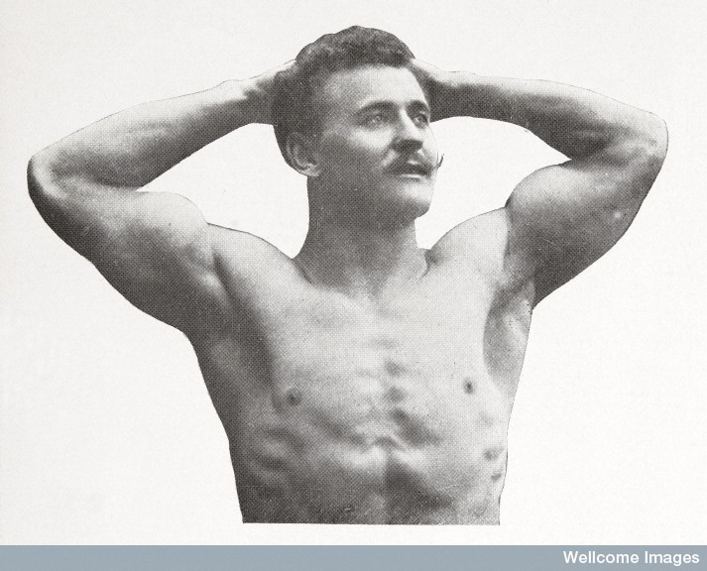
Masculinity
Based on assumption
extremely diverse
influenced by numerous aspects and factors

Slide 8
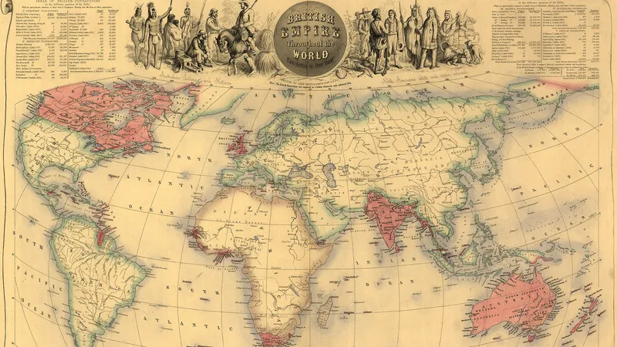
The British Empire
Much colinized

Slide 9
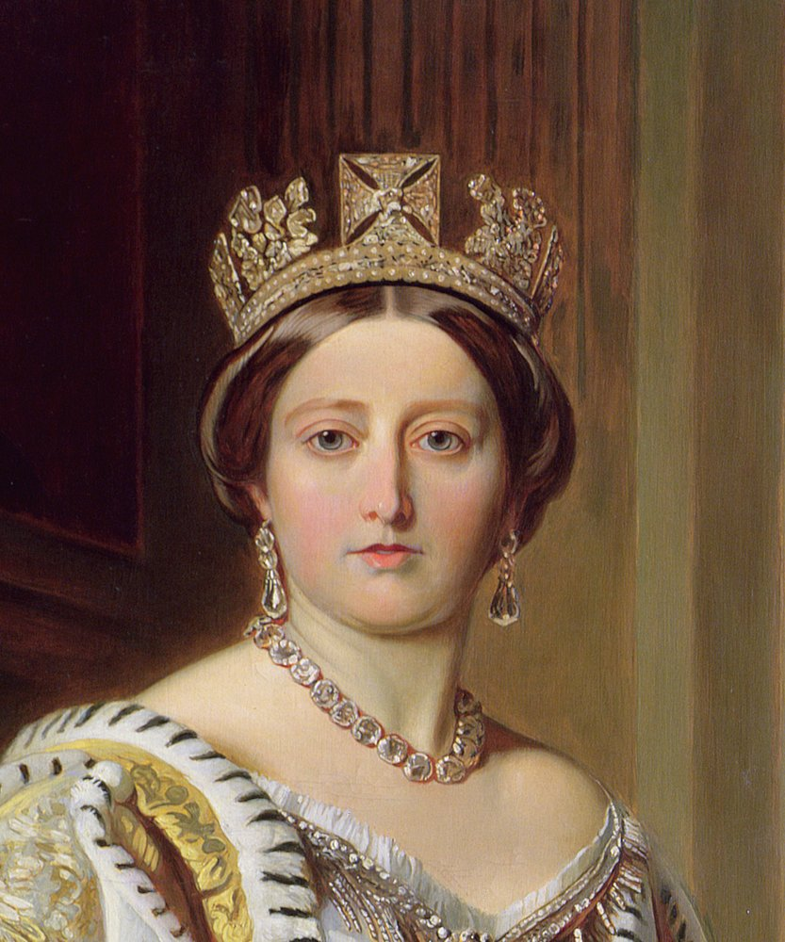
Later years
22/01/1901; 89
1887; 50y; The Golden Jubilee
10y; Diamond Jubilee
Edward VII; King

