Slide 1




TANGRAM ①
TANGRAM ②
TANGRAM ③
TANGRAM ④

Slide 2




TANGRAM ①
TANGRAM ②
TANGRAM ③
TANGRAM ④

Slide 3




TANGRAM ①
TANGRAM ②
TANGRAM ③
TANGRAM ④

Slide 4




TANGRAM ⑤
TANGRAM ⑥
TANGRAM ⑦
TANGRAM ⑧

Slide 5

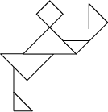


TANGRAM ⑤
TANGRAM ⑥
TANGRAM ⑦
TANGRAM ⑧

Slide 6

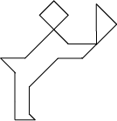


TANGRAM ⑤
TANGRAM ⑥
TANGRAM ⑦
TANGRAM ⑧

