Slide 1



Slide 2


Slide 3


Slide 4


Slide 5


Slide 6


Slide 7


Slide 8


Slide 9


Slide 10


Slide 11


Slide 12


Slide 13


Slide 14
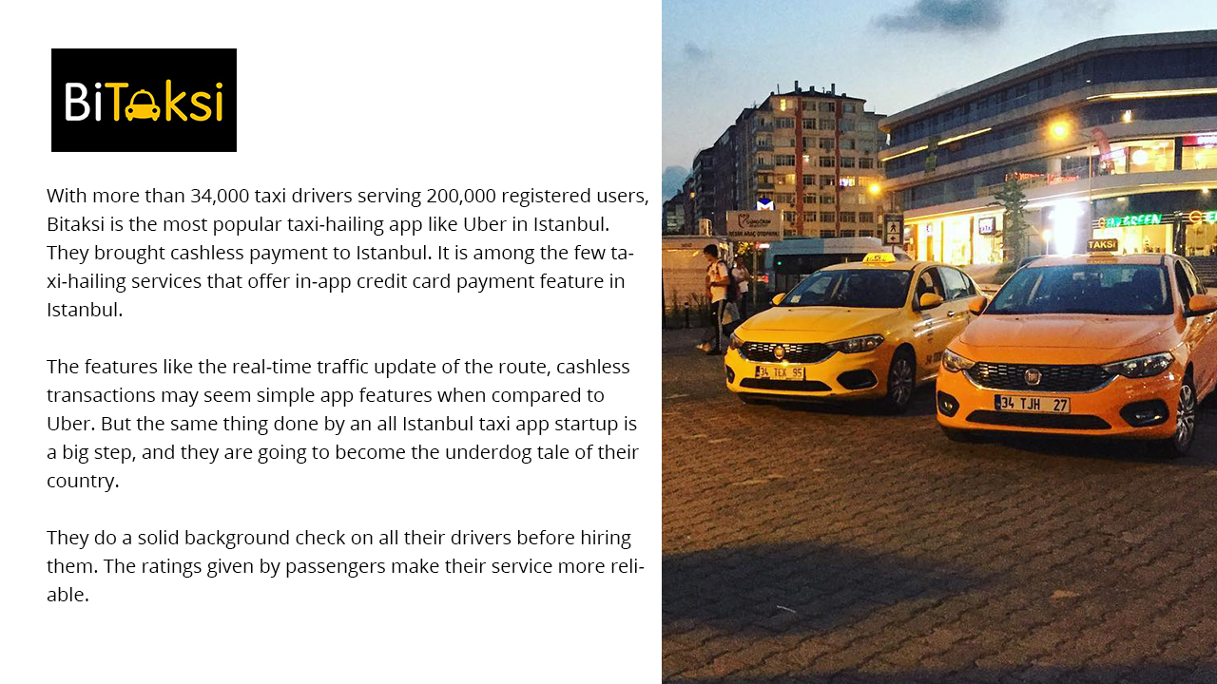

Slide 15


Slide 16


Slide 17

Contact Us
5123 W 98th St,
Suite 1033, Minneapolis,
MN, 55437
Excellent Webworld
biz@excellentwebworld.com
+1-(480)-409-4504

