Slide 1


Slide 2
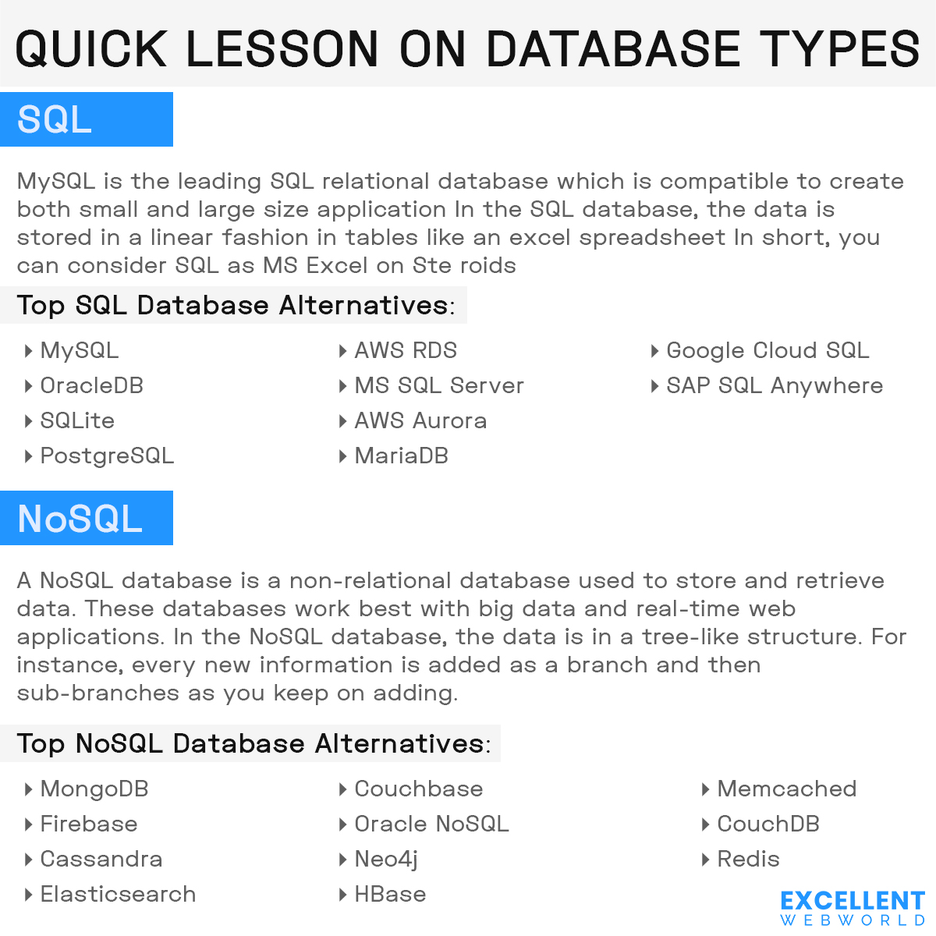

Slide 3


Slide 4


Slide 5


Slide 6


Slide 7


Slide 8


Slide 9


Slide 10


Slide 12


Slide 13


Slide 14


Slide 15


Contact Us
biz@excellentwebworld.com
+1-(480)-409-4504
excellent.webworld
https://www.excellentwebworld.com

Slide 16


