Slide 1

Sequence 4: Act and React
NIVEAU 3E – RANDON BENEDICTE

Slide 2
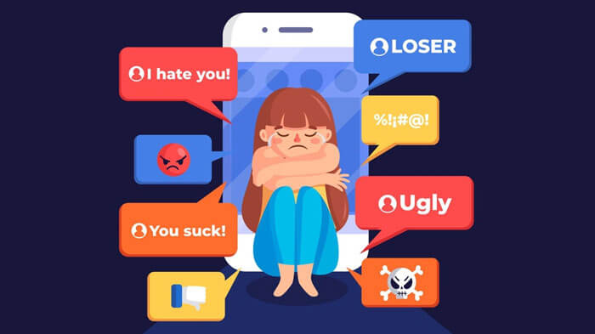
Recap!
What is the problem denounced in the drawing?
Give a definition.
What should you do to avoid it?

Slide 3
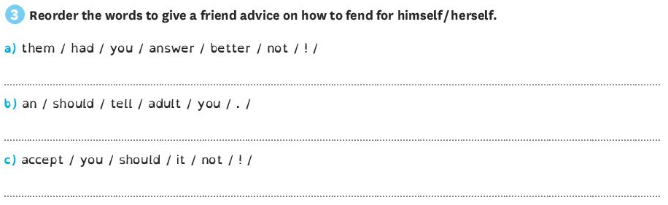
Let’s correct!

Slide 4
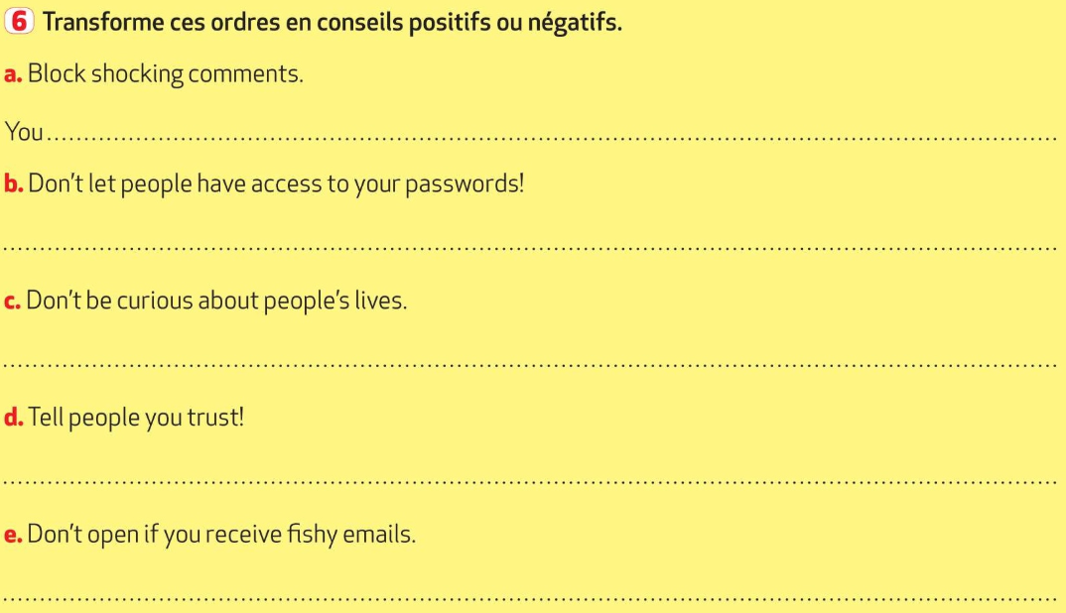
Let’s correct!

Slide 5

React!
Type of document?
Identify the main character.
Make suppositions:
Hobby?
Problem?

Slide 6

Oral comprehension activity
Watch part 1 of the video (from the begining to 1’11)
Where does the scene take place?
What is the boy’s position in the team?
What happened during the last match of the season? Did his team win or lose the game?
After the match, what happened to Daniel?
What was his reaction?

Slide 7
Check your answers:
Where does the scene take place?
The scene takes place in the USA, more precisely in Hillsborough a city in California.
What is the boy’s position in the team?
Daniel is the goalkeeper / the goalie of the team.
What happened during the last match of the season? Did his team win or lose the game?
He couldn’t stop the ball in the last minutes of the match so his team lost the game. They were very disappointed.
After the match, what happened to Daniel?
Pictures were published on Facebook / a very popular social network and he was tagged as the « worst goalie ever » = the worst goalie of all times.
What was his reaction?
He was shocked. He says it was just « horrible ».

Slide 8
Oral comprehension activity
Watch part 2 of the video (from 1’11 to the end): answer the questions and do the activities on your worksheet in pairs
Say if the statements are right or wrong and explain why with two or three sentences:
Daniel Cui reacted positively to the comments online.
His friends didn’t react.
All the students finally show support to Daniel.
That story changed Daniel and made him a better goalkeeper.

Slide 9
Check your answers:
Say if the statements are right or wrong and explain why with two or three sentences:
Daniel Cui reacted positively to the comments online. WRONG
He was shocked by all the means comments he read online so he didn’t want to go back to school because was too much negativity. He didn’t want people to laugh at him and call him names.
His friends didn’t react. WRONG
His friends reacted very quickly and helped him. They used a great picture of him as their profile picture to show their support.

Slide 10
Check your answers:
c. All the students finally show support to Daniel. RIGHT
Little by little (= petit à petit), the students of Daniel’s school all used his picture as their profile picture to show support and to stop harassing / bullying him.
d. That story changed Daniel and made him a better goalkeeper. RIGHT
Daniel felt confident again and he became a better goalkeeper the next season.

Slide 11
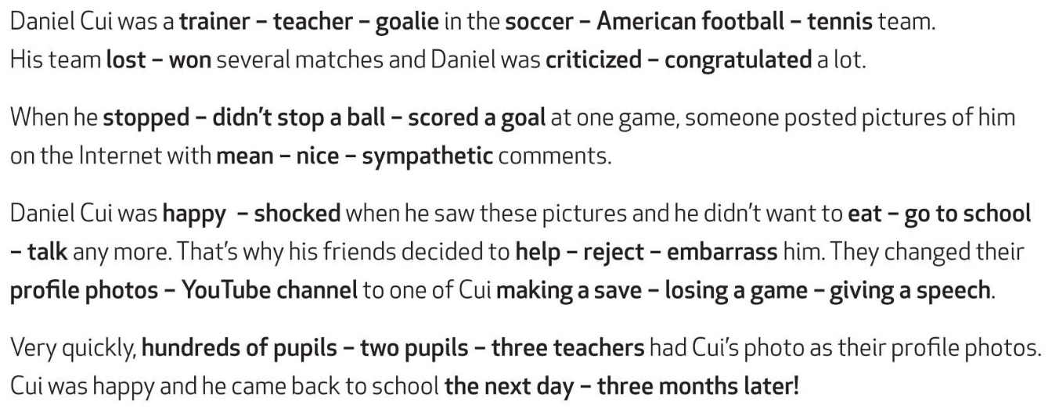
Recap!
Read the text and circle the correct answer:

Slide 12
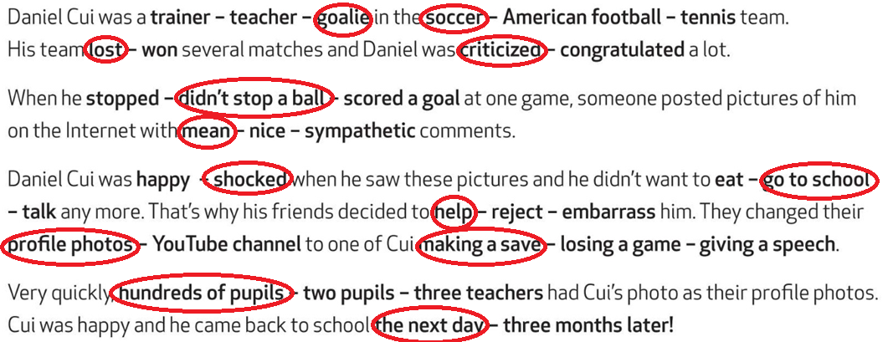
Recap! Check your answers

Slide 13
Recap:
Daniel Cui, an American soccer goalie / goalkeeper from California has been bullied: he has suffered from cyberbullying. Here is his story.
Some students posted photos of him on the Internet, with horrible comments, because during an important game he couldn’t stop the ball. Daniel didn’t want to go to school any more because he was shocked. So, his friends decided to react and help him! They found a great picture of Daniel and they made it their profile pictures. The whole school stood up for (= défendre / se battre en faveur de) him. So Daniel Cui felt better and he came back to school the next day. He felt more confident (= confiant), so the next season, he made the best save (= un arrêt) of his life and his team won!

Slide 14
Le present perfect et le prétérit simple
1. Observe et déduis :
a. My brother has often been bullied.
b. He was bullied when he was in primary school.
Souligne le groupe verbal en rouge dans chaque phrase.
On parle d’un bilan, d’une expérience dans la phrase A et on parle d’un fait daté et passé dans la phrase B.

Slide 15
2. Repère :
a. I’ve never texted him.
b. She had a new mobile phone for her birthday last month.
Le verbe de la phrase a est conjugué au □ prétérit simple □ present perfect.
Le verbe de la phrase b est conjugué au □ prétérit simple □ present perfect.
3. Récapitule :
On emploie le PRETERIT SIMPLE pour parler d’un fait passé que l’on peut dater.
On emploie le PRESENT PERFECT pour parler d’un bilan ou d’une expérience.

Slide 16
4. Entraîne-toi :
Indique si tu utilises le prétérit simple ou le present perfect avec ces expressions :
When I was 12 years old:
preterit (c’est daté précisément)
Last year:
preterit (date précise dans le passé.)
Ever:
present perfect (interroge sur les experiences)
Yesterday:
preterit (date precise dans le passé)
Already:
present perfect (référence à des expériences déjà faites)

Slide 17
Conjugue les verbes au prétérit simple ou au present perfect :
I have never sent mean messages. (bilan d’expériences)
Katie received a mean message yesterday. (daté par yesterday)
When he was in primary school, he was a victim of bullying.
(daté précisément par “primary school”)
My cousins have often been victims of cyberbullying.
(bilan d’expériences)

Slide 18
Homework.
Etre capable de parler de l’expérience vécue par Daniel.
Savoir différencier le prétérit et le present perfect et quand les utiliser.
Faire les exercices « let’s practise at home » sur la feuille distribuée.

Slide 19
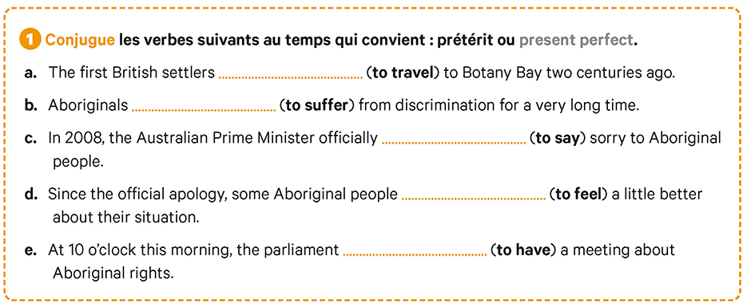
Exercises:

Slide 20
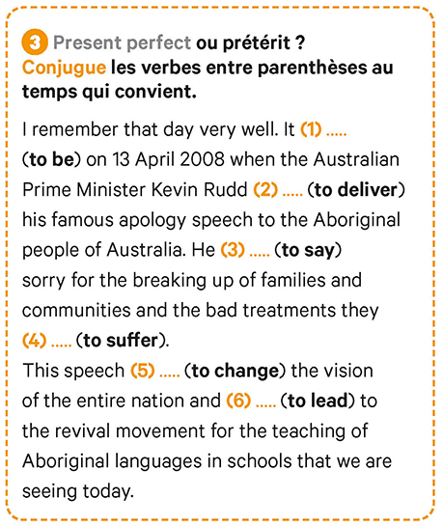
Exercises:

