Slide 1
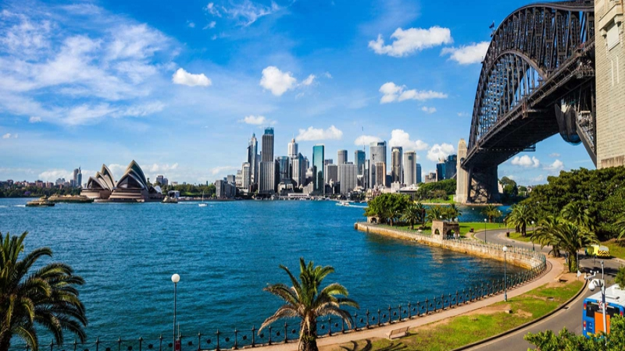
Sequence 5: Welcome Down Under
Niveau 4e – RANDON Bénédicte -
Collège Rosa Parks Cavaillon

Slide 2
Check your knowledge

Slide 3
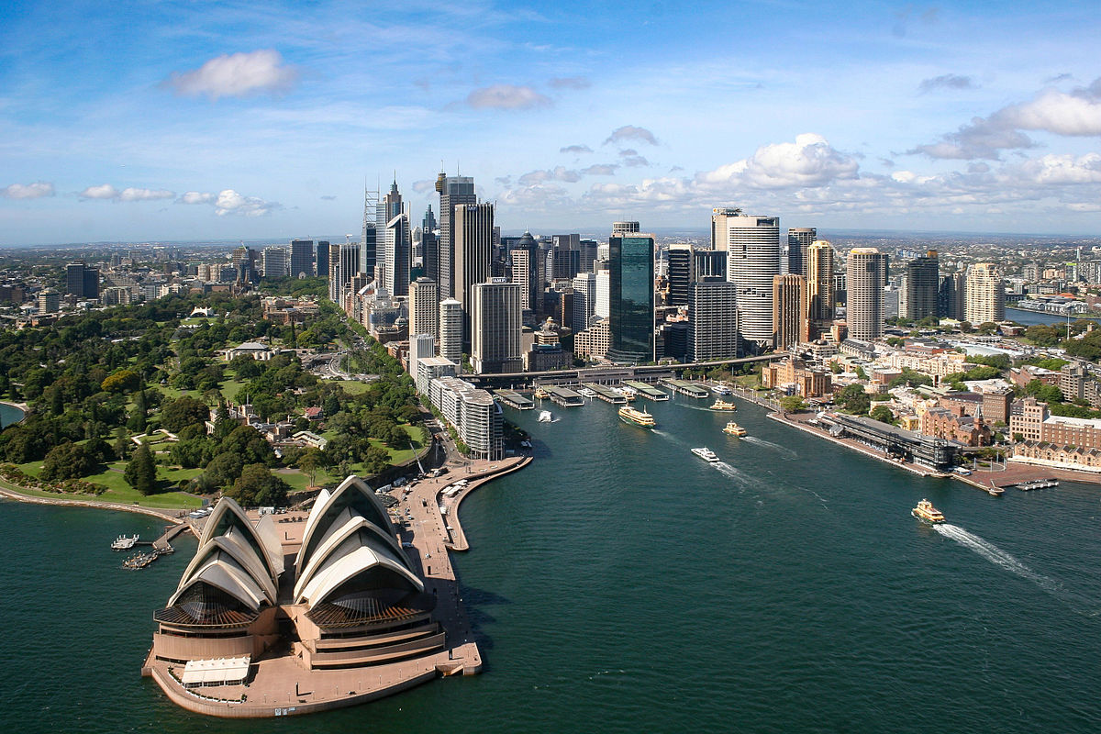
Let’s see what you remember
See if you remember the vocabulary of your lesson. Do the following activity:
https://learningapps.org/watch?v=p7ujrupva20

Slide 4
Oral comprehension activity

Slide 5
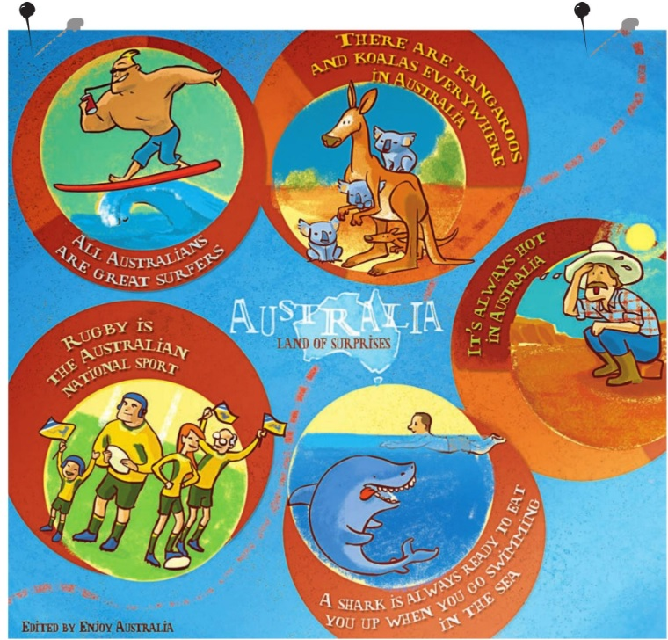
React! What can you see?
What type of document is it?
What is the subject of the document?
Describe it. What can you see in it?
Now concentrate on the sentences: are they right or wrong? What is your opinion?

Slide 6

Listen!
GLOBAL COMPREHENSION
Listen to the complete document and answer the questions:
What type of document is it?
What is the subject of the conversation?
How many characters are there? Who are they?

Slide 7
Listen!
DETAILLED COMPREHENSION
Listen to the document and answer the questions on your worksheet:
What is the first stereotype the presenter is talking about? Number it on the document.
What do the boys think about it? Write all the information you can.

Slide 8
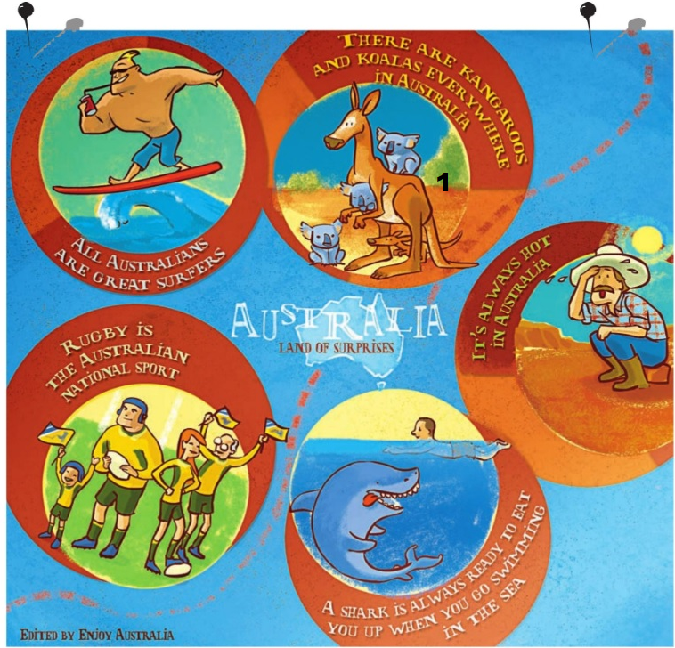
Listen! Check your answers.
What is the first stereotype the presenter is talking about? Number it on the document.
What do the boys think about it? Write all the information you can.
Neil lives in Darwin, he has never seen a koala. Where he lives there are more crocodiles, snakes and spiders. Sean says there are kangaroos almost everywhere in Australia but there are lots of different species. In Perth, where he lives, they are small and grey.

Slide 9
Listen!
DETAILLED COMPREHENSION
Listen to the document and answer the questions on your worksheet:
What is the second stereotype the presenter is talking about? Number it on the document.
Listen to the radio presenter’s question and write it down.
What does the girl think about it? Write all the information you can.

Slide 10

Listen! Check your answers
What is the second stereotype the presenter is talking about? Number it on the document.
Listen to the radio presenter’s question and write it down. What about the Australian teenagers’ reaction?
Have you ever had any problem with a sharks? The teenagers all laugh because it is absolutely wrong.
What does the girl think about it? Write all the information you can.
She lives in Queensland, she goes surfing almost everyday after school and she has never seen a shark.

Slide 11
Listen!
DETAILLED COMPREHENSION
Listen to the document and answer the questions on your worksheet:
What is the third stereotype the presenter is talking about? Number it on the document.
What does the boy think about it? Write all the information you can.

Slide 12

Listen! Check your answers
What is the third stereotype the presenter is talking about? Number it on the document.
What does the boy think about it? Write all the information you can.
He lives in Alice Springs, in the middle of the desert. He has never been to the sea so he isn’t a surf champion!

Slide 13
Listen!
DETAILLED COMPREHENSION
Listen to the document and answer the questions on your worksheet:
What is the fourth stereotype the presenter is talking about? Number it on the document.
What does the girl think about it? Write all the information you can.

Slide 14

Listen! Check your answers
What is the fourth stereotype the presenter is talking about? Number it on the document.
What does the girl think about it? Write all the information you can.
She says she lives in Tasmania and she has never been swimming to the sea in winter because it is too cold!

Slide 15
Listen!
DETAILLED COMPREHENSION
Listen to the document and answer the questions on your worksheet:
What is the fifth stereotype the presenter is talking about? Number it on the document.
What does the boy think about it? Write all the information you can.

Slide 16
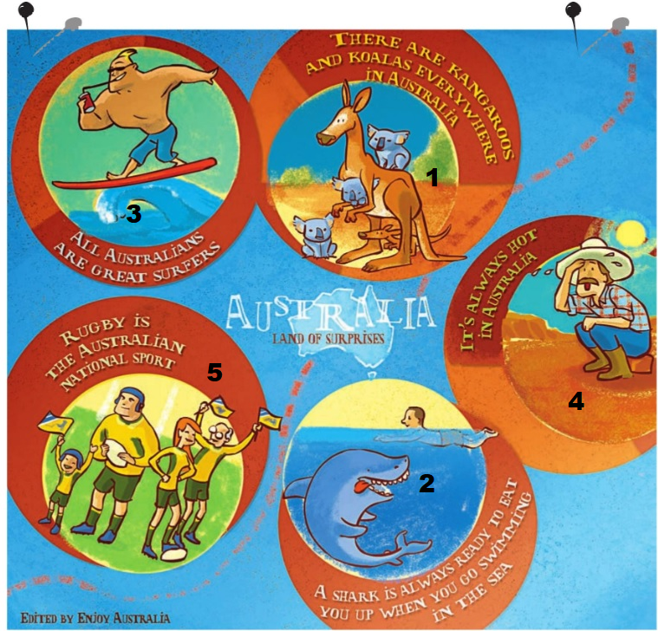
Listen! Check your answers
What is the fifth stereotype the presenter is talking about? Number it on the document.
What does the boy think about it? Write all the information you can.
He has never been a rugby fan because he prefers Aussie rules football. He says Australian people love cricket, golf, soccer and swimming so rugby is not their national sport.

Slide 17
Recap

Slide 18
Recap:
Stereotypes about Australia:
The document is a radio programme dealing with what French people think about Australia. The presenter is talking about the most widespead stereotypes about Australia with five teenagers who are correcting them.
The first cliché is that there are kangaroos and koalas everywhere in Australia. Neil says that in Darwin there are no koalas but there are spiders, snakes and crocodiles. Actually, he has never seen a koala! However, Sean says there are kangaroos everywhere but there are lots of different species so they are all different.
The second cliché is about sharks. French people think it is dangerous to swim in the ocean because of them. The presenter asks: « Have you ever had any problems with sharks? » Helen lives in Queensland and she goes surfing everyday after school, she has never seen a shark!
The third cliché is that Australian are all good surfers. Greg says it is absolutely wrong, he live in Alice Springs in the middle of the desert so he has never seen the sea!
The fourth cliché is about the warm / hot weather. Lulling lives in Tasmania and she has never been swimming in winter because it is too cold.
Finally, the last cliché is about Rugby being the national sport in Australia. The boy says he has never been a rugby fan. Actually, Australian people love soccer, Aussie rules football, golf and swimming too.

Slide 19
Grammar

Slide 20
Le present perfect avec ever et never
Observez les phrases: soulignez le groupe verbal en rouge et entourez les adverbes ever et never.
Has she ever seen a shark?
I have seen kangaroos.
You have never been to the sea because you live in Alice Springs.
Observez attentivement le groupe verbal. Comment se forme le present perfect ?
Tu remarques que l’auxiliaire est HAVE / HAS et qu’il est conjugué au PRESENT
Les verbes, eux, sont au PARTICIPE PASSE du verbe.

Slide 21
ATTENTION : formation du participe passé :
Les verbes réguliers = ON AJOUTE ED A LA FIN DE LA BASE VERBALE
Ex : He has PLAYED Aussie rules football.
Les verbes irréguliers = ON UTILISE LA 3E COLONNE DE LA FICHE DES VERBES IRREGULIERS.
Ex : He has been surfing .
A quoi sert cette forme verbale dans ces phrases ? Coche la bonne case.
□ A parler d’un moment précis du passé.
□ A parler du présent.
□ A parler d’une expérience, d’un bilan d’expériences.

Slide 22
Lis les exemples a et c et coche l’option correcte.
Ever est toujours employé dans une phrase □ interrogative □ affirmative
Et il est employé pour demander à l’interlocuteur de faire un bilan de ses expériences.
Never se traduit par □ déjà □ jamais □ juste

Slide 23
Forme affirmative | Forme négative | Forme interrogative
I have seen | I haven’t seen | Have I seen?
You have seen | You haven’t seen | Have you seen?
She has seen | She hasn’t seen | Has she seen?
We have seen | We haven’t seen | Have we seen?
You have seen | You haven’t seen | Have you seen?
They have seen | They haven’t seen | Have they seen?

Slide 24
Phonology

Slide 25
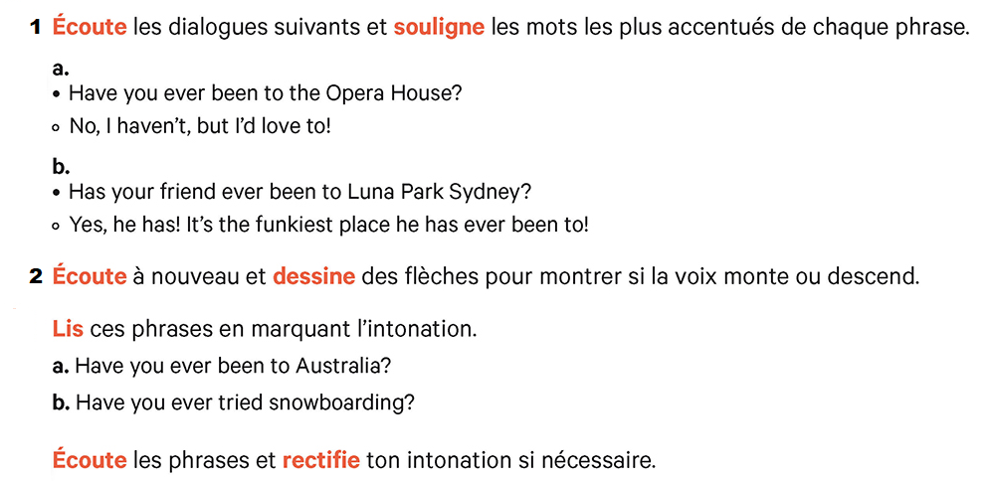
Phonology: l’intonation des phrases.
Complete the document on your worksheet :

Slide 26
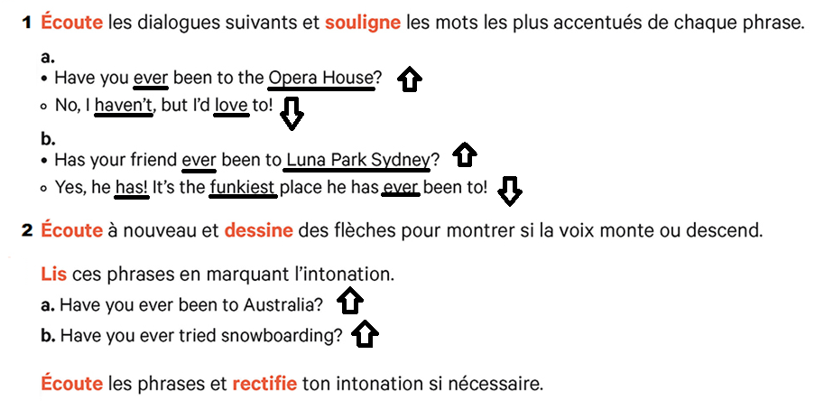
Phonology: check your answers.

Slide 27
Transfert

Slide 28
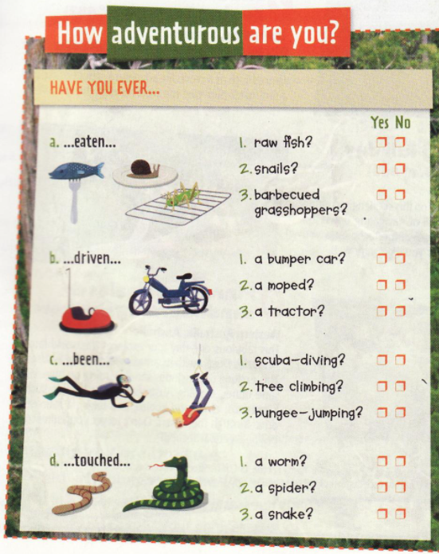
Pair work:
Work in pairs on the quiz below.
STEP 1: Ask your partner the questions and tick his/ her answers on the document.
STEP 2: Change roles.
STEP 3: Tell the class about your partner.

Slide 29
Homework:
Apprendre le recap.
Savoir construire le present perfect et placer les adverbes ever / never correctement.
Faire le travail personnel sur le genially dont le lien figure sur la worksheet + les exercices distribués.

Slide 30
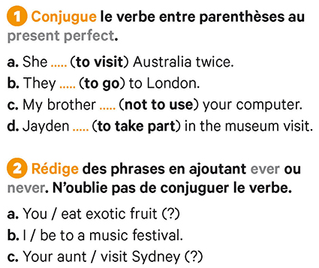
Practise:

Slide 31
Check your answers
a. She has visited Australia twice.
b. They have gone to London.
c. My brother hasn’t used your computer.
d. Jayden has taken part in the museum visit.
2. a. Have you ever eaten exotic fruit?
b. I have been to a music festival.
c. Has your aunt ever visited Sydney?

