Slide 1
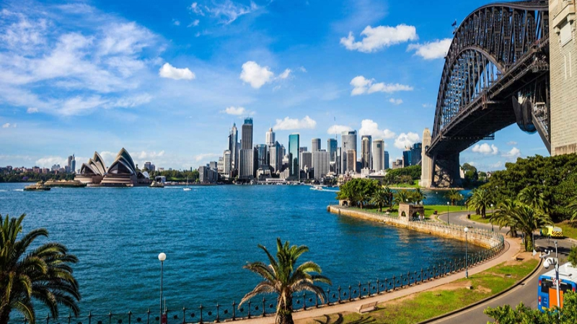
Sequence 5: Welcome Down Under
Niveau 4e – RANDON Bénédicte -
Collège Rosa Parks Cavaillon

Slide 2
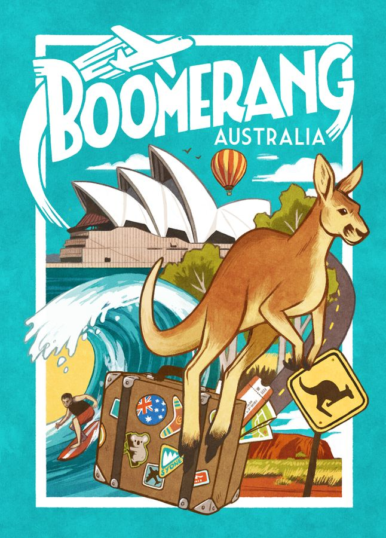
React!
What type of document is it?
Identify elements.
Describe.
What country is it?

Slide 3
Global oral comprehension

Slide 4

Oral comprehension activity:
Watch the video SOUND OFF and write as many words as you can on the worksheet.

Slide 6
Oral comprehension activity:
Watch the video and complete the grid on the worksheet:
Type of landscapes | Biggest cities (circle the correct answers)
(rain)forests / the sea / desert / mountains / big cities / the Great Barrier Reef | Adelaïde / Brisbane / Canberra / Perth / Melbourne / Sydney Adelaide / Melbourne / Sydney

Slide 7
Oral comprehension activity:
Watch the video one last time and concentrate on the activities: What can people do in Australia?
Activities in Australia
Scuba diving / going hiking / visiting the forests / admiring the landscapes – the view / feeding the kangaroos

Slide 8
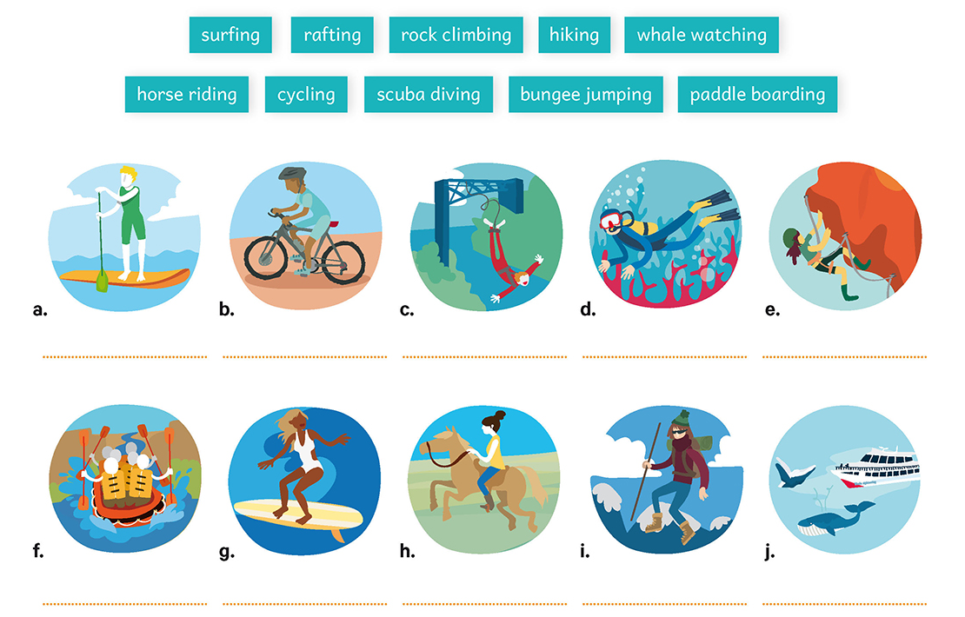
Vocabulary activity:
Match each verb to the correct picture on your worksheet, then check your answers on the next slide:

Slide 9
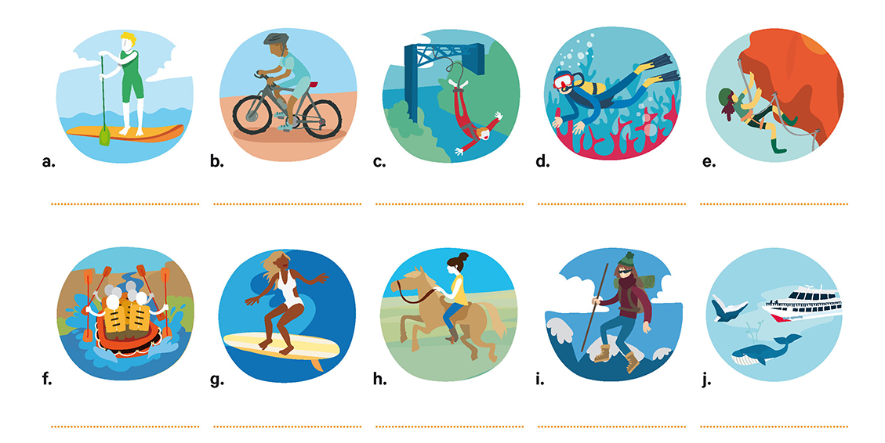










Correction : vocabulary activity.

Slide 10
Detailed oral comprehension

Slide 12
Detailed oral comprehension:
Watch the video from the beginning to 1’29 and concentrate on people’s opinion about Australia.
People’s opinion about Australia
Unique / beauty / splendour / incredible / loved
What can you conclude about tourism in Australia?
Australia is one of the best place to visit / It is a great tourist destination

Slide 13
RECAP:
Complete the text by filling the blanks, then check your answers.
Discover Australia
The document is a tourist advertisement for Australia, it promotes tourism in that country by showing its landscapes and all the activities you can do there. We discover that Australia is a very diverse country in terms of landscapes as you can find beautiful rainforests as well as deserts, the sea and the Great Barrier Reef in the Pacific Ocean. You can also find mountains and big cities such as Adelaide, Sydney and Melbourne. Australia also offers a great number of activities such as scuba diving, hiking or simply admiring the beautiful landscapes or feeding the emblematic Australian kangaroos.
To conclude, we can say that Australia appears as one of the best tourist destinations!

Slide 14
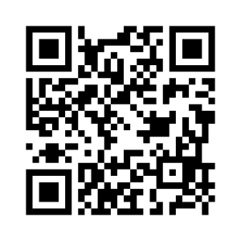
Homework
Apprendre le « recap » : savoir présenter l’Australie comme dans la vidéo.
Apprendre le nouveau vocabulaire (travailler avec le lien genially donné: https://view.genial.ly/6087b5b6b7f1070d38edcf3c/presentation-welcome-down-under )

