Slide 1
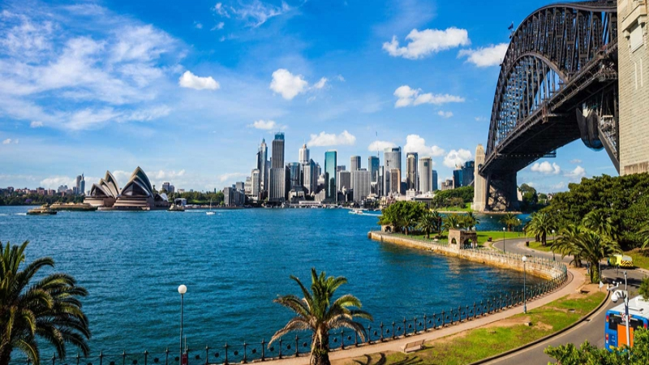
Sequence 5: Welcome Down Under
Niveau 4e – RANDON Bénédicte -
Collège Rosa Parks Cavaillon

Slide 2
Check your knowledge

Slide 3
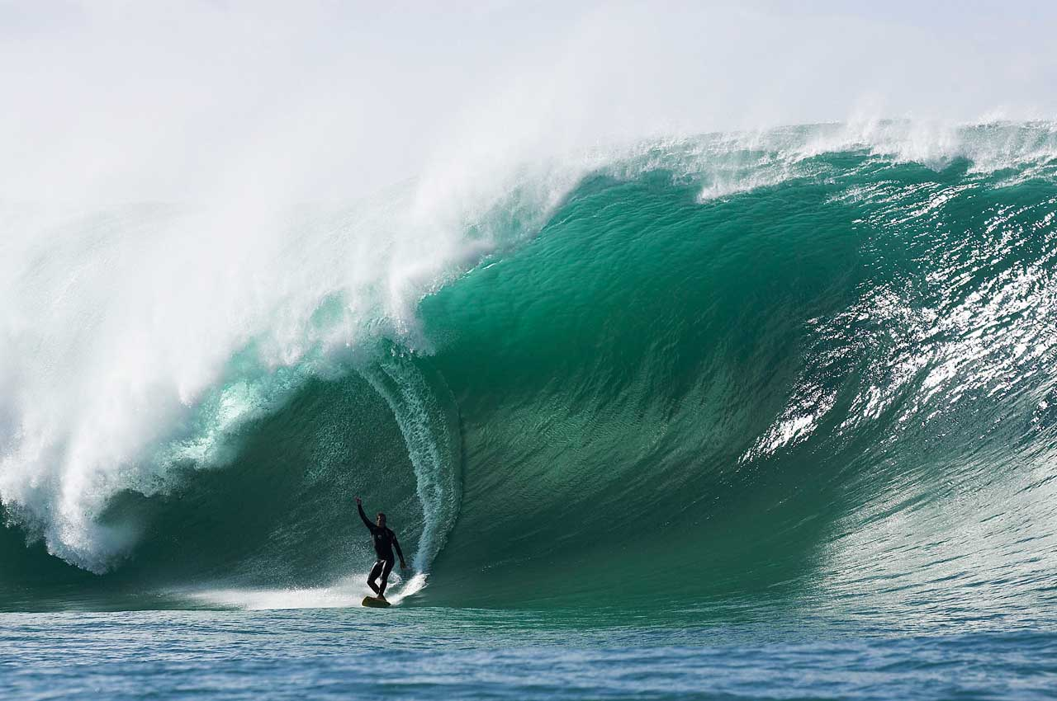
Let’s see what you remember
See if you remember the vocabulary of your lesson. Do the following activity:
https://learningapps.org/watch?v=p52pgwd4k20

Slide 4
Oral comprehension activity

Slide 5
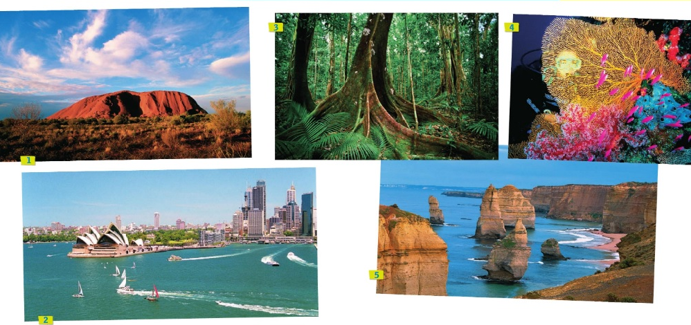
React! What can you see?

Slide 6


Watch the video and complete the map on your worksheet:

Slide 7
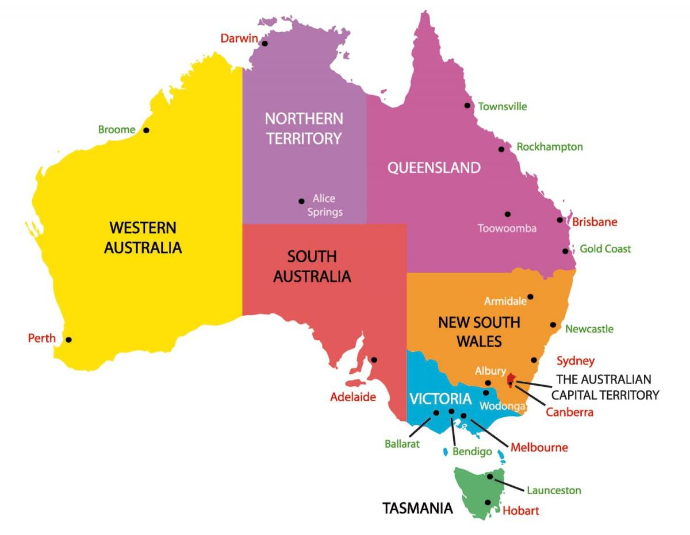

Slide 8
Check your answers:
❶ A sacred place for Aboriginals
❷ Sydney is one of the youngest cities in the world and the biggest of Australia.
❸ Huge trees and exotic plants.
❹The Great Barrier Reef is the largest in the world. A paradise if you like snorkeling and scuba diving.
❺ Impressive rocks, 3,000km away from Antarctica only!
In the middle of the desert (Northern Territory)
The capital of New South Wales
In the North
In Queensland, near the city of Cairns.
From Melbourne (South Australia) to Adelaide (capital of Victoria)

Slide 9
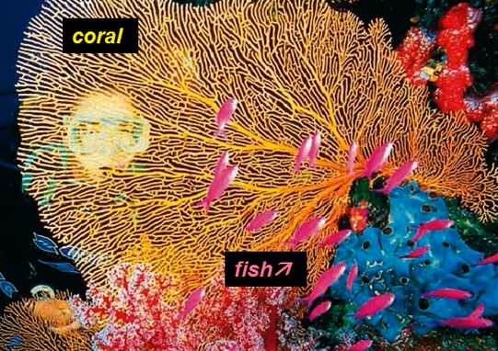
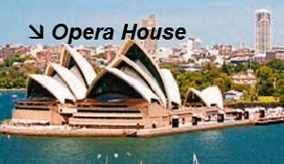
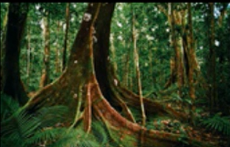
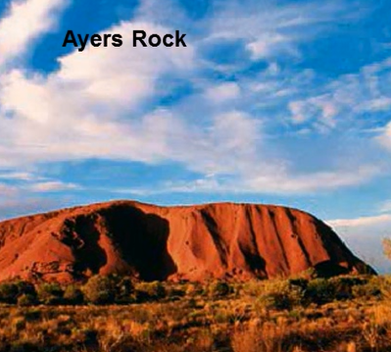
Check your answers
4
2
3
1
5

Slide 10
Practice your pronounciation

Slide 11
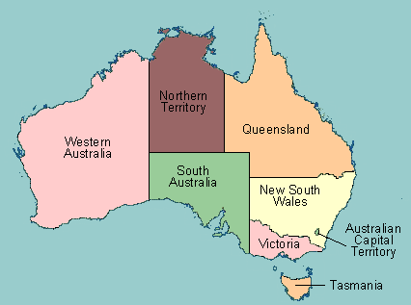
Listen, repeat and memorize:
Listen to the names of the different states of Australia, repeat and try to memorize where they are on the map:

Slide 12
Learn new words

Slide 13
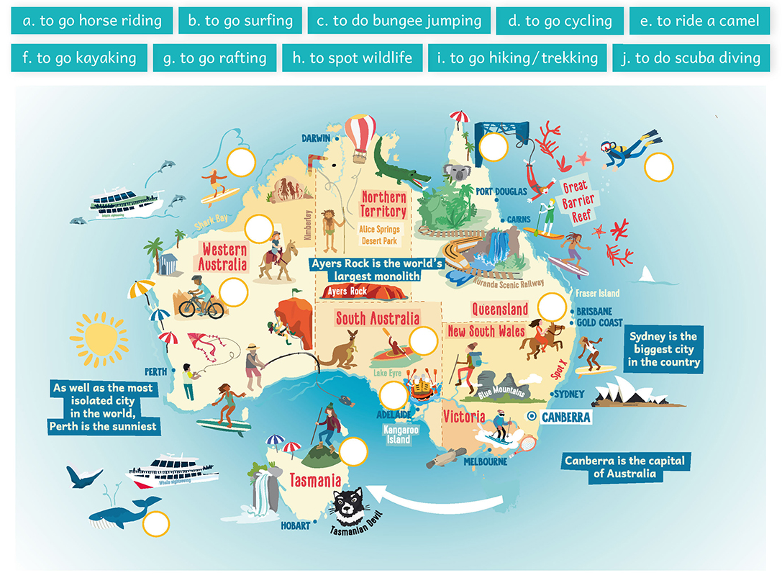
Where can you do these activities? Place the vocabulary on the map:

Slide 14
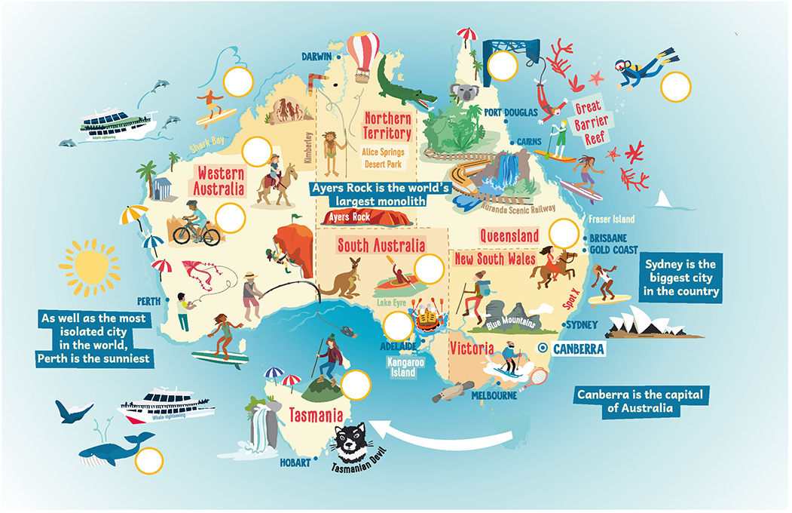
C
B
J
E
D
A
F
G
I
H

Slide 15
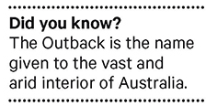
Vocabulary activity:
Look at the map and classify the activities in the grid on your worksheet:
Pacific Ocean
Mountain
River
Australian Outback

Slide 16
Vocabulary activity correction:
Look at the map and classify the activities in the grid on your worksheet:
Pacific Ocean
Mountain
River
Australian Outback
To go horse riding et to do bungee jumping ne sont pas dans le tableau car ce ne sont pas des activités spécifiques à un endroit particulier. On peut les pratiquer dans n’importe quelle région.
ATTENTION: Dans cet exercice, on vous donne les INFINITIFS, il y a donc le TO. Lorsque vous allez vouloir conjuguer les verbes, il faudra LE SUPPRIMER pour obtenir la base verbale.
To go scuba diving / to spot wildflife / to go surfing
To go hiking / trekking
To go rafting / to go kayaking
To go cycling / to ride a camel

Slide 17
Recap

Slide 18
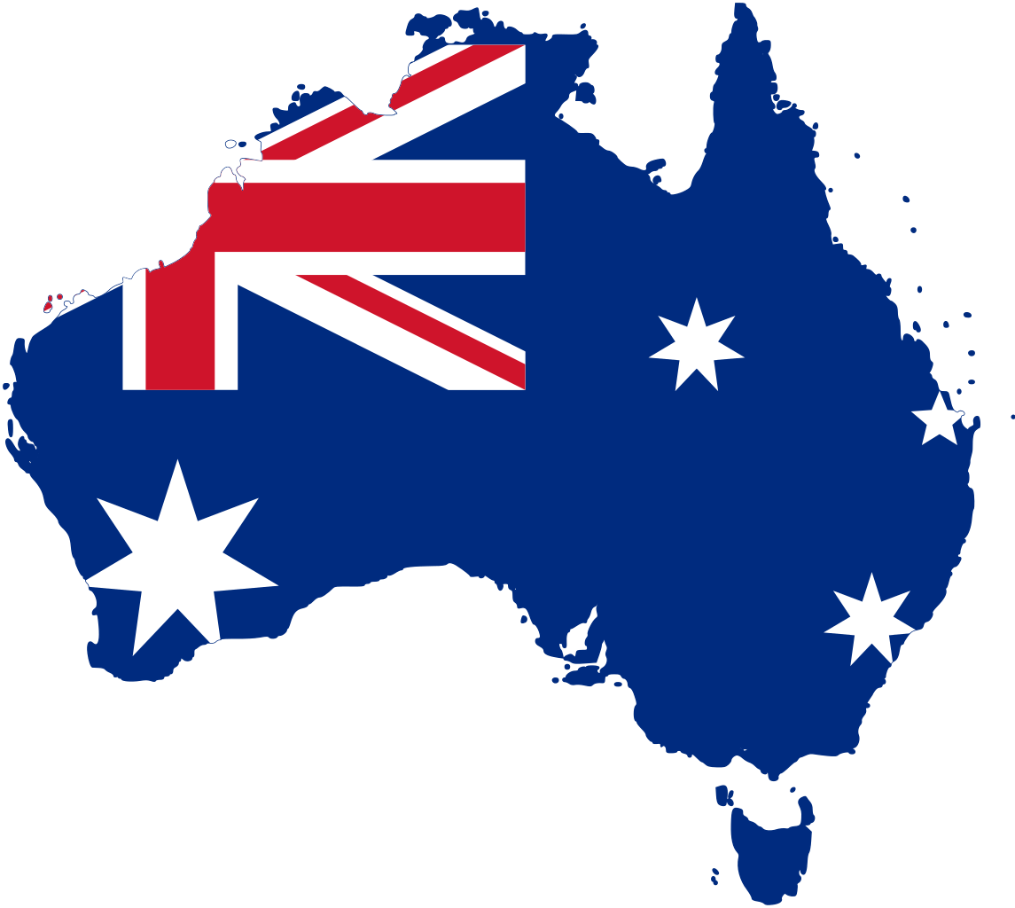
Let’s recap!
Let’s use all the information we have on the worksheet to write a paragraph about Australia and the activities we can do there.
Cette photo par Auteur inconnu est soumise à la licence CC BY-SA

Slide 19
Recap:
Discover Australia
Australia is a continental island situated in the Southern Hemisphere. It is divided in states such as Western Australia, Northern Territory, South Australia, Queensland, New South Wales, Victoria, Tasmania and the Australian Capital Territory. The main cities are Sydney, Melbourne, Adelaide, Perth and the capital city Canberra.
Perth is situated in Western Australia, it is the most isolated city but it is also the sunniest one. Ayers Rock, or Uluru, which is in the Northern Territory is situated next to Alice Springs; it is the largest monolith in the world and it is also a sacred place of aboriginal people. Sydney is the biggest city of Australia and it is also the best known worldwide because of its Opera House and its incredible beaches.
In Australia, you can practise a wide range of activities such as surfing, rafting, kayaking, hiking, trekking, riding a camel and scuba diving because the territory offers beautiful coasts but also rivers, mountains and deserts in the Outback.

Slide 20
Le superlatif
Observe les phrases suivantes :
Australian people are the friendliest people in the world. =
I saw the biggest snake of the zoo. =
Uluru the most wonderful place in Australia =
His holidays in Australia were the best. =
It was the worst experience of my life. =
Dans ces phrases, souligne l’adjectif en rouge et note sa forme de base.
Dans les phrases a et b, quelle est la terminaison qui a été ajoutée ?
Quel est le mot qui précède l’adjectif ?
Dans la phrase c, a-t-on ajouté une terminaison à l’adjectif ?
Quels sont les deux mots qui précédent l’adjectif ?
Dans les phrases d et e, que remarques-tu ?
friendly
big
wonderful
good
bad
EST
THE
NON
THE MOST
ILS SONT IRREGULIERS

Slide 21
On utilise le superlatif pour comparer UN élément avec UN GROUPE d’autres éléments : cet élément sera au-dessus de tous les autres.
ADJECTIFS COURTS THE + adjectif + EST | 1 syllabe : tall → the tallEST 2 syllabes si l’adjectif se termine par un y, ow ou er: Pretty → the prettiEST
ADJECTIFS LONGS THE + MOST + adjectif | 2 syllabes si l’adjectif ne se termine pas par un y ou er : Boring → the MOST boring. 3 syllabes et plus : dangerous → the MOST dangerous.

Slide 22
ATTENTION : les modifications orthographiques sont les mêmes que pour le comparatif de supériorité :
Quand l’adjectif se termine par un y, il se transforme en IEST
Happy → THE HAPPIEST
Les adjectifs d’une syllabe se terminant pas une consonne précédée d’une seule voyelle doublent la consonne finale.
Big → THE BIGGEST
Certains adjectifs sont irréguliers. Apprends-les par cœur.
Good → THE BEST Bad → THE WORST

Slide 23
Written expression activity

Slide 24
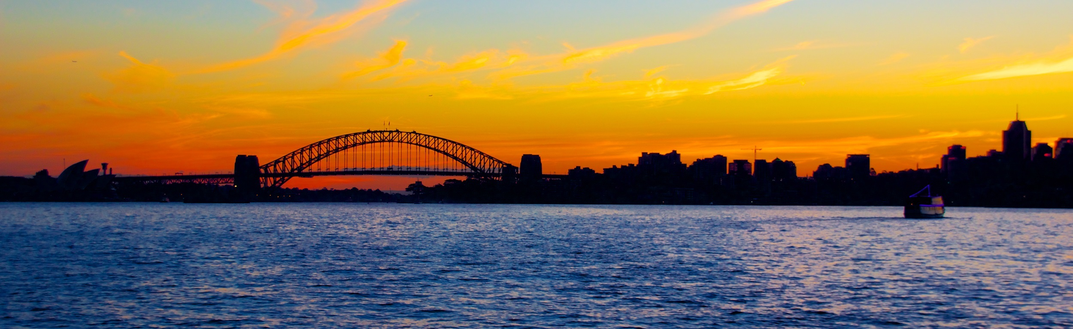
Follow up work!
Do the activity on your worksheet and stick it up in your copybooks.

Slide 25
Homework:
Apprendre la carte de l’Australie = savoir situer les états et les grandes villes.
Connaître le vocabulaire de la séance = revoir worksheet + s’entraîner sur le Genially grâce au QR code.

Slide 26
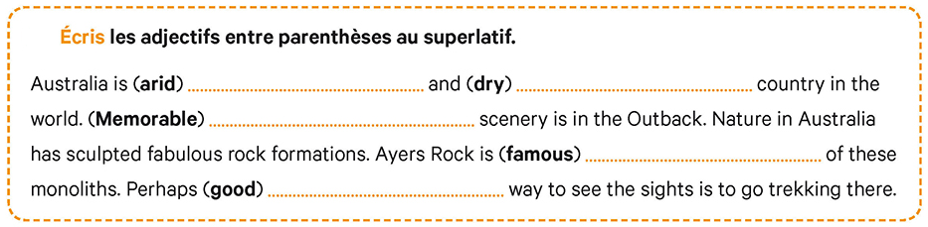
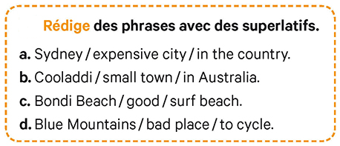
Let’s practise at home:

Slide 27
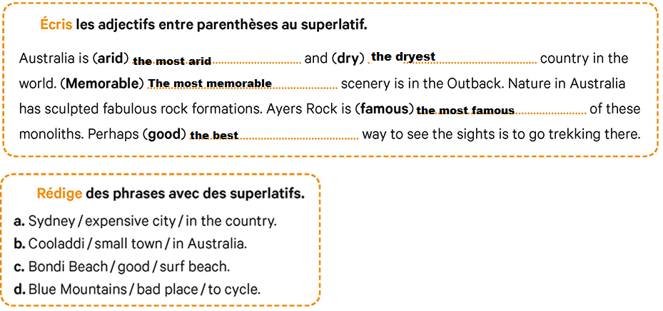
Correction
Sydney is the most expensive city in the country
Cooladdi is the smallest town in Australia
Bondi Beach is the best surf place
Blue Mountains is the worst place to cycle.

