Slide 1

Sequence 4: Act and React
NIVEAU 3E – RANDON BENEDICTE

Slide 2
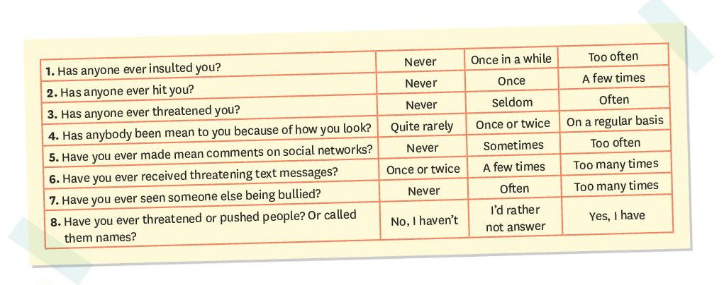
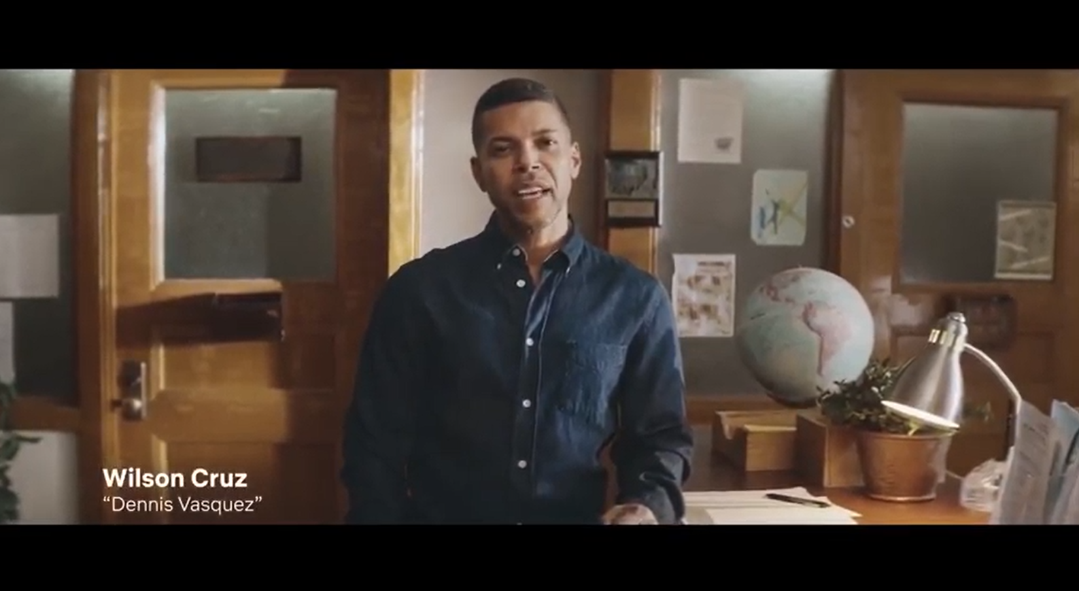
Recap:
What are the 4 types of bullying?
Who are the 4 types of people playing a part?
Talk about your experience.

Slide 3
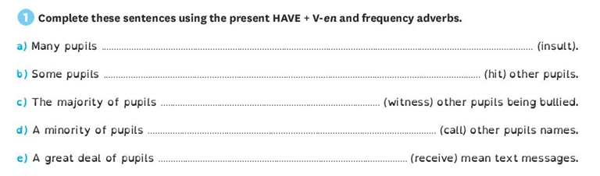
Let’s correct the exercices.

Slide 4
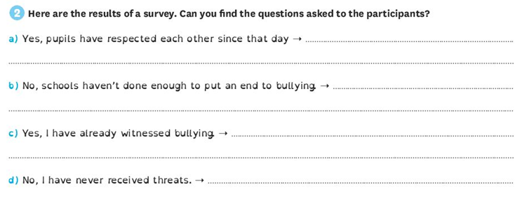
Let’s correct the exercices.

Slide 5
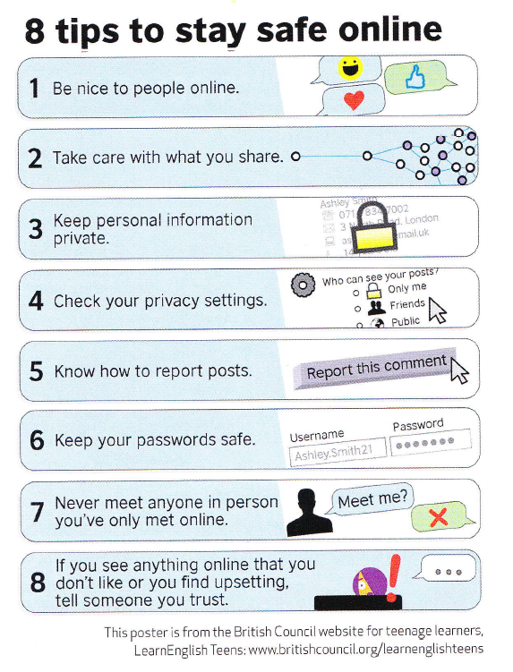
React!
What type of document is it?
What is the subject of that document?

Slide 6
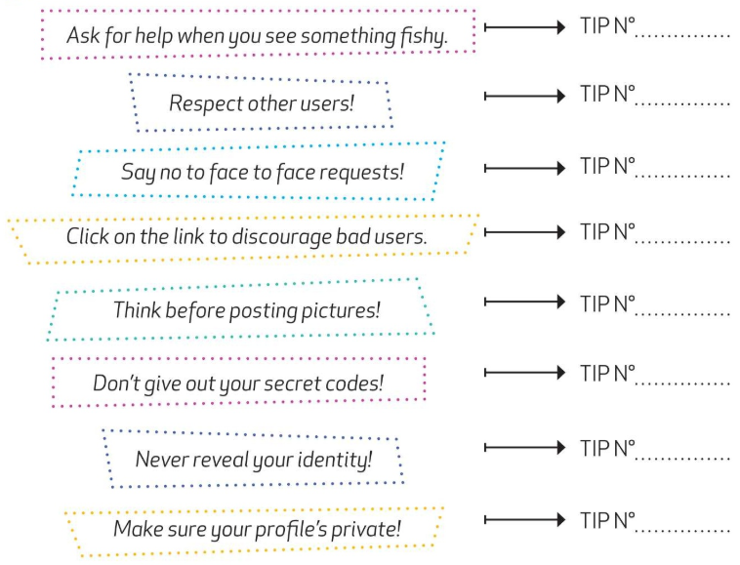
Reading comprehension:
Read the poster and look at the pictures. Then on your worksheet, match each tip in the poster with a label.

Slide 7
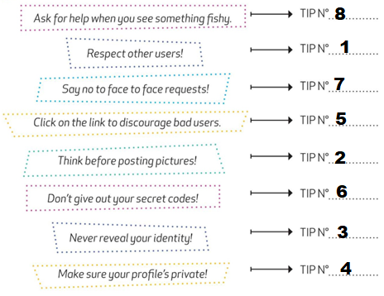
Check your answers:

Slide 8

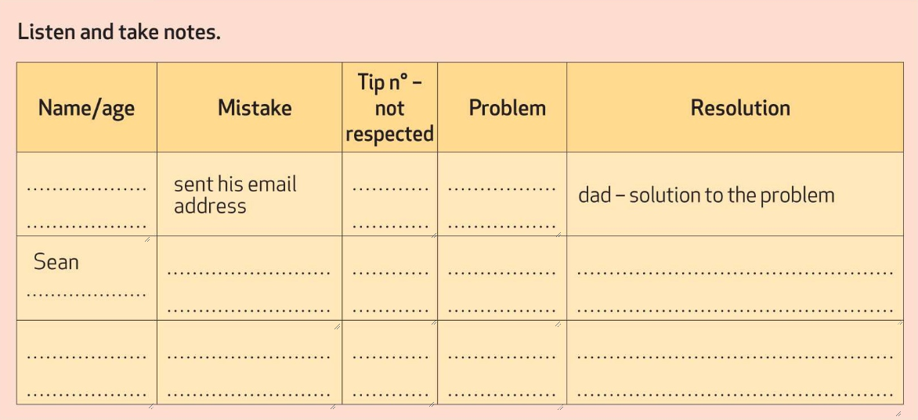
Oral comprehension:
Listen to the recording and complete the grid on your worksheet.

Slide 9
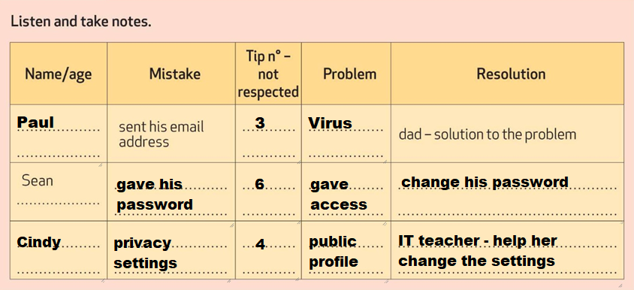
Check your answers:

Slide 10
Recap:
Cyberbullying:
That form of bullying is when someone is a victim of name-calling, gossiping, malicious talk or threats online. To avoid cyberbullying you have to respect simple rules; for example, you should check your privacy settings on social networks and you shouldn’t give your passwords or any personal information. You’d better not meet a person you’ve met online and you’d better take care with what you share.
Ask an adult if you need help or if you face harassment online, you shouldn’t remain silent because it can really be a serious problem.

Slide 11
L’expression des conseils
1. Observe et déduis :
Recopie le terme qui convient en face de chaque phrase :
CONSEIL – CONSEIL APPUYE - CONSEIL
a. For your safety you’d better have a password = CONSEIL APPUYÉ
b. She should pay more attention = CONSEIL
c. They shouldn’t invite people they don’t know. = CONSEIL

Slide 12
2. Repère:
a. He’d better be careful
b. You had better log off now.
c. We should spend more time with our family.
Entoure le mot qui suit les expressions soulignées dans les phrases précédentes.
Ce sont □ des verbes conjugués □ des bases verbales
Les expressions soulignées sont □ conjuguées □ invariables.
Relis les phrases a et b de l’activité 2.
Dans la phrase a ‘d est la contraction de □ would □ had

Slide 13
3. Récapitule :
Pour exprimer un CONSEIL on utilise should ou shouldn’t + BASE VERBALE
Pour exprimer un CONSEIL APPUYE, on utilise ‘D BETTER ou HAD BETTER. ‘d est la contraction de HAD.
Remarque : On peut utiliser HAD BETTER à la forme négative pour déconseiller :
You’d better not put personal information online.

Slide 14
4. Entraîne-toi:
Complète les phrases avec les expressions ou auxiliaires qui conviennent.
He SHOULDN’T be agressive.
You HAD BETTER NOT / ‘D BETTER NOT reveal your address online. It could be dangerous.
My sister SHOULD make sure her mobile is switched off when she is in class.
They SHOULD spend less time online.

Slide 15

Follow up activity.
Watch the video and answer the questions:
Type of document?
What did they decide?
What may have happened? Make hypotheses.

Slide 16

Follow up activity.
Imagine you can talk to the young girl. What would you advise her to do or not to do?

Slide 17
Homework.
Etre capable des parler des règles de sécurité sur internet.
Savoir donner des conseils et définir le cyberbullying tout en expliquant comment s’en prémunir.
Faire les exercices « let’s practise at home » sur la feuille distribuée.

Slide 18
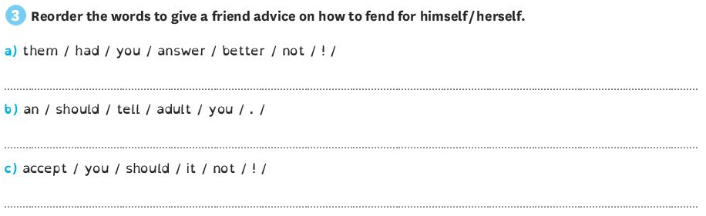
Exercises:

Slide 19
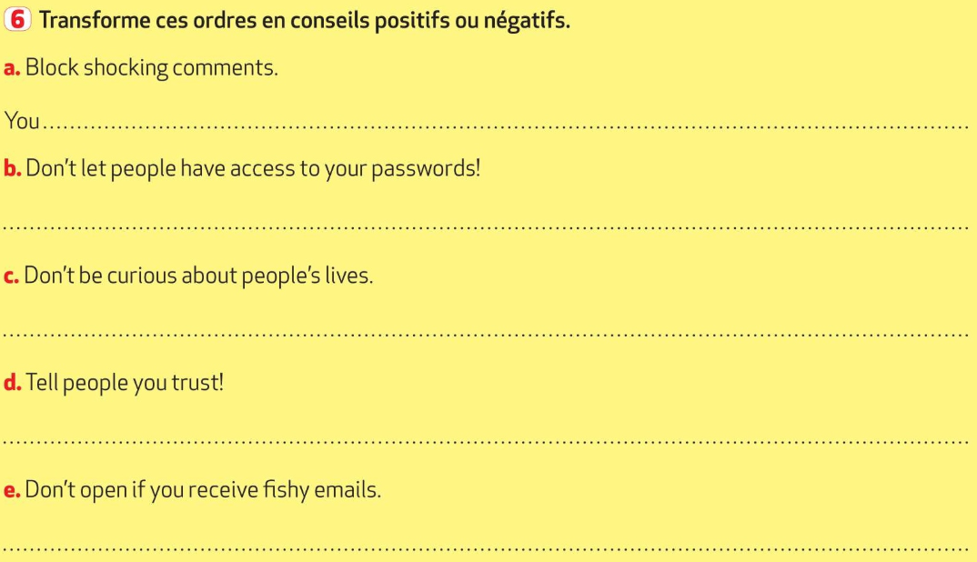
Exercises:

