Slide 1
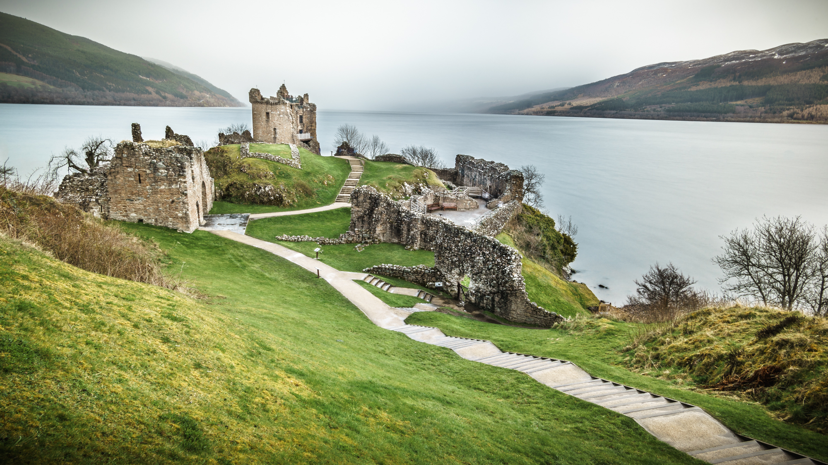
Sequence 5:
What a surprising country!
Randon Bénédicte – Collège Rosa Parks – Cavaillon

Slide 2

REACT:
Type of document?
Justify.
What can you see? Describe.
Does the monster look scary?
Look at the man, identify his emotion.

Slide 3

Watch the video and do the activities on your worksheet:

Slide 4
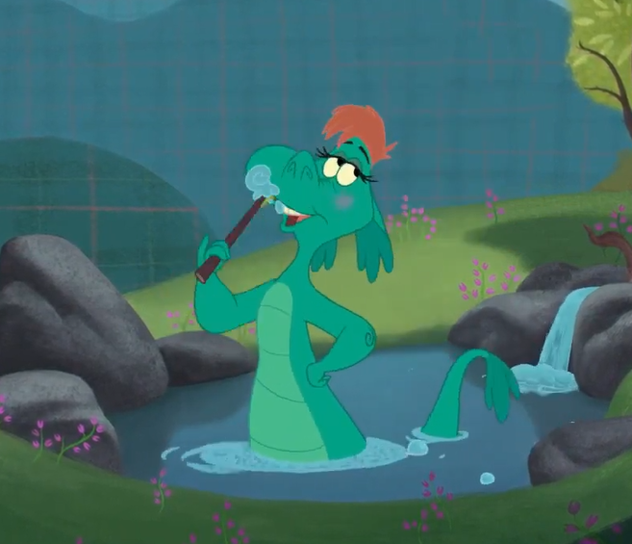
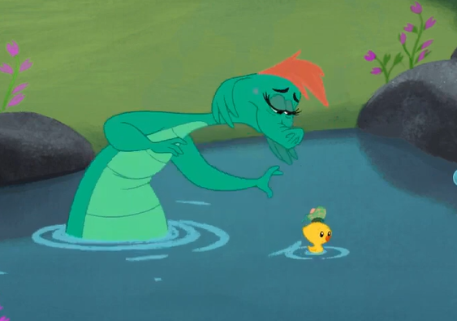
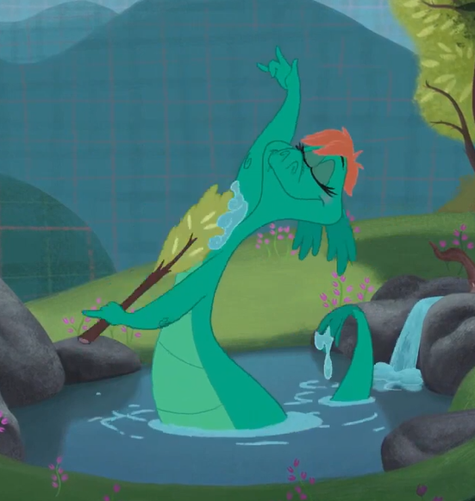
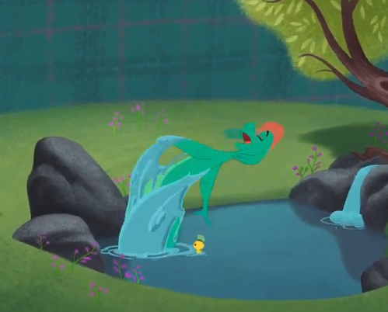
MATCH THE VERBS TO THE CORRECT PICTURES.
Brush her teeth
Have a shower / Have a bath
Play with her friend
Jump in the pond

Slide 5
ORAL EXPRESSION ACTIVITY:
Watch the video again and concentrate on the emotions of Nessie. How does she feel?

Slide 6
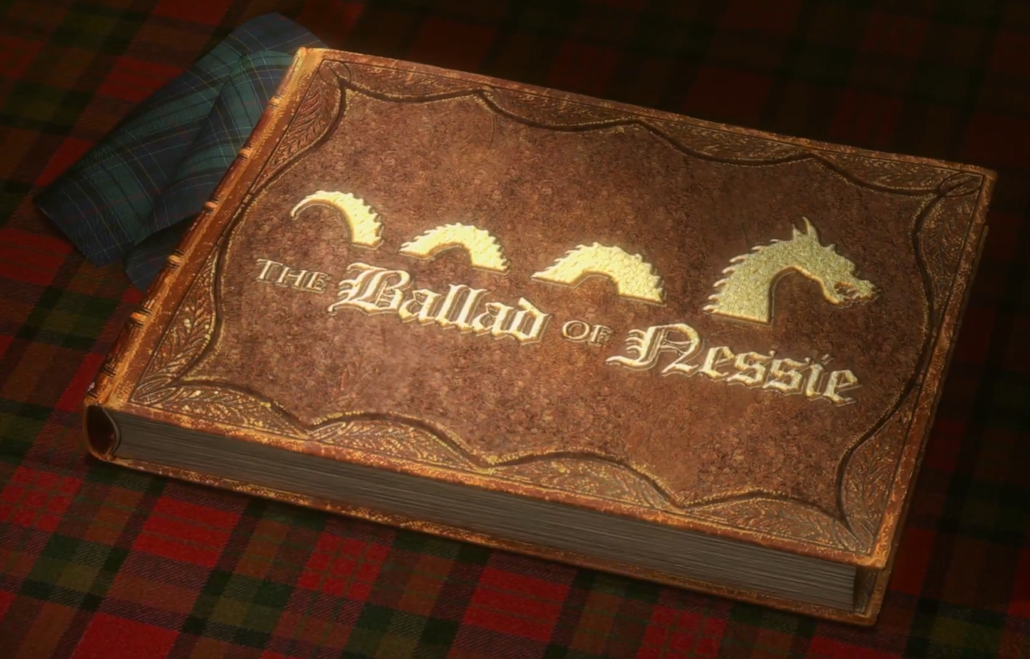
ORAL EXPRESSION ACTIVITY:
Use the information you have to recap orally.
What does Nessie usually do in her pond?

Slide 7
In the morning, Nessie usually has a bath in her pond. She always washes and brushes her teeth. Then, she plays with her friend: a small yellow duck. She often jumps in the water.
She is very happy / glad / pleased / joyful.

Slide 8
Today, there is something different… Watch the video and identify the problem! What is happening?

Slide 9
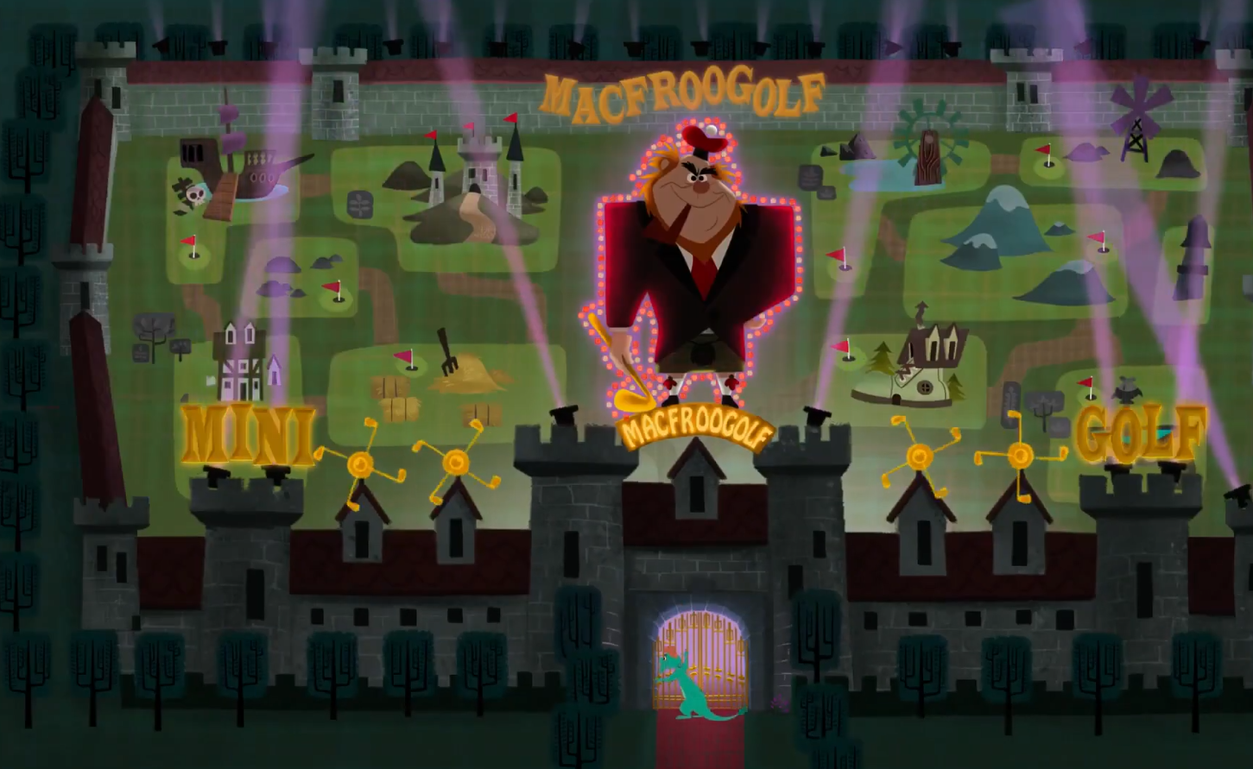
Mr. MacFroogle is arriving and he is destroying her pond!

Slide 10
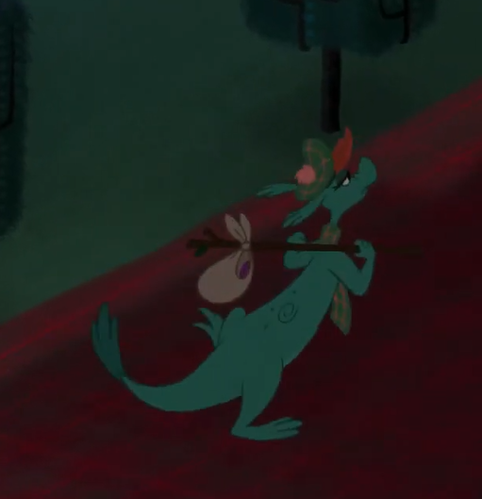
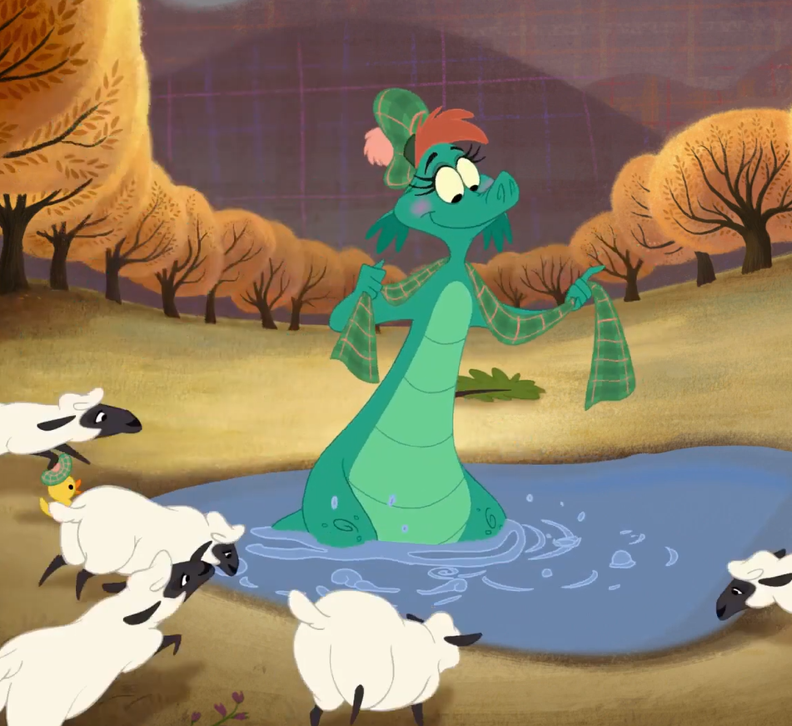
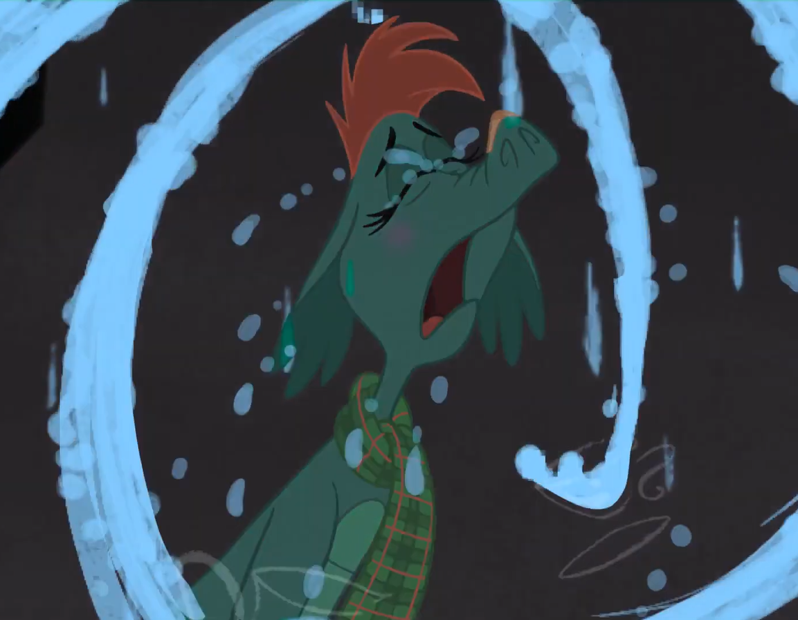
WHAT IS NESSIE DOING NOW?
MATCH THE VERBS TO THE CORRECT PICTURES.
Leave
Look for a new home
Cry

Slide 11
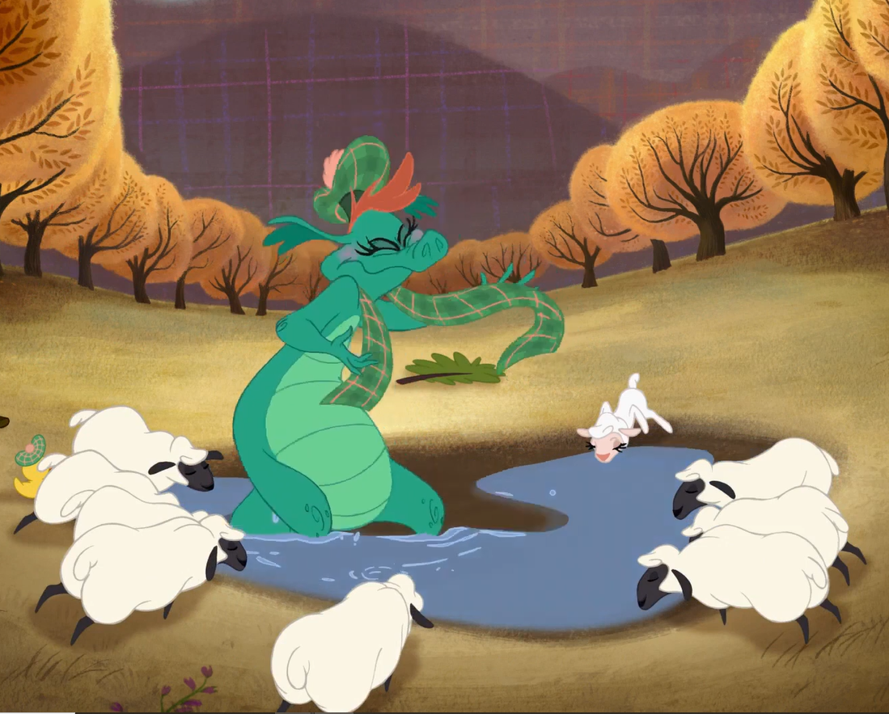
WHY IS NESSIE SO SAD?
The sheep are drinking all the water of the pond.

Slide 12
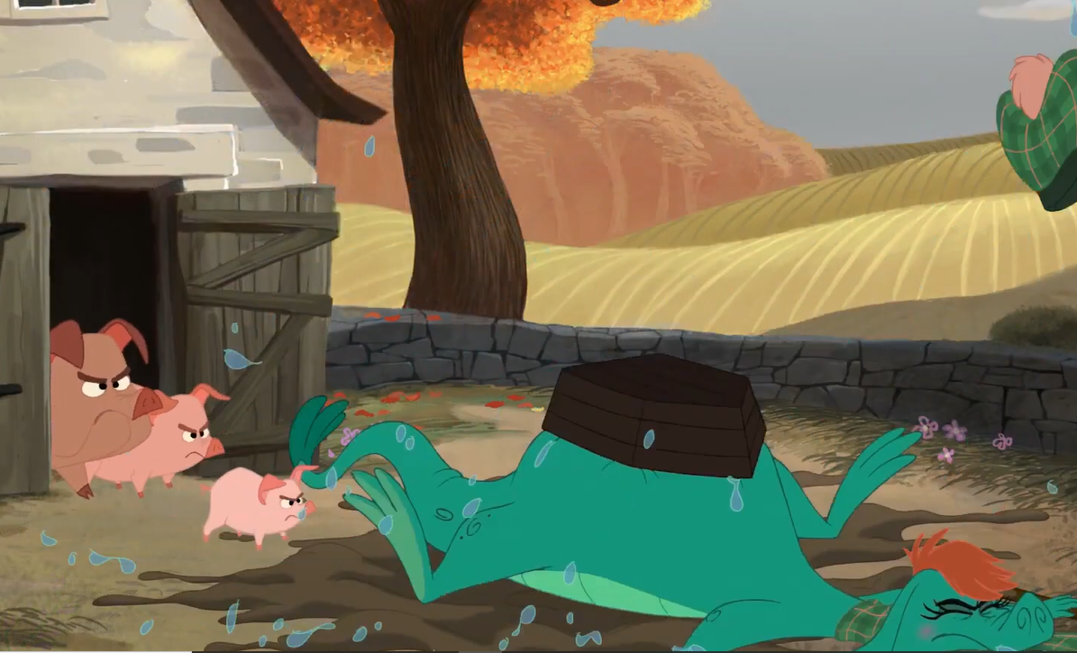
WHY IS NESSIE SO SAD?
The pigs are angry!

Slide 13
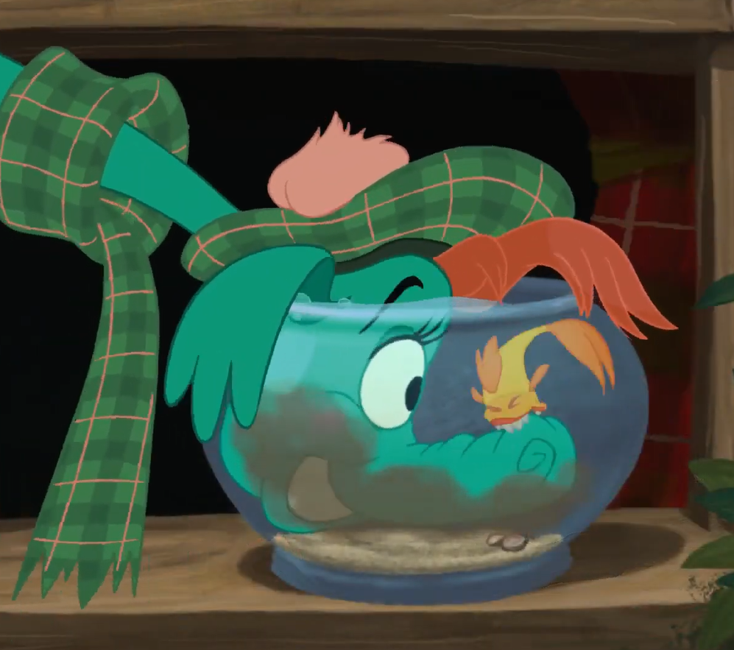
WHY IS NESSIE SO SAD?
The goldfish is biting her nose.

Slide 14
ORAL EXPRESSION ACTIVITY:
Use the information you have to recap orally.
What is Nessie doing now?

Slide 15
Mr. MacFroogle is arriving and he is destroying Nessie’s pond to create a golf.
Nessie is very sad. She is leaving because she is looking for a new home now! Nessie is very sad because the sheep are drinking all the water of the small pond, the pigs are angry at her and the goldfish is biting her nose. She is depressed so she is crying a lot…

Slide 16
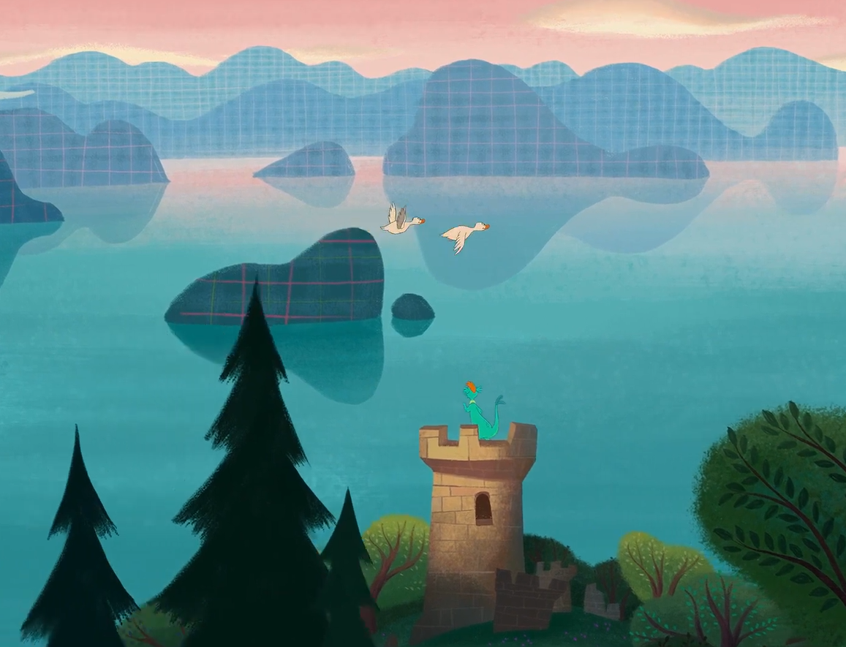
A NEW HOME:
Watch the end of the video and identify the activities of Nessie in her new home « Loch Ness ».
Concentrate on her emotions too, how does she feel?

Slide 17
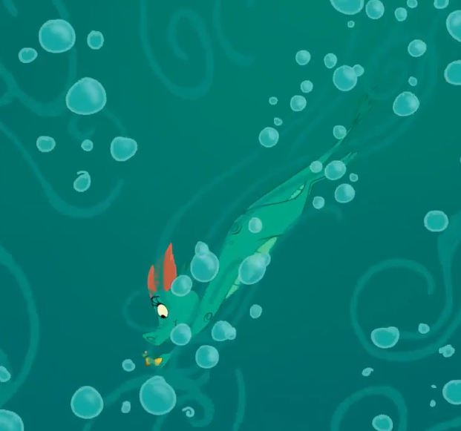
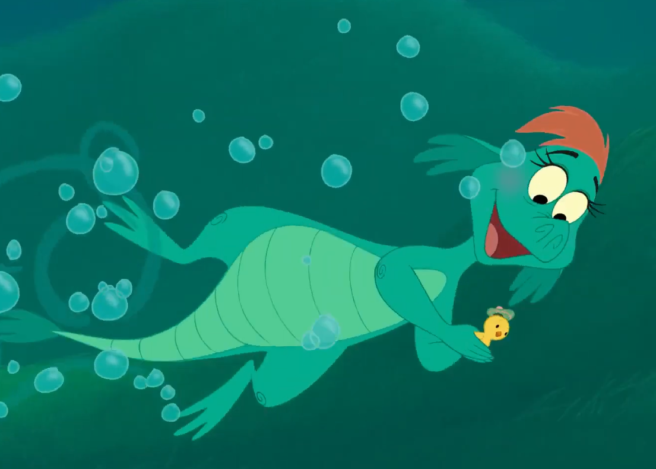
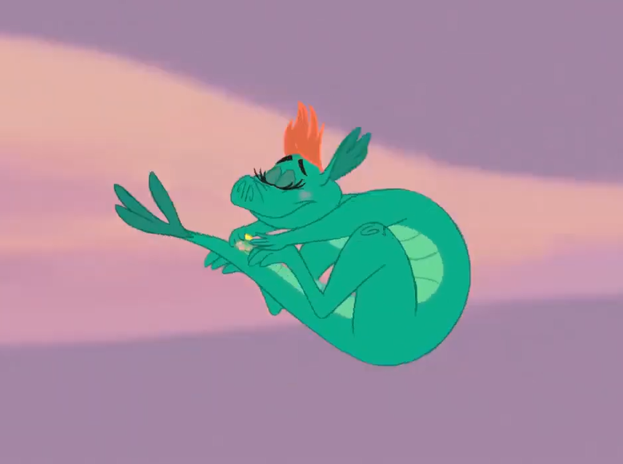
A NEW HOME:
Jump
Dive
Swim

Slide 18
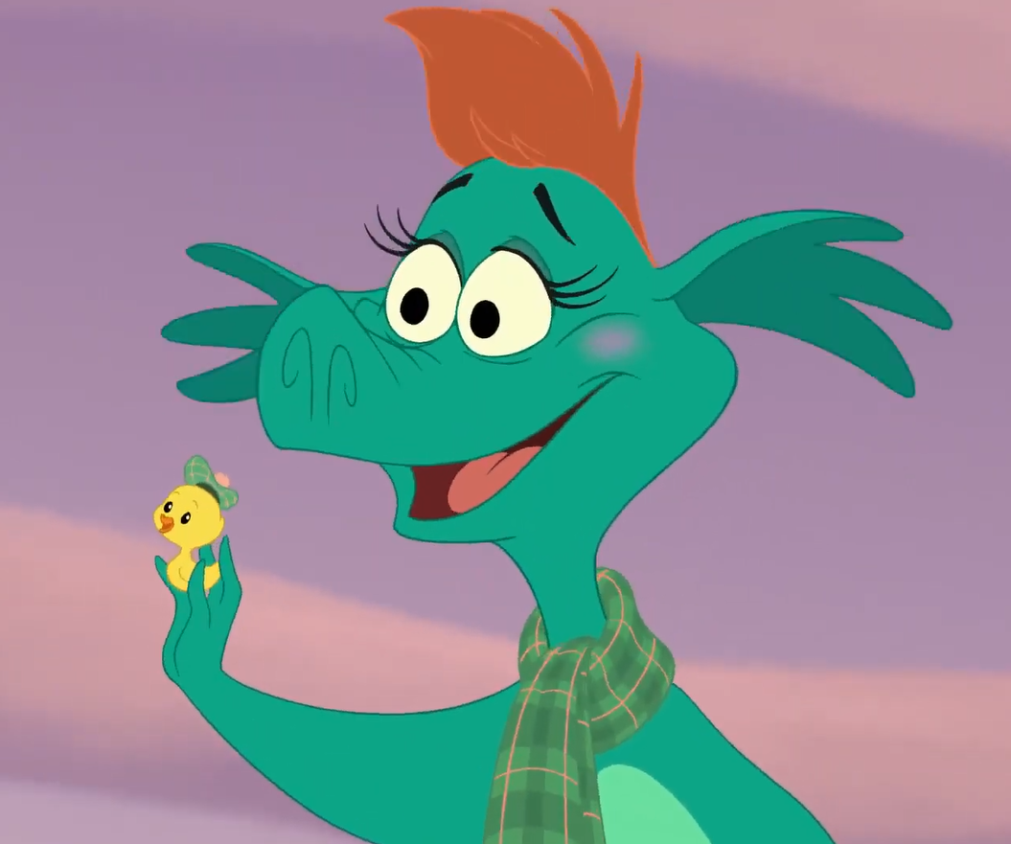
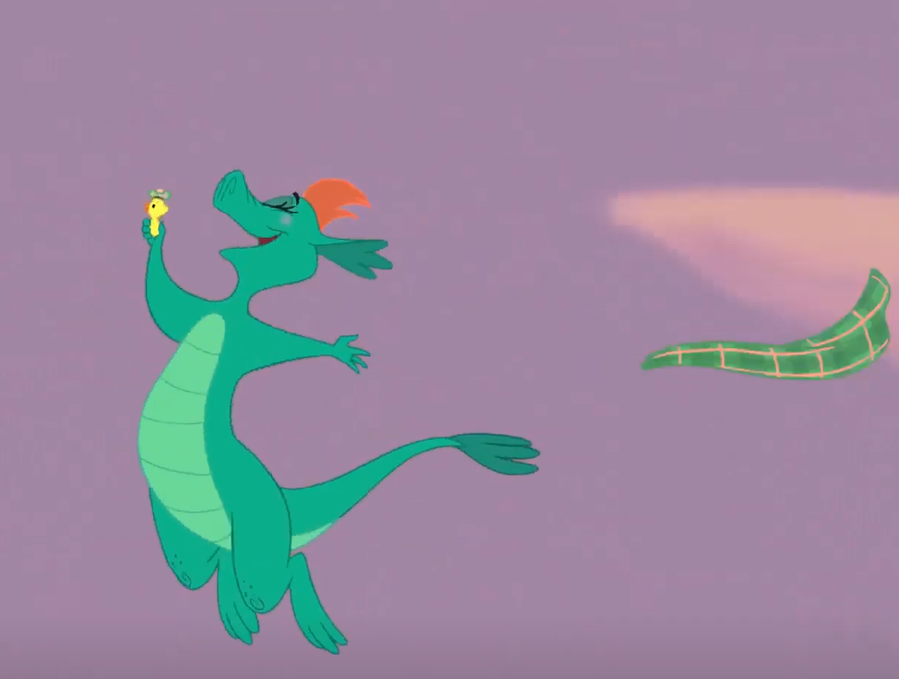
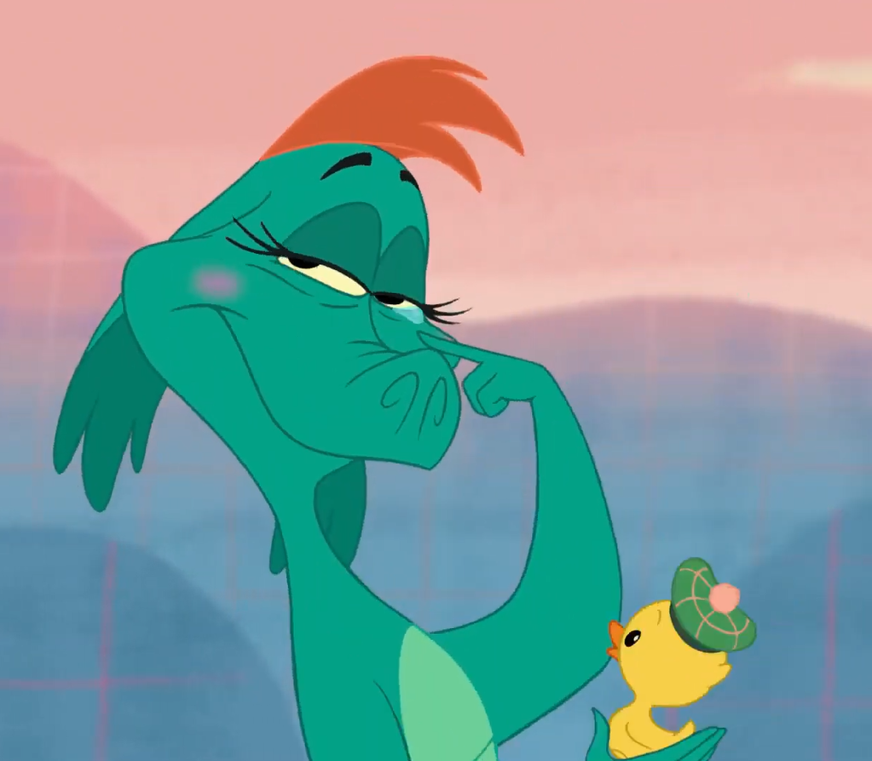
A NEW HOME: EMOTIONS
Surprised
Happy / delighted
Moved / touched

Slide 19
ORAL EXPRESSION ACTIVITY:
Use the information you have to recap orally.
What is Nessie doing in Loch Ness?

Slide 20
Nessie is surprised to discover Loch Ness! She is delighted! She is jumping / diving and swimming with her friend. She is touched / moved because she finally has a new home.

Slide 21
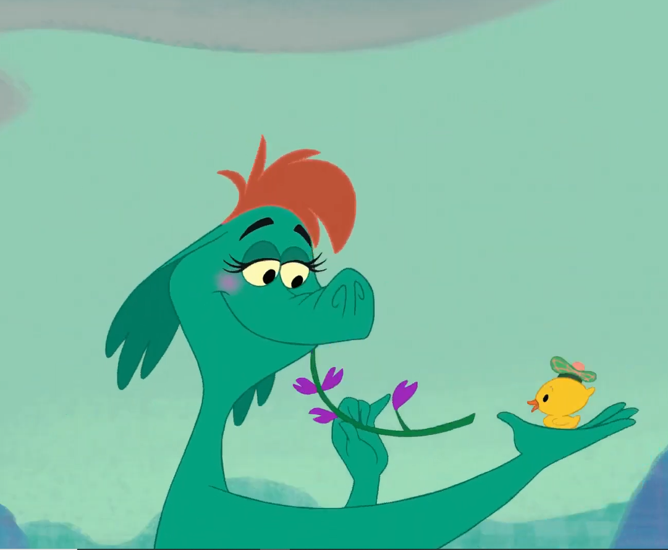
Recap:
Use the information you have about the ballad of Nessie to write a short paragraph.

