Slide 1

Sequence 4: Act and React
NIVEAU 3E – RANDON BENEDICTE

Slide 2

Recap!
Type of document?
Names?
Problem?

Slide 3
Check you remember the vocabulary.
Match the words to their definitions.
Bullying can be… |  | Threatening him or her on a regular basis.
A bully is someone who… |  | Physical, verbal or psychological.
Cyberbullying means… |  | Threatening or insulting someone using smartphones and social networks.
Bullying someone means… |  | Makes fun of others, calls them names or hits them.

Slide 4
Check your answers.
Bullying can be… |  | Threatening him or her on a regular basis.
A bully is someone who… |  | Physical, verbal or psychological.
Cyberbullying means… |  | Threatening or insulting someone using smartphones and social networks.
Bullying someone means… |  | Makes fun of others, calls them names or hits them.

Slide 5

React!
Type of document?
General of subject of the document?
Who are the people talking?

Slide 6

Oral comprehension activity
Watch the video again and do the activities on your worksheet in groups of 4.

Slide 7
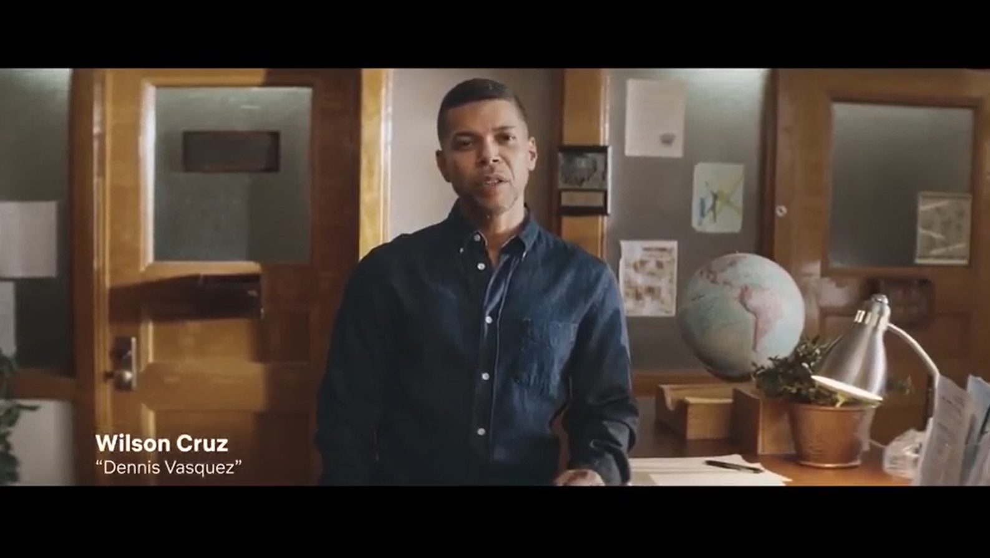
Check your answers!
“In our show “13 reasons why”, bullying takes on many forms: physical, verbal , cyber and social isolation. But bullying rarely exists between two people alone.
The person bullying isn’t the only influence. Whether in school hallways, at parties or online, those surrounding the bullying play a part too.”

Slide 8
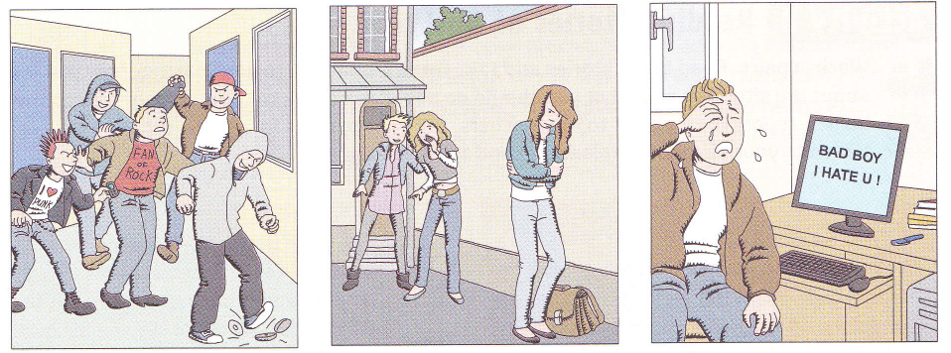
Label the pictures:
Physical bullying
Social / Verbal bullying
Cyberbullying

Slide 9
The 4 types of people:
Type 1: Those who □ exist □ assist
Type 2: Those who □ reinforce □ endorse
Type 3: The □ insiders □ outsiders
Type 4: The □ defenders □ pretenders

Slide 10
Keywords to define the 4 types of people:
Type 1 | Type 2 | Type 3 | Type 4
didn’t start the bullying
Encourage it by joining in.
Part of the audience.
Laugh along or attract the attention of others.
Give power to the bully by encouraging him
Don’t encourage the bullying but they don’t defend the bullied ones.
Heroes
Step in / intervene to defend the bullied person.
Tell an adult or offer comfort.

Slide 11

Solutions given to stop bullying:
Don’t keep it to yourself = talk about the situation.
Tell a trusted adult : a coach, a teacher, a school councelor or a parent.

Slide 12
Recap!
The document was an anti bullying campaign made by the main actors of Netflix series « 13 reasons why ».
There are four different types of bullying: it can be physical, verbal, social or cyber. Bullying is never a problem between only two people, there are many people involved.
There are people who assist the bully by encouraging the bullying and joining in. There are those who reinforce the bullying by laughing and attracting other people’s attention. That behaviour gives power to the person bullying by encouraging him to carry on / continue.
The outsiders / bystanders don’t encourage the bullying but they don’t defend the bullied ones. The defenders are the last type, they are heroes who step in! They help the bullied one by telling an adult or by offering comfort.
If you know someone who is bullied or if you are bullied yourself, don’t keep it to yourself! You must talk about the situation and tell a trusted adult (a coach, a teacher, a school councelor or an adult).

Slide 13
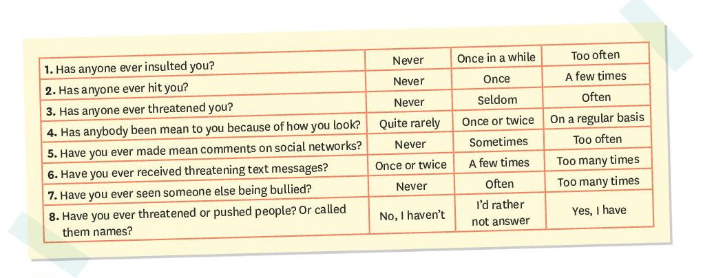
Written comprehension activity:
What type of document is it?
The document is a survey

Slide 14
Written comprehension activity:
On your worksheet, circle the verbs referring to bullying.

Slide 15
Check your answers:
Circle the verbs referring to bullying.

Slide 16
Vocabulary
Find synonym of the following words in the document:
Menace / intimidate= threaten
Bad / nasty = mean
Insult someone = call someone names
Menacing / intimidating = threatening

Slide 17
Written comprehension activity:
On your worksheet, classify the questions according to the type bullying:

Slide 18
Check your answers:
Physical bullying | Verbal bullying | Social bullying | Cyberbullying
Has anyone ever hit you?
Has anyone ever insulted you?
Has anyone been mean to you because of how you look?
Have you ever made mean comment on the social networks?
Have you ever threatened or pushed people?
Has anyone ever threatened you?
Or called them names?
Have you ever received threatening text messages?

Slide 19

Take the quiz !
Answer the questions for you and write a short paragraph to talk about your own experience on your worksheet:
Rappel:

Slide 20
Recap:
Have you ever been bullied at school?
The document is a survey about bullying.
As a student, I have never been insulted or hit but I have already been threatened in the playground. I have never pushed or threatened another student because I think it is really mean and it can really hurt emotionally.
I haven’t made mean comments on social networks but I have already received mean / threatening text messages.
I have already seen someone else being bullied and I reacted because I refused to be a bystander / an outsider!

Slide 21
Grammar!
Complete the document on your worksheet and then check the answers on the following slides.

Slide 22
Le present perfect avec ever et never
Observe les phrases:
Has he ever insulted you ?
I have received mean messages.
You have never pushed people.
Soulignez le groupe verbal en rouge dans les phrases ci-dessus et entourez les adverbes ever et never.
Observez attentivement le groupe verbal. Comment se forme le present perfect ?
AUXILIAIRE HAVE AU PRÉSENT + VERBE AU PARTICIPE PASSÉ.

Slide 23
ATTENTION : formation du participe passé :
Les verbes réguliers = ON AJOUTE ED
Ex : He has received mean text messages.
Les verbes irréguliers = 3E COLONNE DES VERBES IRREGULIERS
Ex : He has made mean comments on social networks .
A quoi sert cette forme verbale dans ces phrases ? Coche la bonne case.
□ A parler d’un moment précis du passé.
□ A parler du présent.
□ A parler d’une expérience, d’un bilan d’expériences.
Lis les exemples a et c et coche l’option correcte.
Ever est toujours employé dans une phrase □ interrogative □ affirmative
Et il est employé pour demander à l’interlocuteur de faire un bilan de ses expériences.
Never se traduit par □ déjà □ jamais □ juste

Slide 24
Forme affirmative | Forme négative | Forme interrogative
I have seen | I haven’t seen | Have I seen?
You have seen | You haven’t seen | Have you seen?
She has seen | She hasn’t seen | Has she seen?
We have seen | We haven’t seen | Have we seen?
You have seen | You haven’t seen | Have you seen?
They have seen | They haven’t seen | Have they seen?

Slide 25

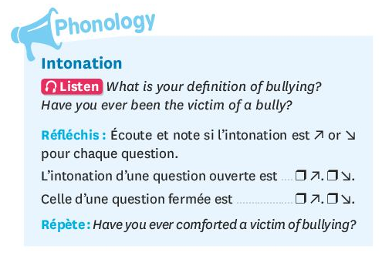
Phonology: intonation des questions
Listen and complete the document on your worksheet.

Slide 26
Transfert: oral expression.
Take the quiz with your partner.
Use the survey we’ve just worked on and ask the questions to your partner.
First,be very careful to the pronunciation of the questions.
Then, tick your partner’s answers on your document and change roles.
Finally, use your partner’s answers to write a short paragraph about his/ her experience.
BE CAREFUL: use the 3rd person singular in your paragraph!

Slide 27
Homework.
Etre capable de citer les 4 types de harcélement et de les définir.
Savoir construire le present perfect et utiliser les adverbes ever et never.
Faire les exercices distribués.

Slide 28
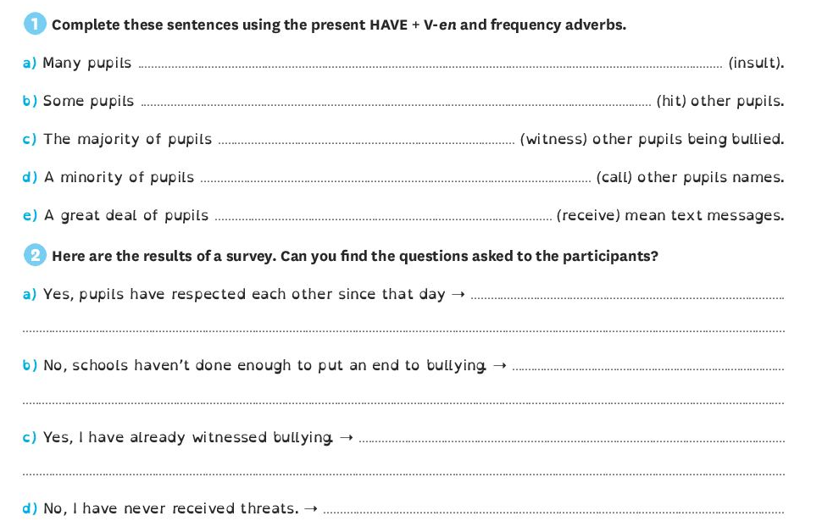
Exercises

