Slide 1

Sequence 4: Act and React!
NIVEAU 3E – RANDON BENEDICTE

Slide 2

React!
Type of document?
Justify.
Title?
Characters?
Description.
Make suppositions about the subject of the film (may / might / must…)

Slide 3

Watch the video (part 1)
Type of document?
Identify the characters. (names)
Place? Justify
Problem between them?

Slide 4
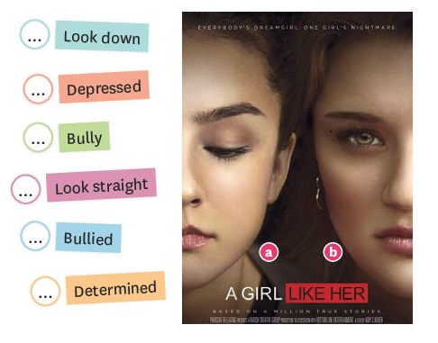
Watch the video (part 2)
Associate these words to the correct character on the film poster. Use a dictionary if needed:

Slide 5
Check your answers:
A
A
B
B
A
B

Slide 6
Learn new words:
Read the definition and associate each term to its French equivalent:
Bullying consists of repeated attacks on the same person, the bullied, by a bully or a group of bullies.
Bullying |  | Harceleur
Bullied |  | Harcèlement
Bully / Bullies |  | La personne harcelée

Slide 7

Oral comprehension activity:
Listen to the document and answer the questions:
When was the film released?
2015
What are the names of the two girls on the poster?
Jessica and Avery
How old are they?
16 years old.
What is the problem between them?
Jessica is harassed / bullied by Avery, her ex-best friend.

Slide 8
Oral comprehension activity:
Listen to the document again and concentrate on the character of Avery:
What are the two words used to qualify her?
Dreamgirl / nightmare.
Why did the author choose to talk about her this way?
Because she has 2 faces.
Find all the adjectives used to talk about Avery’s faces.
Angelic / public / cruel / discreet

Slide 9
Recap!
With the information you have about the film / movie, fill in the blanks, then check your answers:
It’s a ___________ for the ________ American movie A Girl Like Her directed by Amy S. Weber. The film denounces ________________ by telling the story of a ________________ student, Jessica, who’s being ____________ by her ______ friend, Avery, one of the most __________ girls in her school. Avery has _________________, a public and __________ one and a ______________ and more discreet one.

Slide 10
Check your answers:
It’s a movie / film trailer for the 2015 American movie A Girl Like Her directed by Amy S. Weber. The film denounces bullying by telling the story of a 16-year-old student, Jessica, who’s being harassed / bullied by her ex friend, Avery, one of the most popular girls in her school. Avery has two faces, a public and angelic one and a cruel and more discreet one.

Slide 11
Homework.
Apprendre le vocabulaire nouveau de la séance + être capable de parler du film « a girl like her »
Savoir définir les termes: bullying / bullied / bully.

