Slide 1
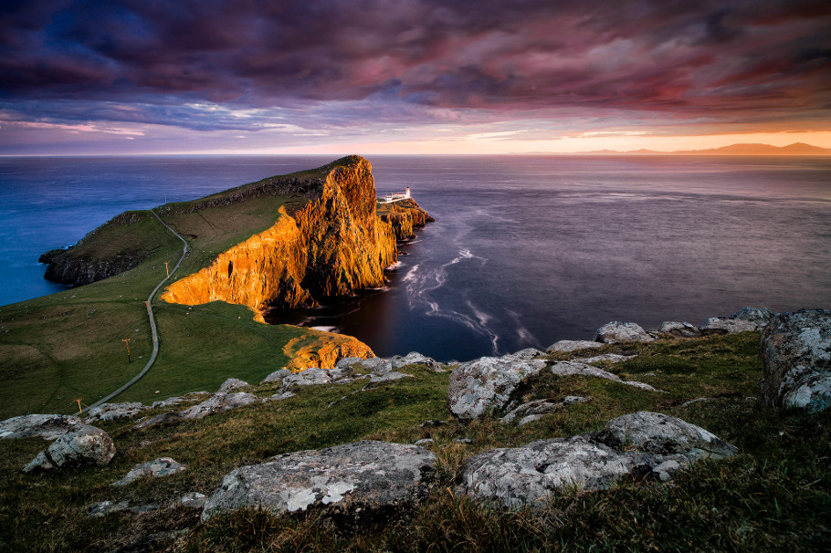
Sequence 5: What a surprising country!
Randon Bénédicte – Collège Rosa Parks – Cavaillon

Slide 2

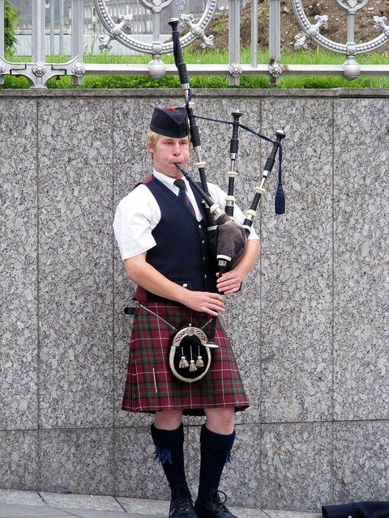
RECAP:
What is that?
What can you say about that picture?

Slide 3
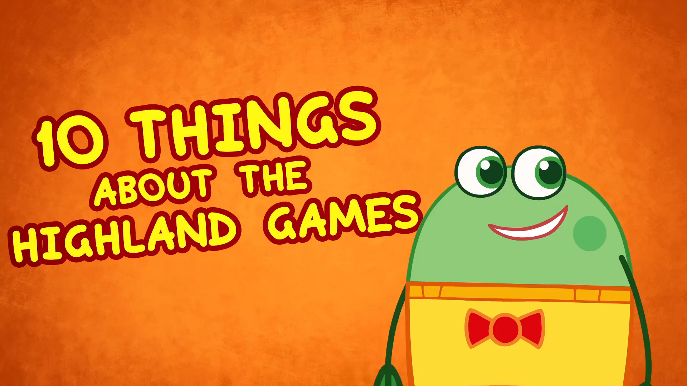
REACT:
Watch the video carefully:
Identify the subject of the video.
Where ?
When?
What?

Slide 4
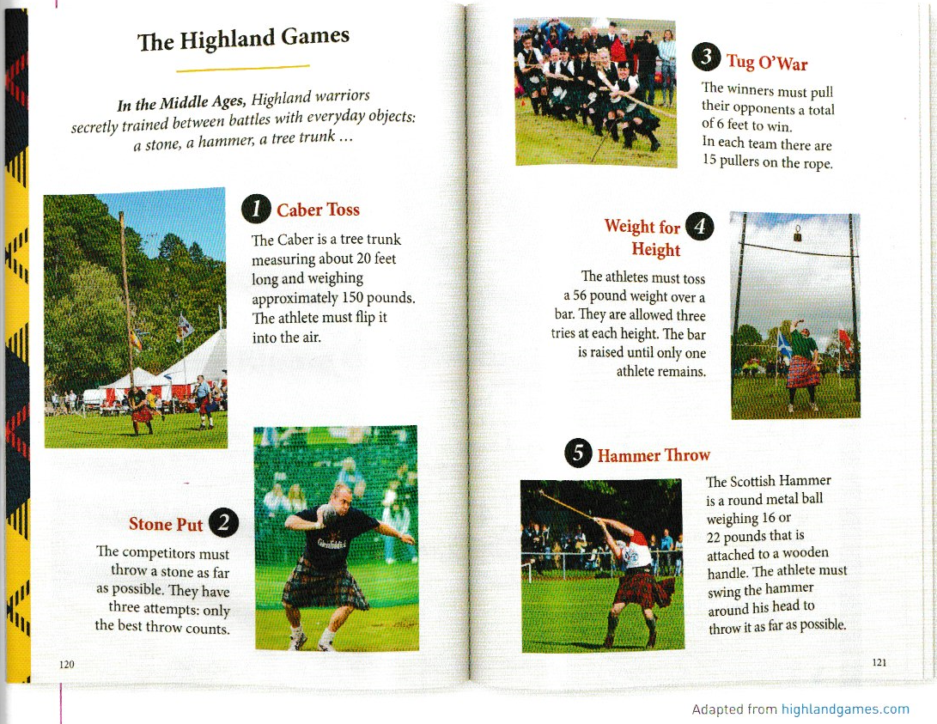
Written comprehension:
Read the text and do the activities on your worksheet.

Slide 5
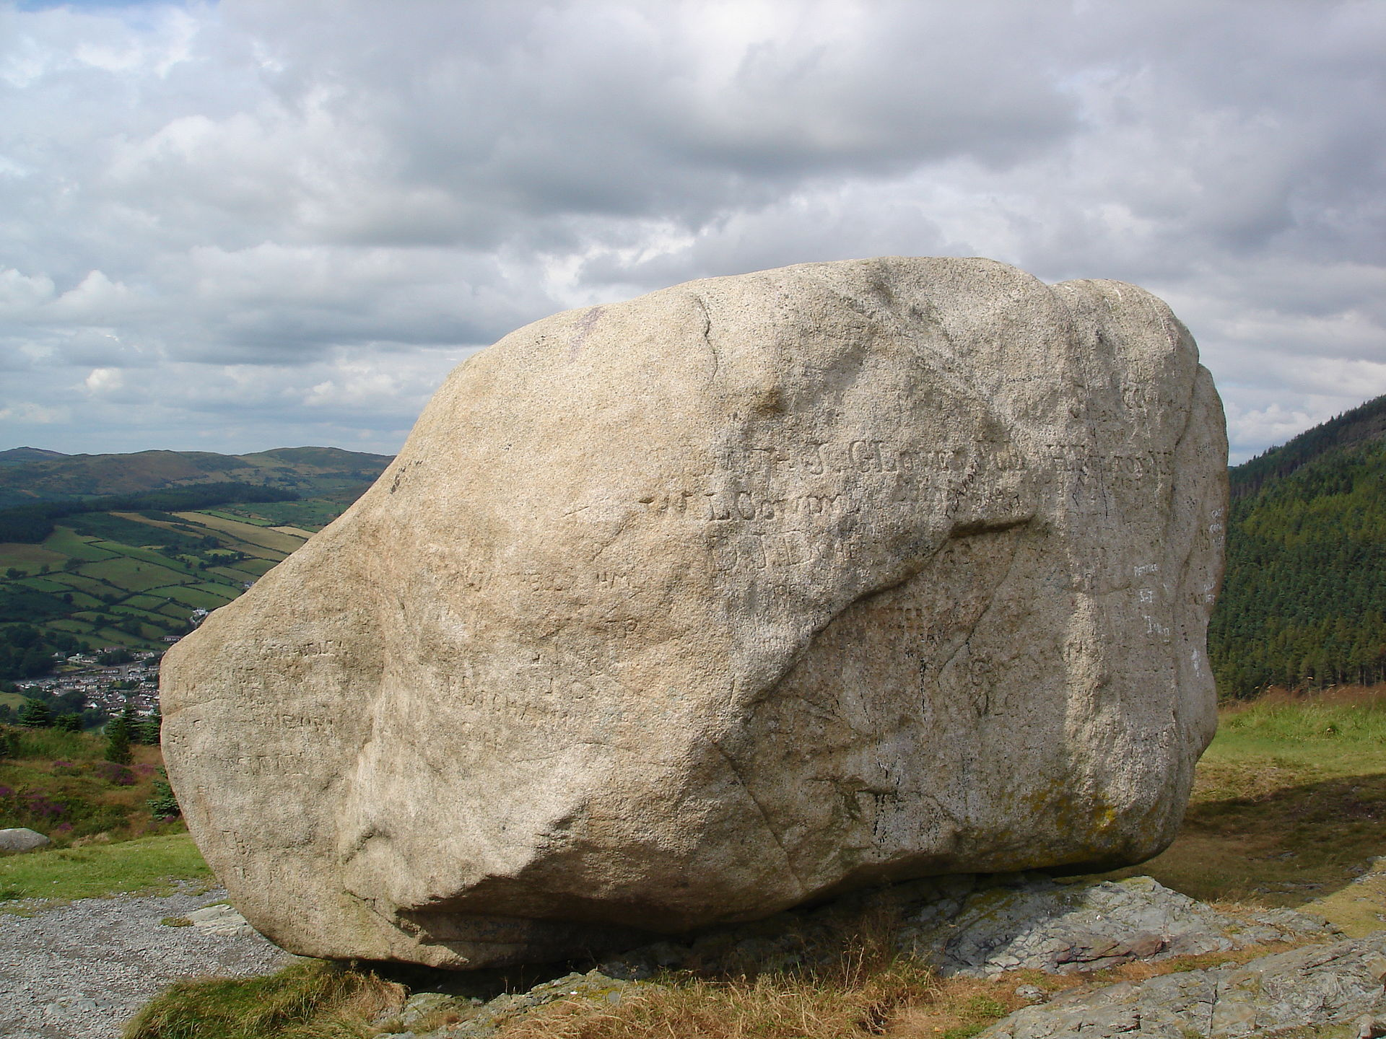
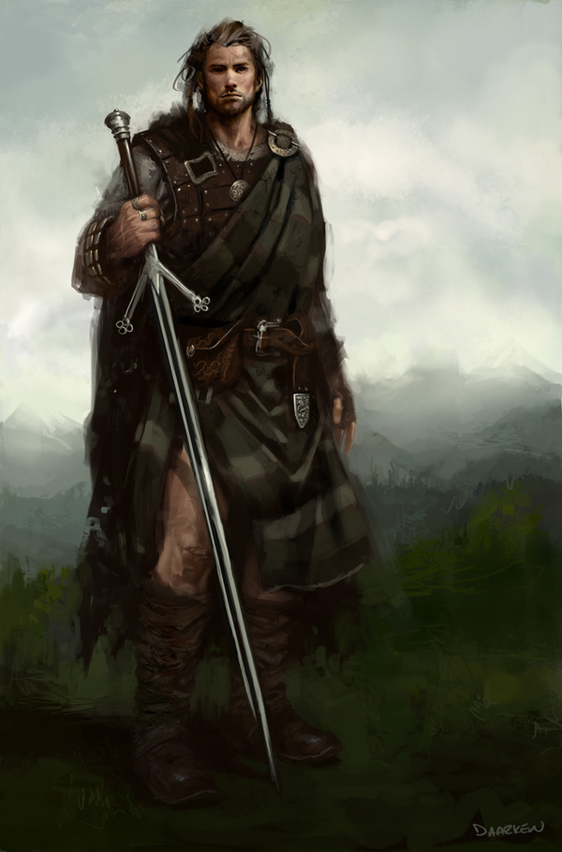
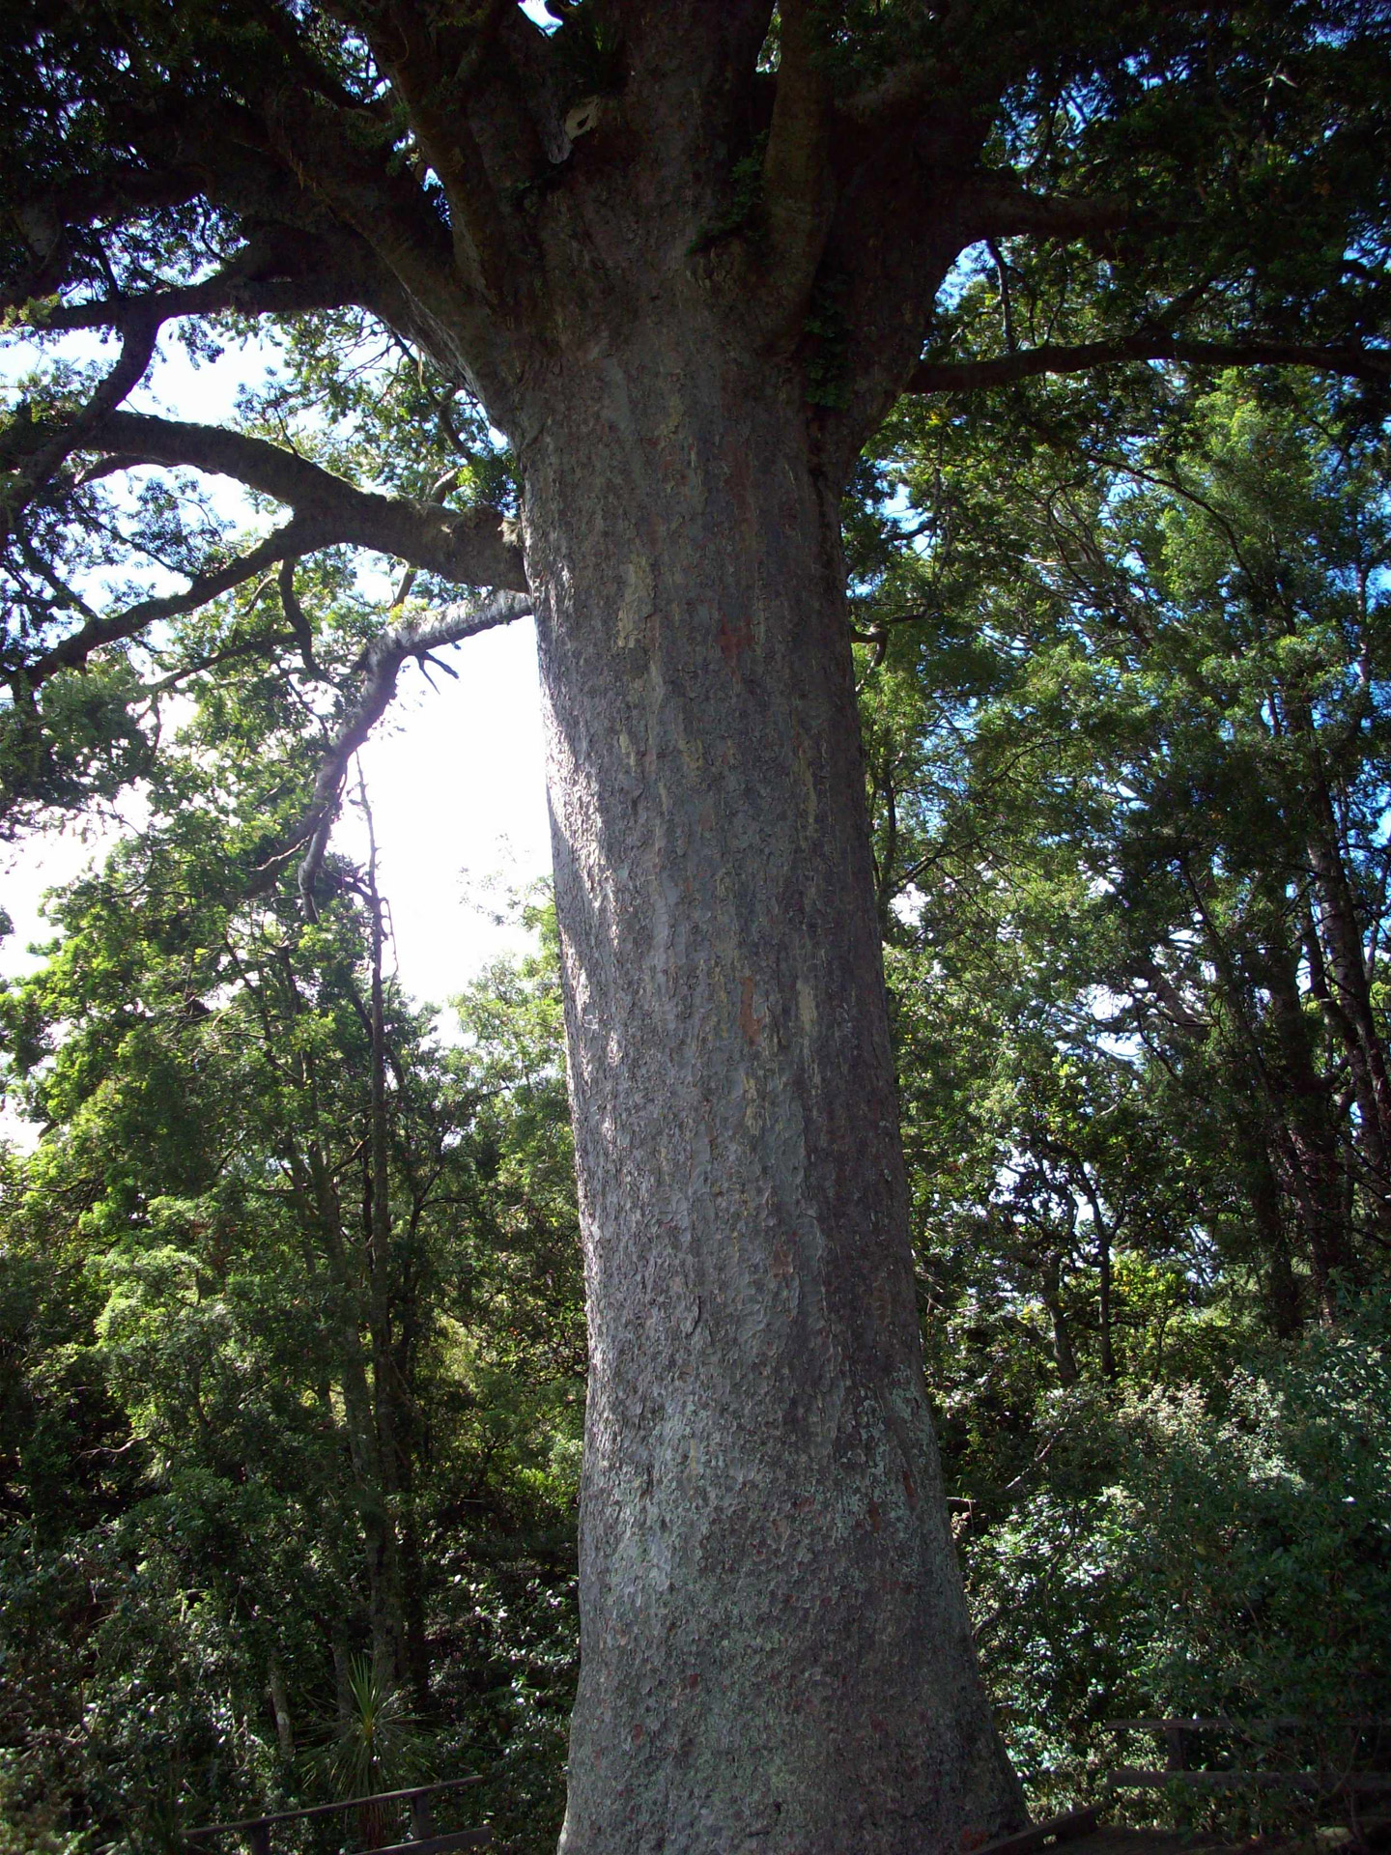
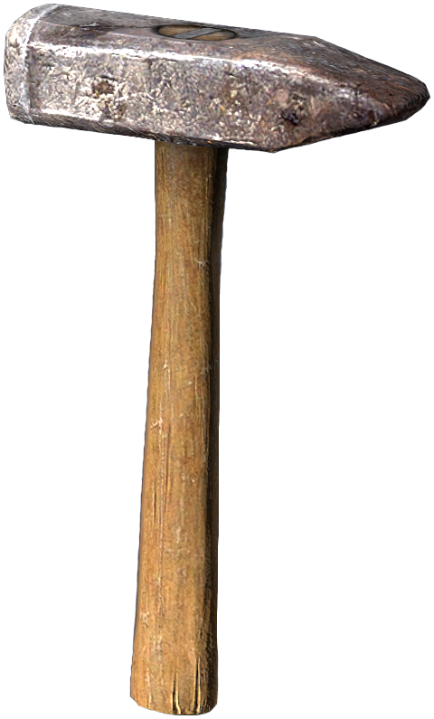
Written comprehension:
Read the introduction and match the words with the corresponding picture:
A stone
A warrior
A tree trunk
A hammer

Slide 6
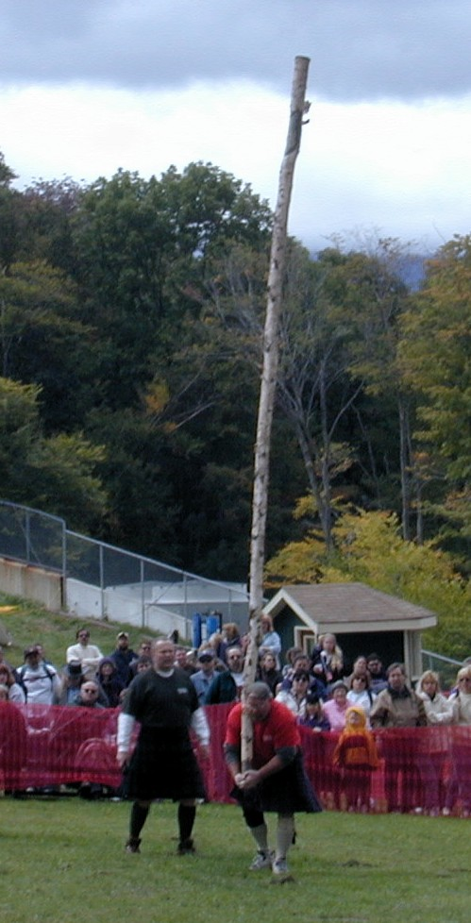


Written comprehension:
What objects do the athletes need? Complete the information for each sport.
Name of sport:
Caber Toss
Objects / Material:
A tree trunk
The athlete must
Flip the tree trunk / the caber into the air
A caber is a Scottish word synonym of tree trunk

Slide 7
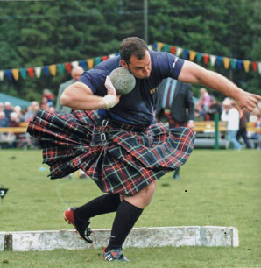
Written comprehension:
Name of sport:
Stone Put
Objects / Material:
A stone
The athlete must
Throw a stone as far as possible

Slide 8
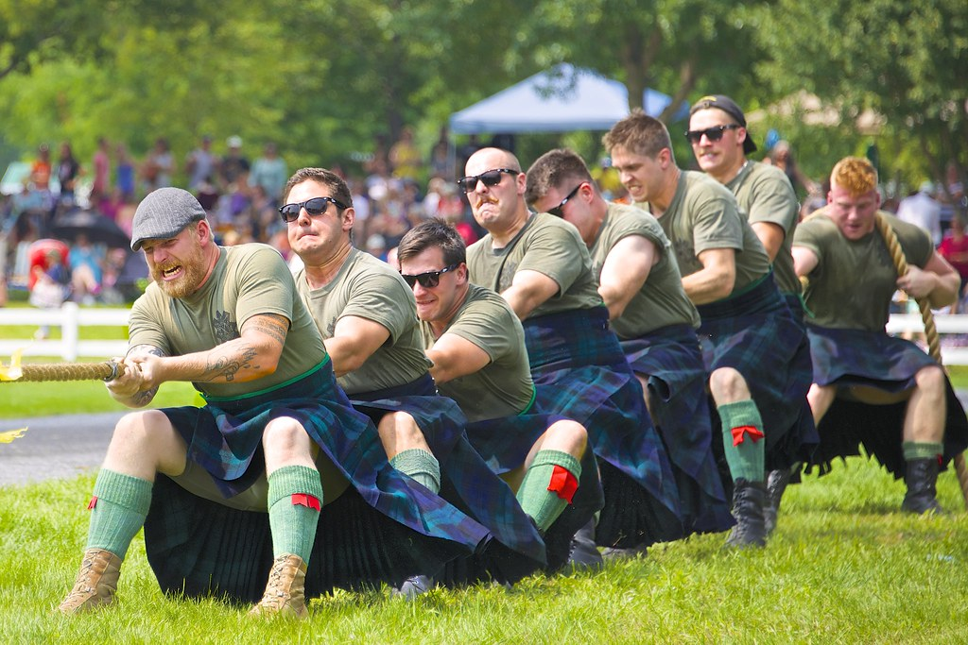
Written comprehension:
Name of sport:
Tug O’War
Objects / Material:
A rope
The athlete must
Pull their opponents 6 feet.

Slide 9
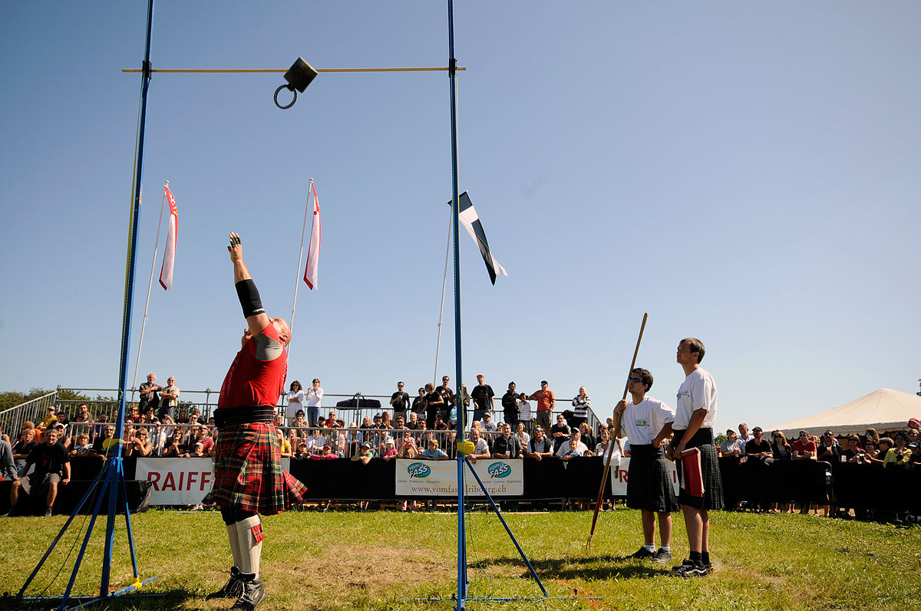
Written comprehension:
Name of sport:
Weight for Height
Objects / Material:
A 56 pound weight
The athlete must
Toss the weight over a bar.

Slide 10
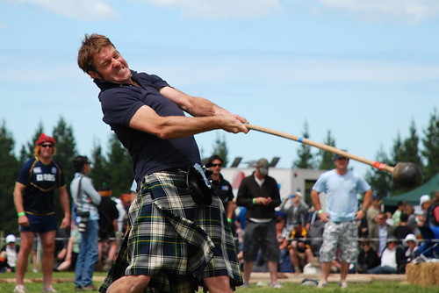
Written comprehension:
Name of sport:
Hammer Throw
Objects / Material:
A round metal ball
The athlete must
Swing the hammer around his head to throw it as far as possible.

Slide 11
Culture point:
How strong are the Scottish?
Convert the height and weight of a caber into cm and kg.
A caber weighs about 68 kg and is about 6 m long.
CONVERSION
1 foot | 30,48 cm
1 pound | 54 kg

Slide 12
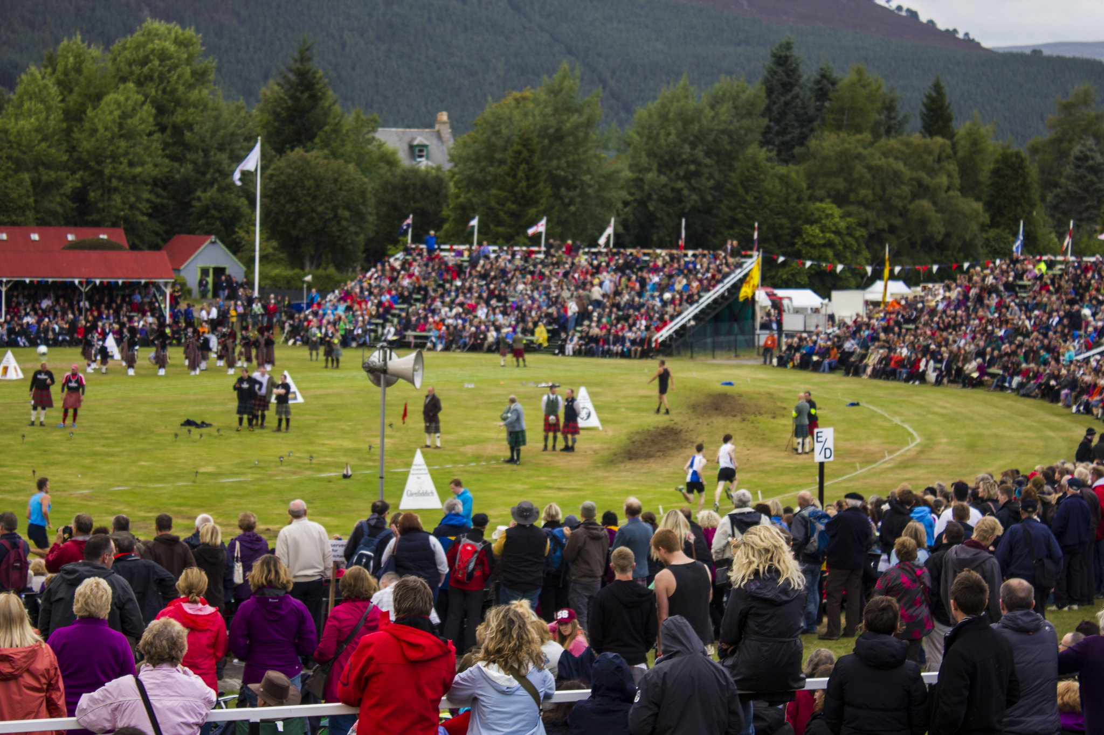
Recap:
Use the information you have about the Highland Games to write a short presentation of the event.

Slide 13
Trace écrite envisagée:
The Highland Games take place in Scotland every year in Spring and Summer. It is a competition of typically Scottish sports but also danse and music.
Scottish warriors invented sports such as Caber Toss. It very famous! The athlete must flip a very long and very heavy tree trunk into the air.
Stone Put is also very spectacular! The athlete must throw a stone as far as possible.
Tug O’War is a very popular challenge. The athletes must pull their opponents 6 feet to win. You mustn’t fall if you want to win!

Slide 14
MUST / MUSTN’T:
Observe les phrases suivantes:
The competitors must throw a stone.
The athlete must swing the hammer.
Dans chaque phrase, souligne le sujet en vert, entoure le verbe en rouge et encadre l’auxiliaire en bleu.
Quel sujet est au singulier? THE ATHLETE
Lequel est au pluriel? THE COMPETITORS
Est-ce que l’auxiliaire MUST change en fonction du sujet? NON
Que permet d’exprimer l’auxiliaire MUST ? L’OBLIGATION

Slide 15
Observe les phrases suivantes:
The competitors mustn’t fall.
The caber mustn’t be 200 pounds .
Dans chaque phrase, souligne le sujet en vert, entoure le verbe en rouge et encadre l’auxiliaire en bleu.
Que remarques-tu dans ces deux exemples.
LES PHRASES SONT A LA FORME NEGATIVE
Dans ce cas là, que permet d’exprimer l’auxiliaire selon toi?
L’INTERDICTION.

Slide 16
RECAP:
Pour exprimer L’OBLIGATION, j’utilise le SUJET + l’auxiliaire MUST + une BASE VERBALE et le reste de la phrase.
Pour exprimer L’INTERDICTION, j’utilise le SUJET + l’auxiliaire MUST + NOT + une BASE VERBALE et le reste de la phrase.

Slide 17
Written expression activity:
You are a jury member for the Highland Games this year and you must talk about the rules to the competitors. Complete the sentences by using MUST or MUSTN’T
You MUST throw the hammer as far as possible.
You MUSTN’T throw the weight at somebody.
You MUSTN’T drop the caber.
The caber MUSTN’T be less than 19 feet long.
The weight MUST weigh 56 pounds.

Slide 18
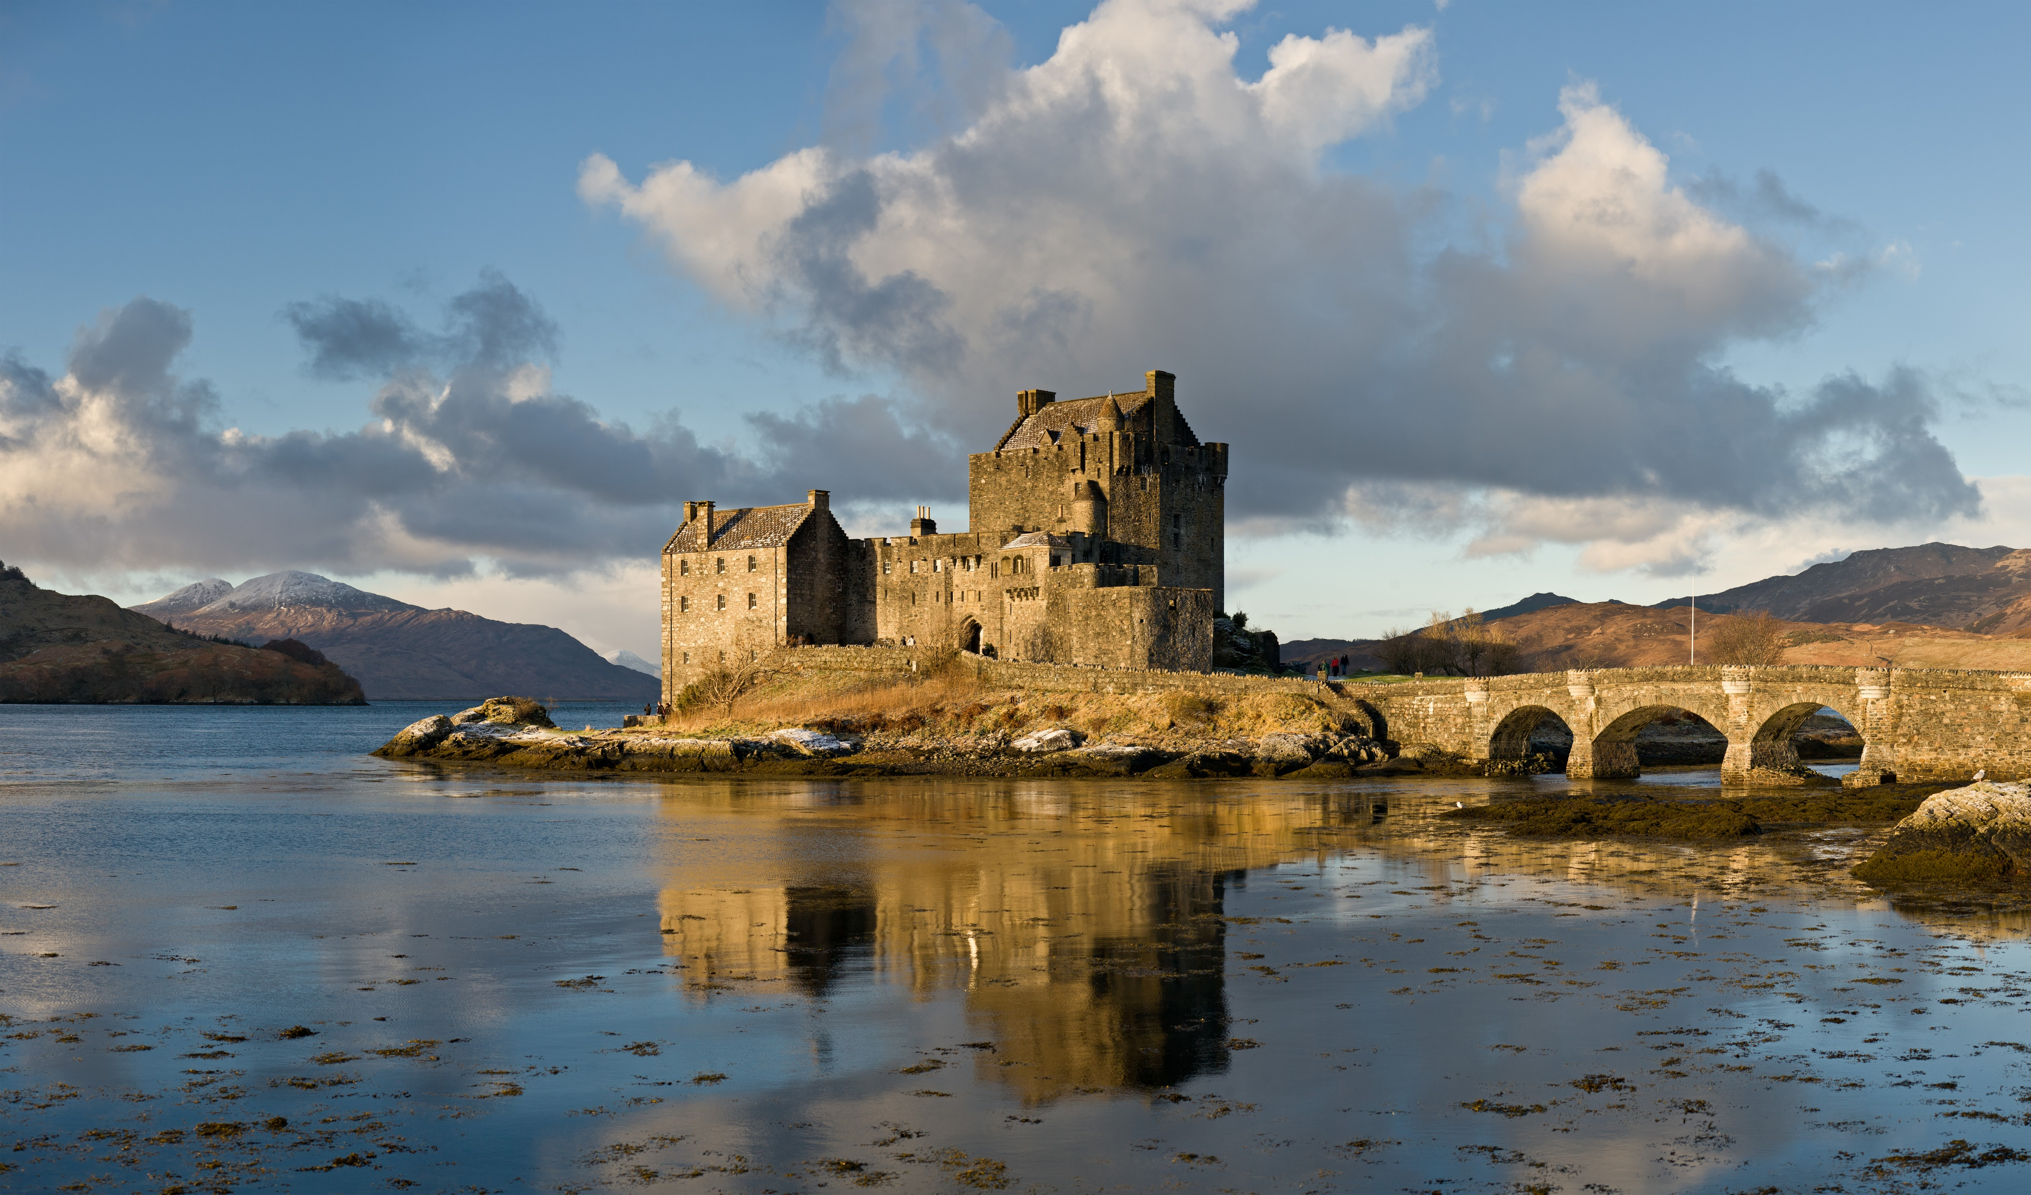
Homework
Être capable de parler des Highland Games et des différentes épreuves.
Savoir utiliser l’auxiliaire MUST.
Faire les exercices 4 et 5 page 103 du manuel.

