Slide 1
Modern literature
The Absurd

Slide 2
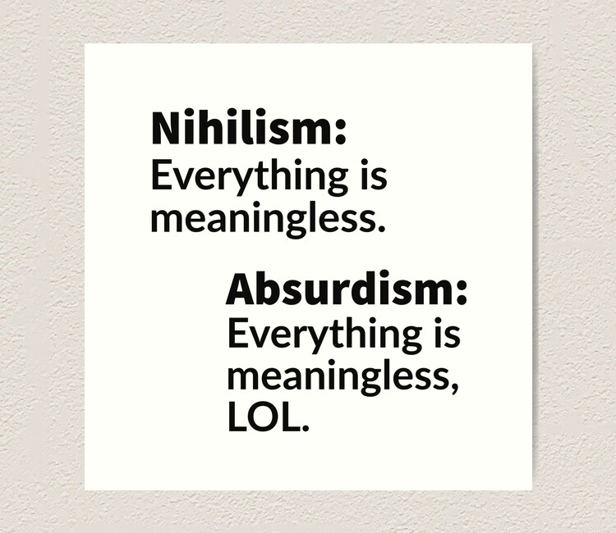
Absurdism = philosophical movement

Slide 3
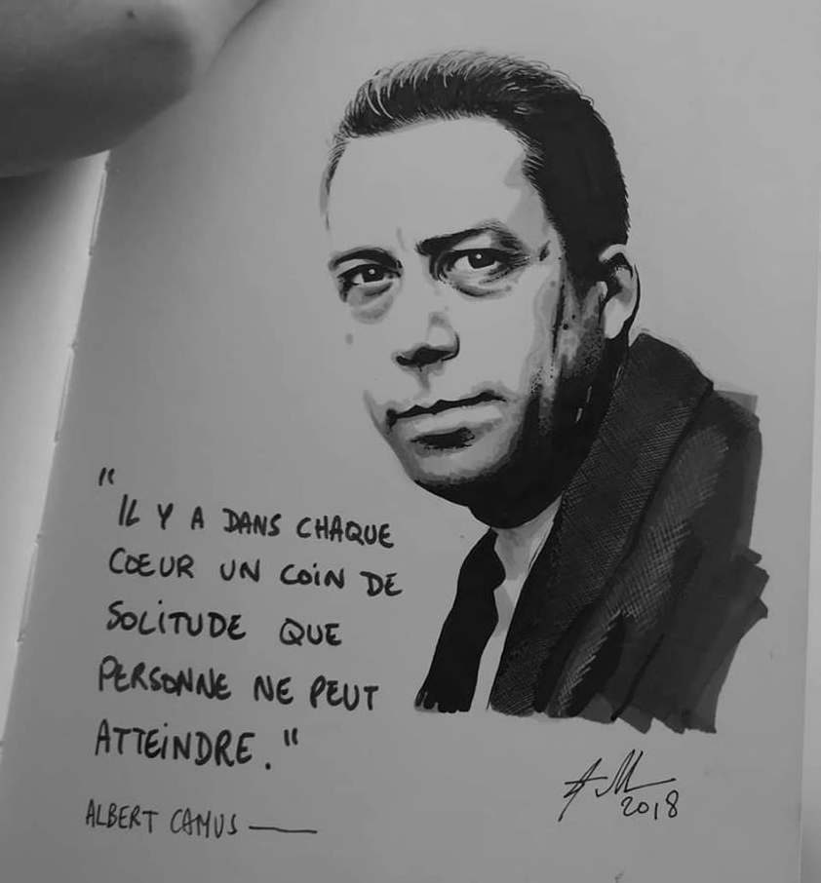
Origins
Aftermath of World War 2
Struggle to find meaning after devastation
Albert Camus
Myth of Sisyphus

Slide 4
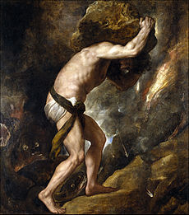

Myth of Sisyphus

Slide 5
Life = meaningless
Several options:
Suicide
Distraction
Denial
Become an actor
Be another kind of artist
Get political
Acceptance

Slide 6
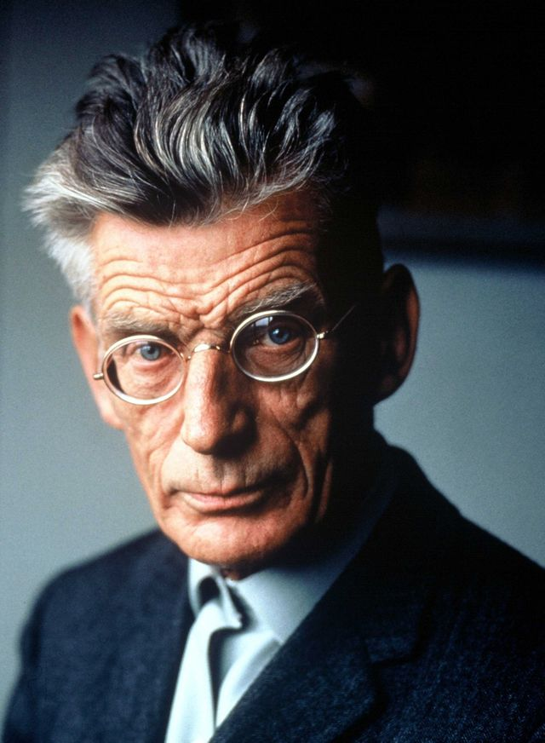
1. Waiting for who?
Absurdism applied to French playwrights: Ionesco, Beckett
Most of his works were written in French
winner of the Nobel Prize for Literature in 1969

Slide 7
Waiting for Godot
most well-known play from the Theatre of the Absurd movement
written between 1949 - 1955
At its premier, the play shocked its audience
What should the characters do?

Slide 8
To that stirring question the characters discuss:
Estragon: Don’t let’s do anything. It’s safer.
Vladimir: Let’s wait and see what he says.
Estragon: Who?
Vladimir: Godot.
Estragon: Good idea.

Slide 9
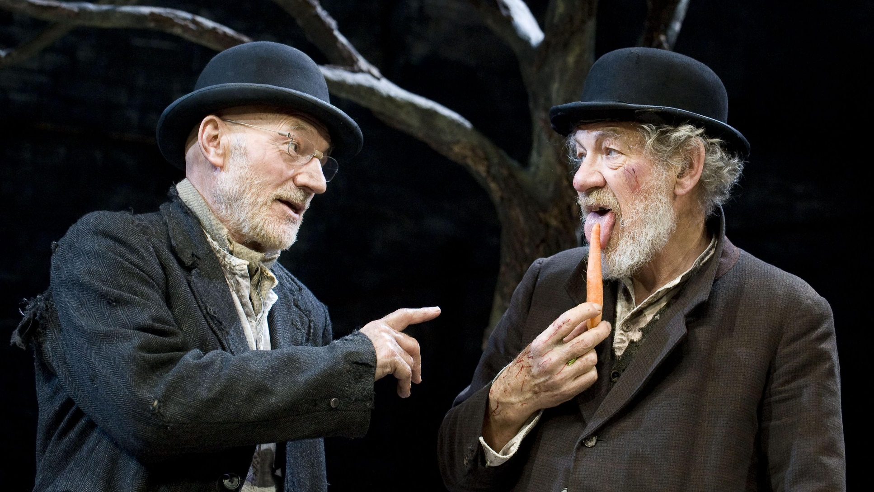
Vladimir & Estragon

Slide 10
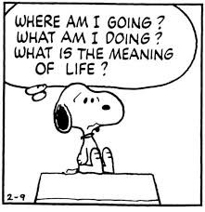
Absurdiam <3 Existentialism
Man is a like a diseased animal
Futile waiting
Hoping for salvation
To live is a struggle :’(

Slide 11
A few characteristics
People isolated/no communication
dialogues fill the void, full of nonsense, clichés, play on words
No realistic settings/imprisoned in reduced spaces
succession of meaningless events
Protagonists with no depth, repeat pointless actions

Slide 12
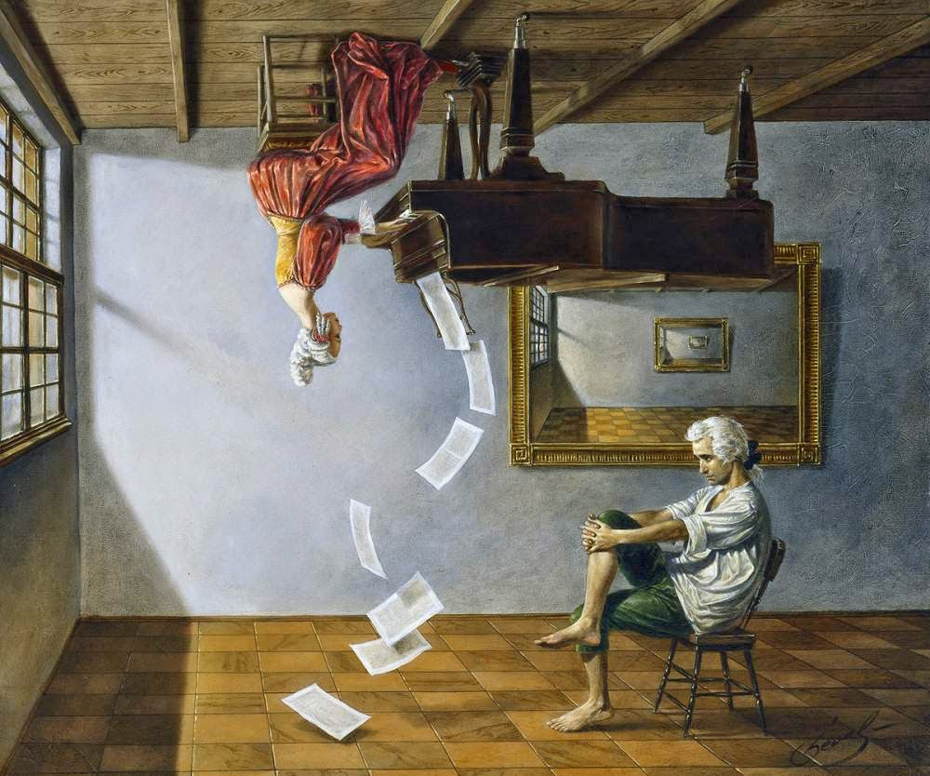
Michael Cheval

