Slide 1
BUILD UP ASSUMPTIONS* ON THE STORY
*Formulez des hypothèses…

Slide 2

Where did the scene take place ?

Slide 3
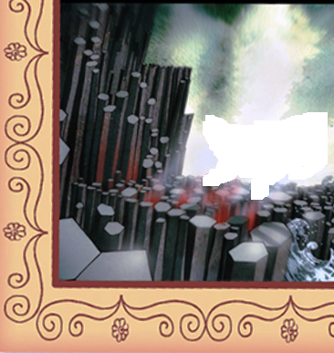
And more precisely ?

Slide 4
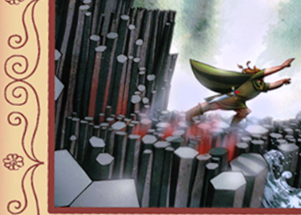
The main character ? Who ? What ?

Slide 5
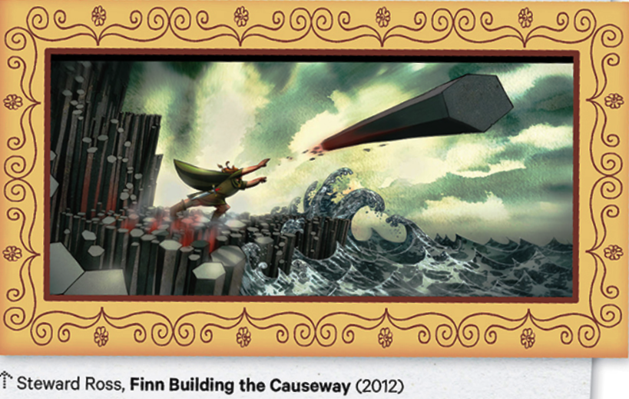
Check…

