Slide 1
THE UNITED KINGDOM
5th Grade
UNIT 1
Lesson 3 pg 22

Slide 2
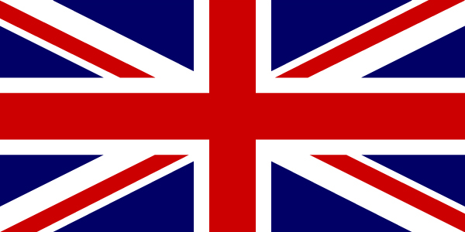
THE BRITISH FLAG
‘’THE UNION JACK’’

Slide 3
LEAD IN
What do you know about the United Kingdom?
Do you know the difference ?
The United Kingdom
Great Britain
The British Isles

Slide 4
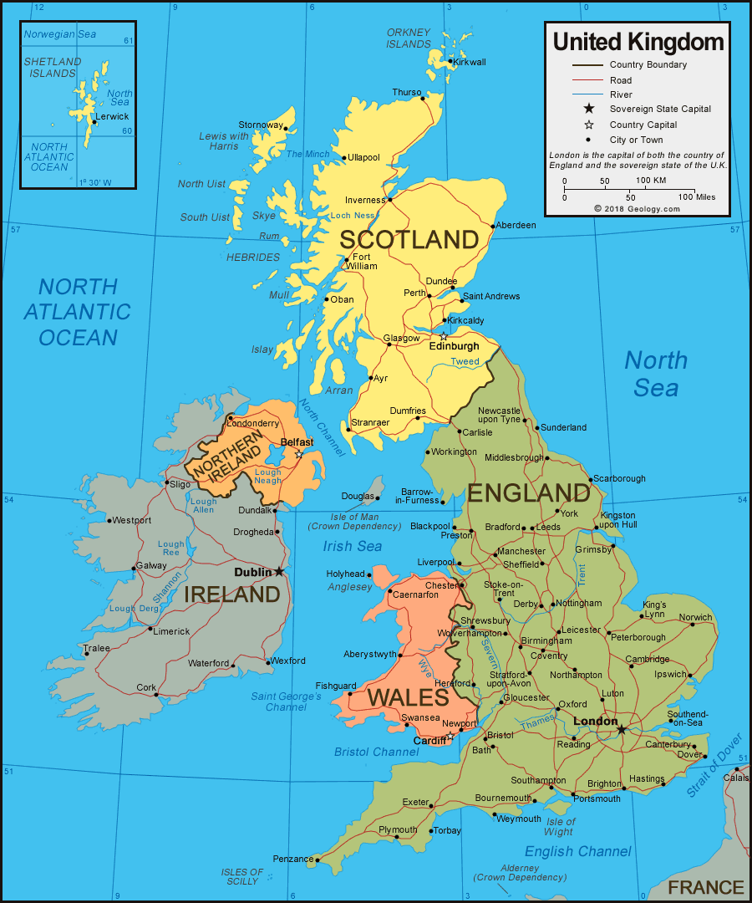
UNITED KINGDOM MAP

Slide 5
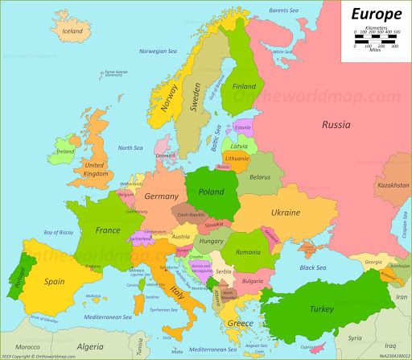
THE BRITISH ISLES
The British Isles are a group of islands in the North Atlantic Ocean. They are situated on the West side of Europe.

Slide 6
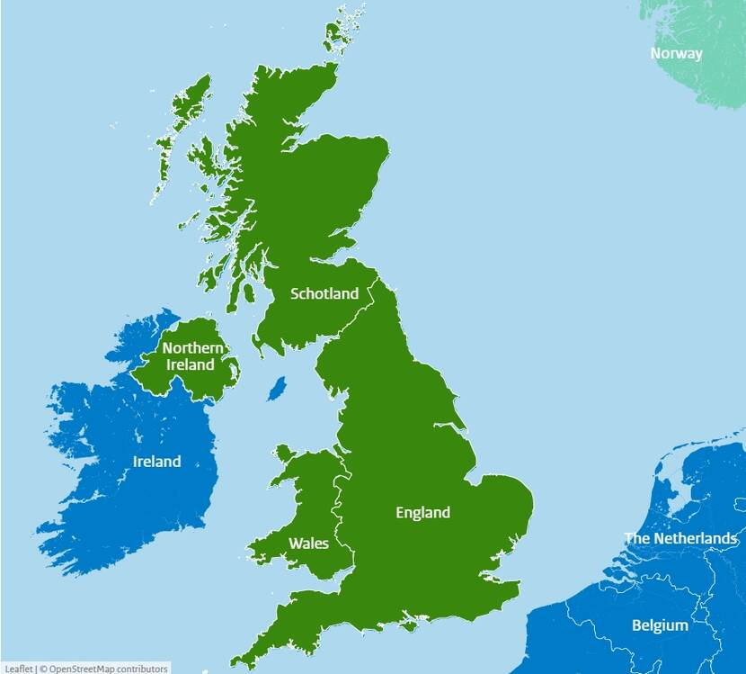
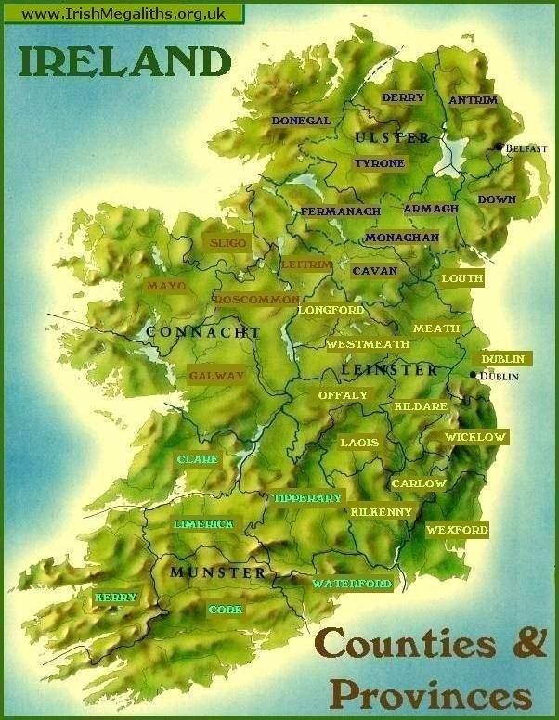
Geographically
The British Isles are made up of 2 main countries. Great Britain and Ireland

Slide 7
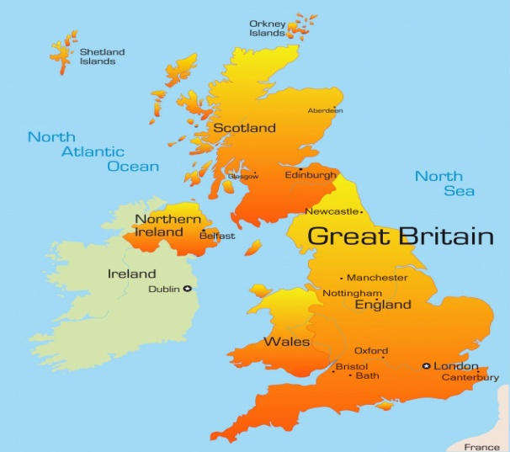
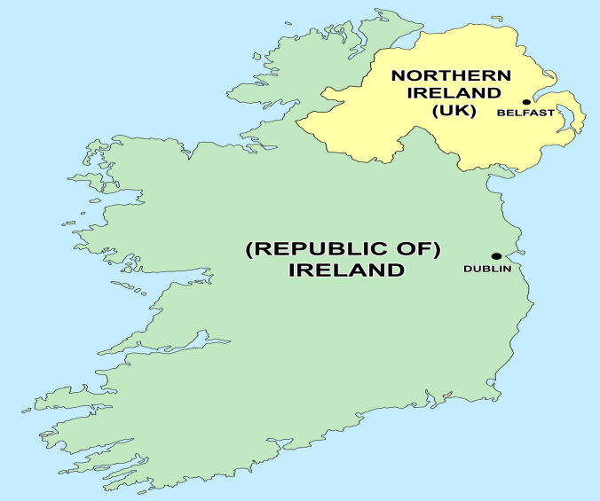
Politically
The two islands are made up of :
a) the United Kingdom and Northern Iirelandi Ireland
b) the Republic of Ireland

Slide 8


Slide 9
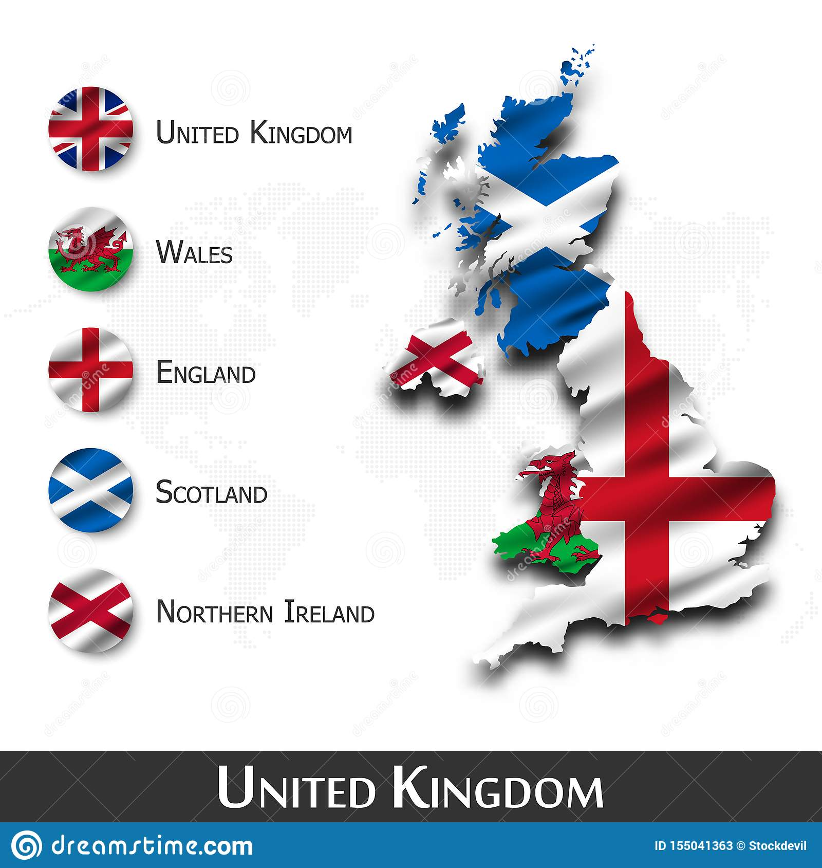
The population of the UK is about 59 million.
Capital City : LONDON

Slide 10
A) GREAT BRITAIN CONSISTS OF 3 COUNTRIES
1. ENGLAND
2. SCOTLAND
3. WALES

Slide 11
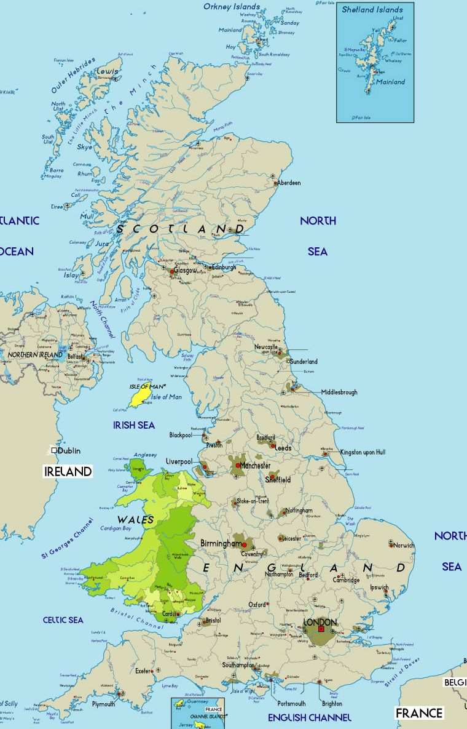
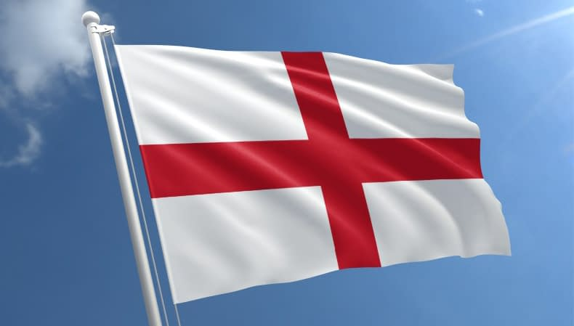
1. ENGLAND
Capital City : LONDON
Population : 11 -12 million people

Slide 12
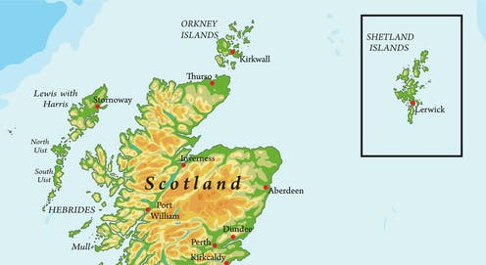
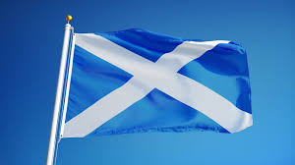
2. SCOTLAND
CAPITAL CITY : EDINBURGH

Slide 13
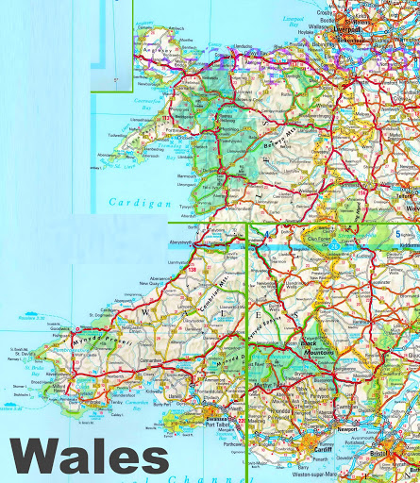
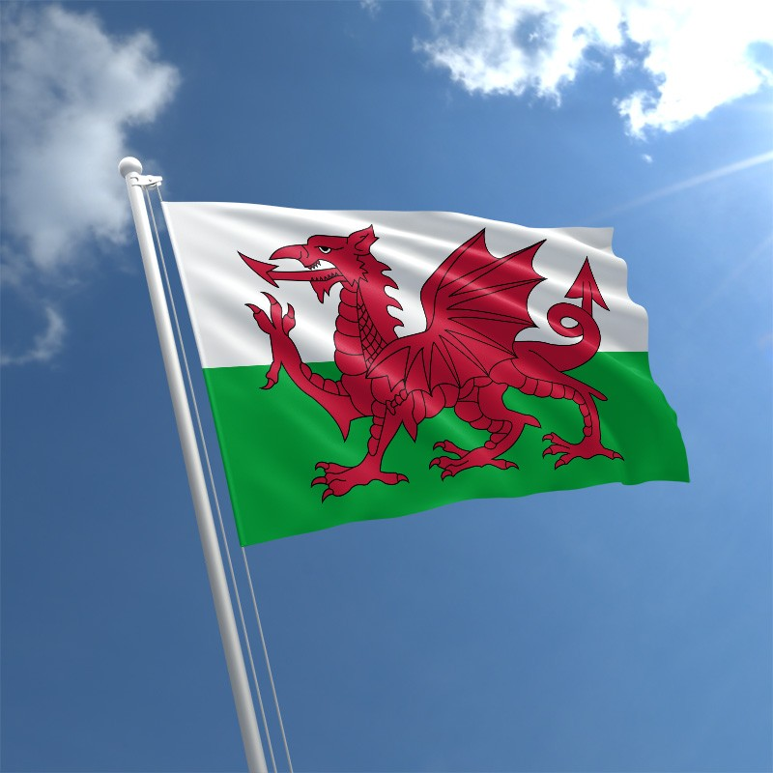
3. WALES
CAPITAL CITY : CARDIFF

Slide 14
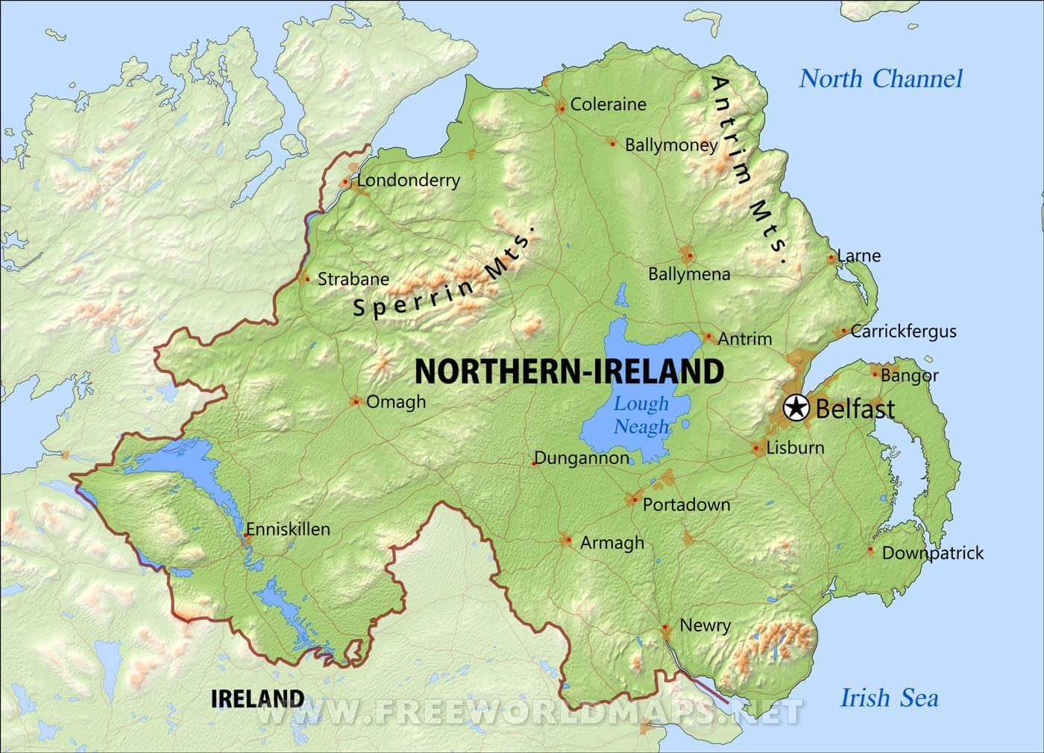
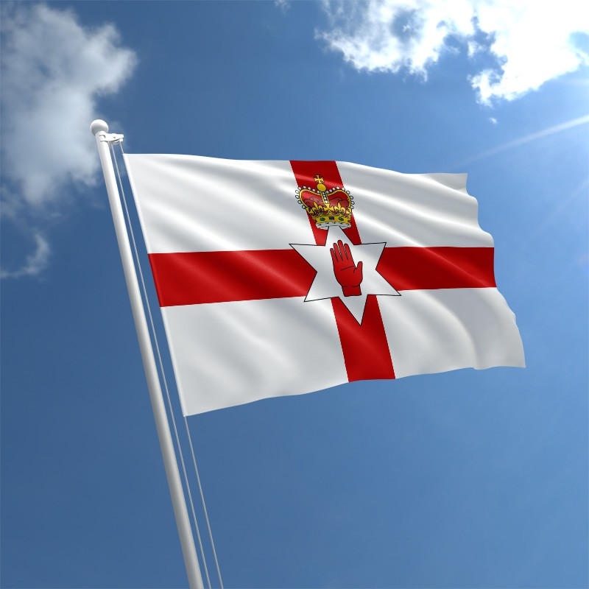
NORTHERN IRELAND
CAPITAL CITY : BELFAST

Slide 15

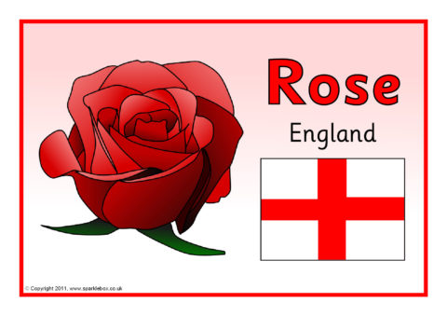
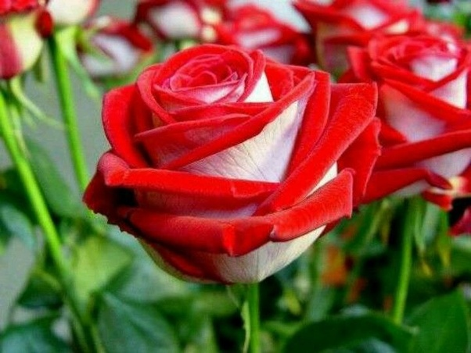
THE NATIONAL FLOWER OF EACH COUNTRY
ENGLAND : THE ROSE

Slide 16
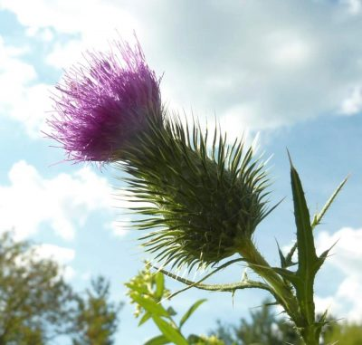
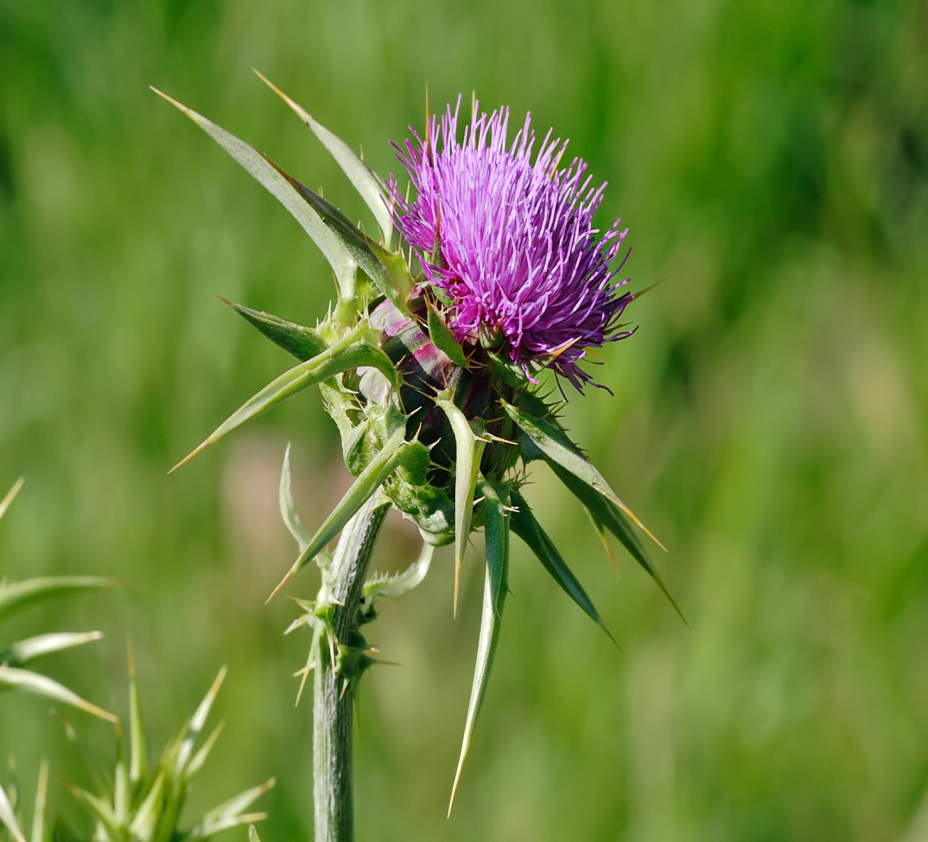
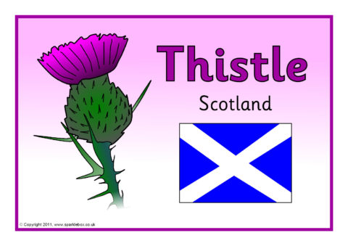
SCOTLAND
THE THISTLE

Slide 17

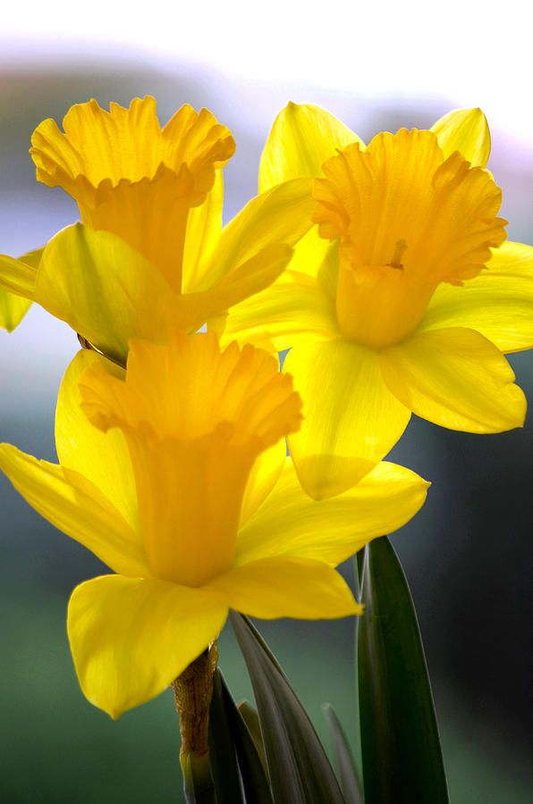
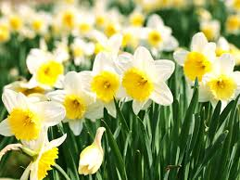
WALES
THE DAFFODIL

Slide 18
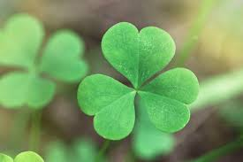

Northern Ireland
THE SHAMROCK

Slide 19

B) THE REPUBLIC OF IRELAND IS IN THE SOUTHERN PART OF IRELAND

Slide 20
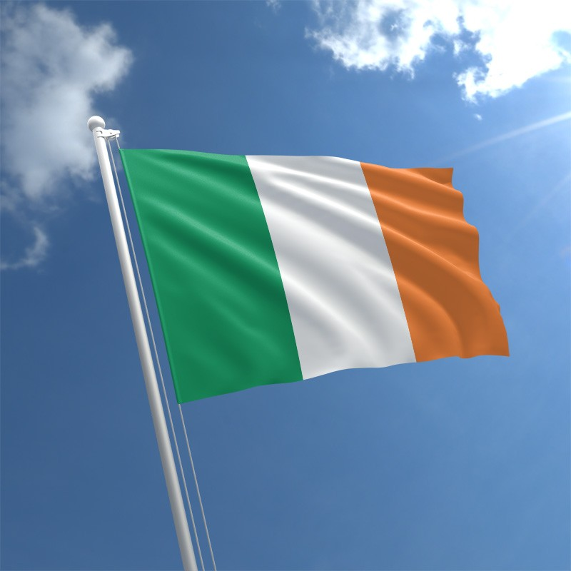
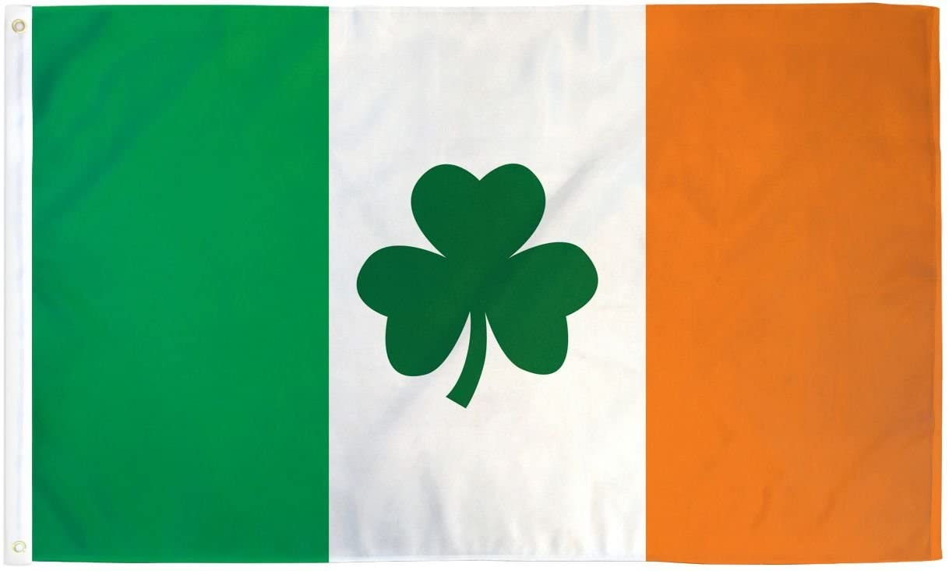
CAPITAL CITY : DUBLIN
POPULATION : 3.7 MILLION

Slide 21
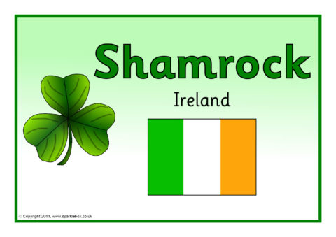
THE NATIONAL FLOWER OF IRELAND
THE SHAMROCK

Slide 22
NATIONALITIES
1. England - English
2. Scotland - Scottish
3. Wales - Welsh
4. Northern Ireland - Northern Irish
5. Ireland - Irish
6. The United kingdom - Britιsh

Slide 23
COUNTRIES AND CAPITALS
The United Kingdom - London
England - London
Scotland - Edinburgh
Wales - Cardiff
Northern Ireland - Belfast
Ireland - Dublin

Slide 24
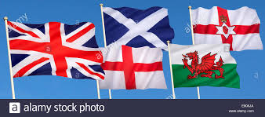
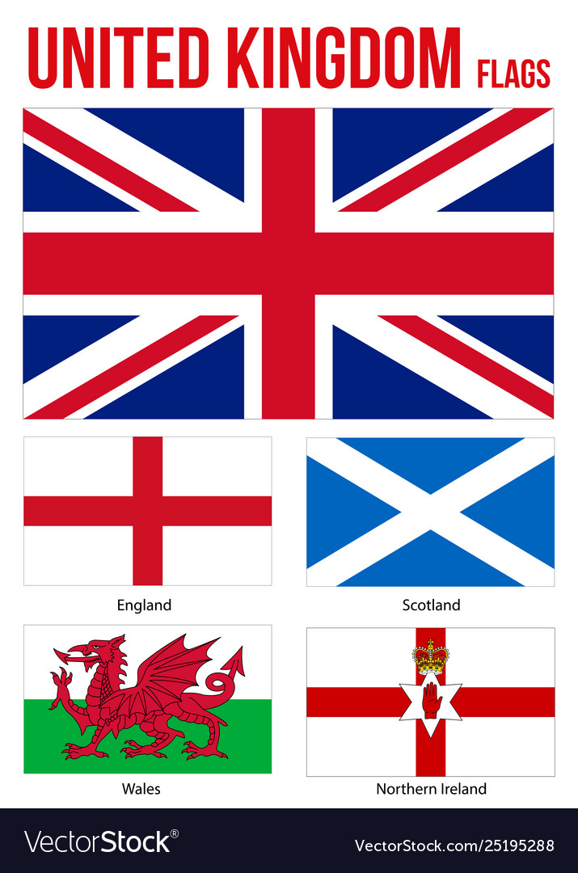
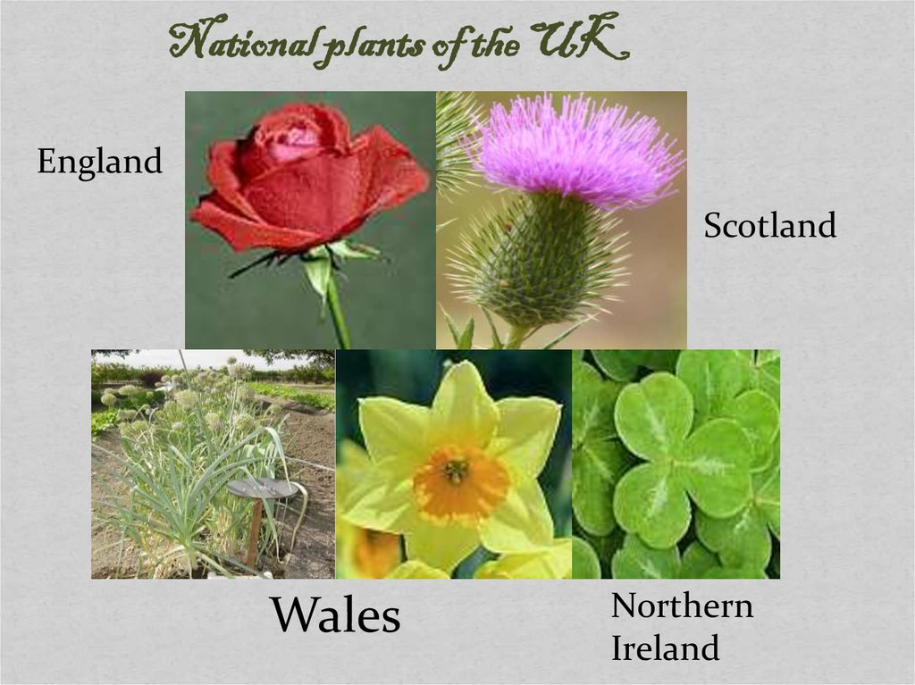

Slide 25
Useful Vocabulary
is situated = βρίσκεται
Is made up = αποτελείται από
two main islands = δύο κύρια νησιά
British Isles = Βρετανικά νησιά
Population = πληθυσμός
twice as big = διπλάσιος
one third = το ένα τρίτο
Includes = περιλαμβάνει
The Republic of Ireland = Η Δημοκρατία της Ιρλανδίας

Slide 26
Northern =Βόρεια
Southern = Νότια
West = Δυτικά
Shamrock = Τριφύλλι
Thistle =Γαίδαράγκαθο
Daffodil = Ασφόδελος

Slide 27
SUMMARY
London is the capital of England.
England is a country.
Britain is an area that consists of England and the country of Wales.
Great Britain is the name of the island that is home to the countries of England, Wales, and Scotland.
The United Kingdom (UK) is a country that is a union of the countries on the island of Great Britain, along with the country of Northern Ireland (which shares the island of Ireland with the Republic of Ireland.)
The Republic of Ireland is a separate country that is not part of the UK.
London is also the capital of the UK.

Slide 28
