Slide 1


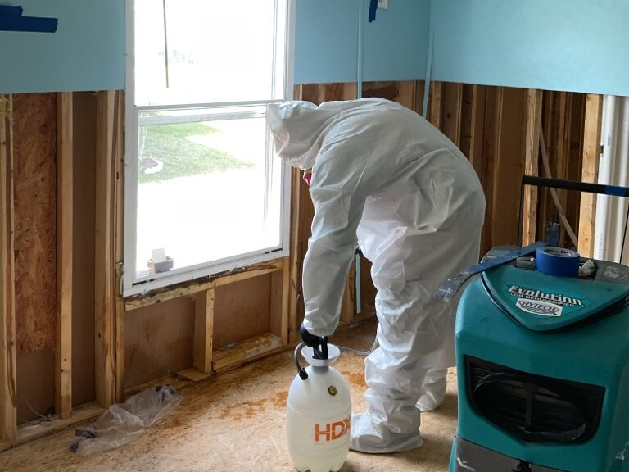

FunGuy Mold Inspections
Professional Mold Inspection
Get a thorough check with our professional mold inspection to identify and address any mold issues in your home or business for a safer environment. Call now!

Slide 2
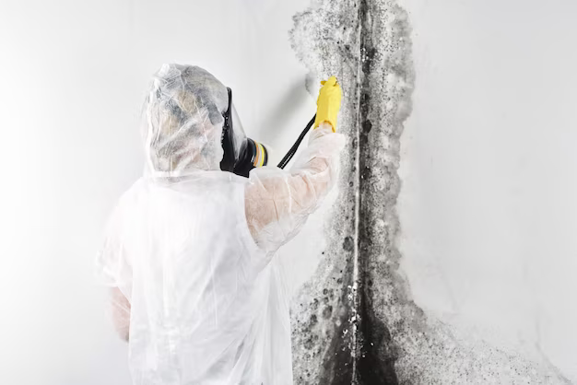
FunGuy Mold Inspections
Asbestos Testing
Our asbestos testing is essential for identifying hazardous materials in your property and ensuring a safe living environment for you and your loved ones.

Slide 3


FunGuy Mold Inspections
How To Clean Mold
Find out how to clean mold quickly with FunGuy Mold Inspection. Explore our straightforward steps to eliminate mold and maintain a fresh & safe home. Hire now!

Slide 4


FunGuy Mold Inspections
Mold Testing
Our video explains mold testing & its importance for your home. Recognize why testing for mold is vital for maintaining a healthy living environment. Watch now!

Slide 5




FunGuy Mold Inspections
United States
Contact Us
FunGuy Mold Inspections is Certified Mold Inspector Specializes in Mold Inspection, Mold Testing, Removal, Flood Cleanup, Indoor Air Quality Testing, Water Damage Restoration & Bacterial Test Service In Los Angeles, San Diego & Ventura Counties.
(866) 674-7541
https://www.youtube.com/channel/UCiiUoL8VeTLoB1topK2GGew

