Slide 1
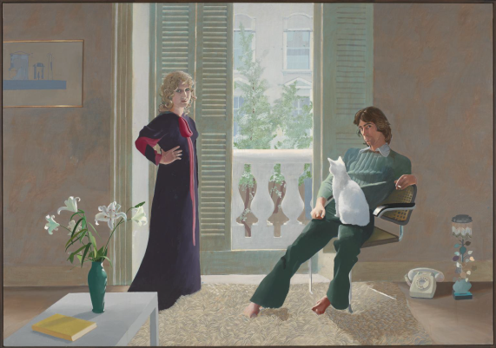
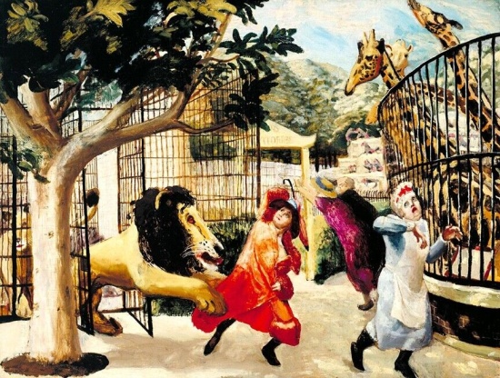
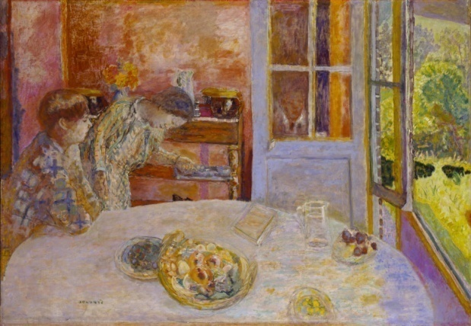
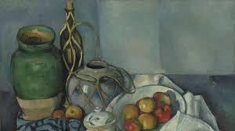
Guessing game : choose a piece of art, describe it and present it to the class.
David Hockney, ‘Mr and Mrs Clark and Percy’, 1971, Tate Modern .
Carel Weight, ‘Allegro Strepitoso’, 1932, Tate Modern .
Pierre Bonnard, ‘The Living Room’, 1925, Tate Modern .
Paul Cézanne,’ Still Life With Apples’, 1894, Tate Modern .

Slide 2
INTERMEDIATE TASK
WRITING: You are preparing a school visit to the National Gallery. Choose a piece of art and describe it as precisely as possible.
SPEAKING : Record a podcast. Your classmates must guess the piece of art.

Slide 3
WRITING: You are preparing a school visit to the National Gallery. Choose a piece of art and describe it as precisely as possible.
✦ Pair work
Rends-toi sur le site https://www.nationalgallery.org.uk/.
Dans l’onglet ‘art and artist’ puis ‘explore the collection’, choisis une oeuvre qui te plait.
✦ Présente et décris cette oeuvre. Tu peux utiliser ton cahier. Donne toutes les informations possibles.
✦ Enregistre-toi
✦ Ecoute chaque podcast et retrouve l’oeuvre qui correspond.

