Slide 1

Guess the new subject. What can you see?

Slide 2

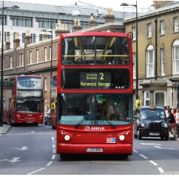
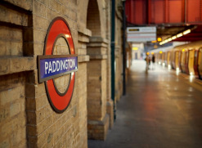

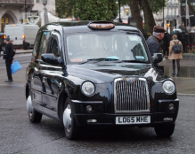
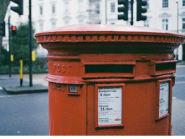
The underground
The Tube
a double-decker bus
a phone box
a pillar box
a black cab
a guard

Slide 4
Do you know any monuments?

Slide 5
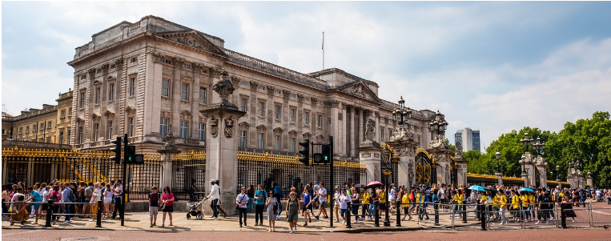
BUCKINGHAM PALACE

Slide 6
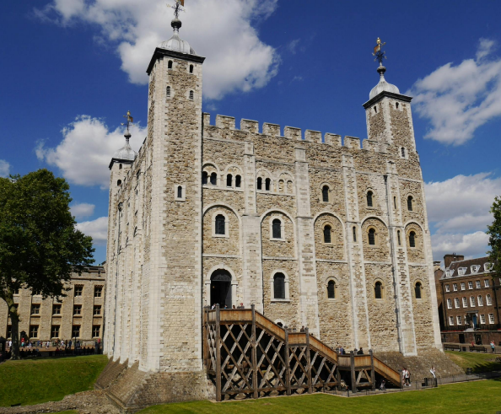
THE TOWER OF LONDON

Slide 7
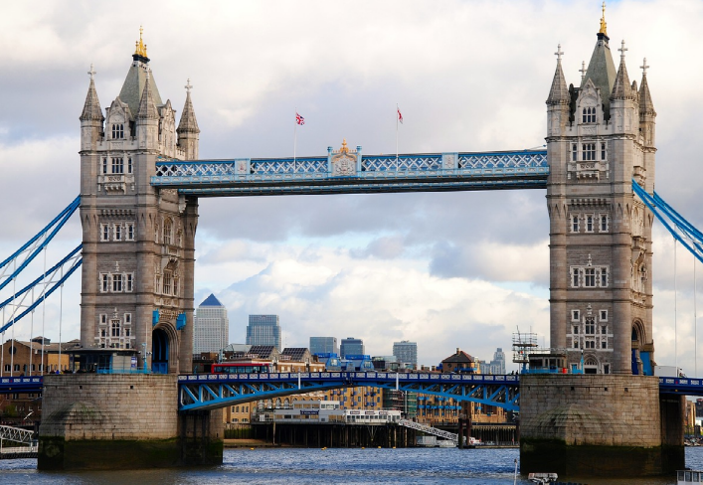
LONDON BRIDGE

Slide 8
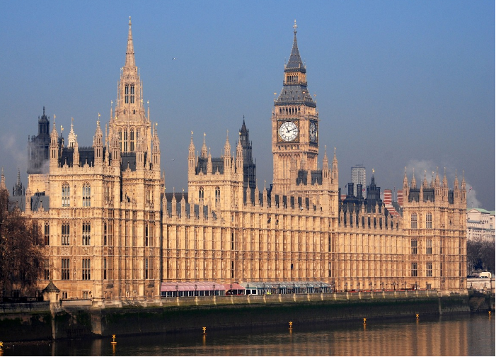
THE HOUSES OF PARLIAMENT
and BIG BEN

Slide 9
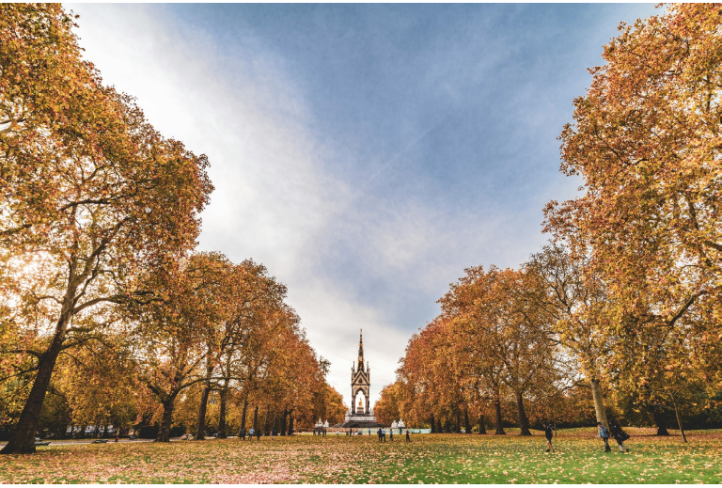
HYDE PARK

Slide 10
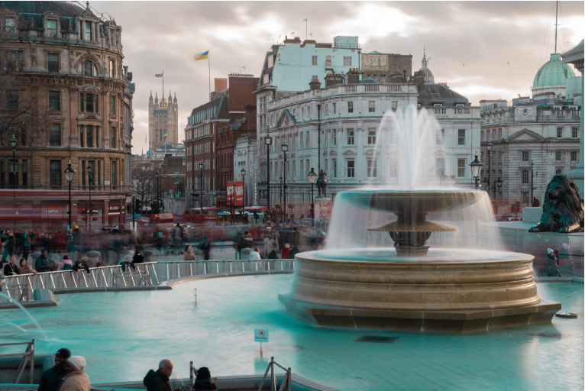
TRAFALGAR SQUARE

Slide 11

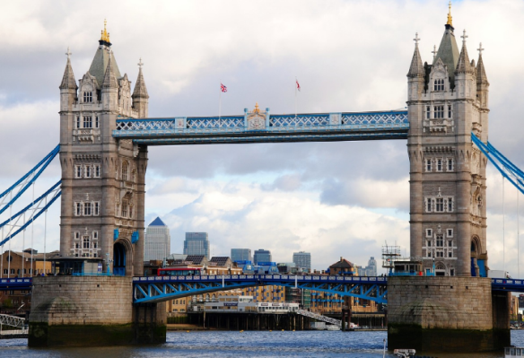


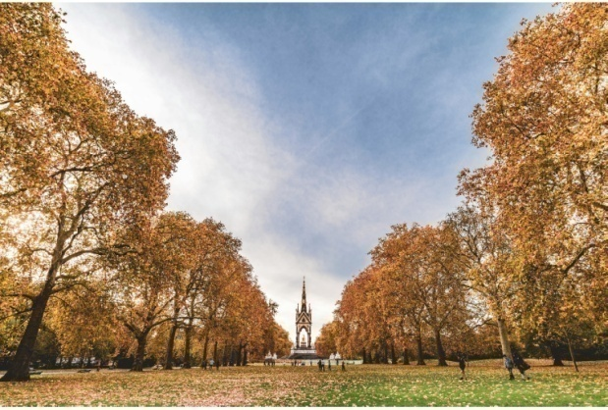
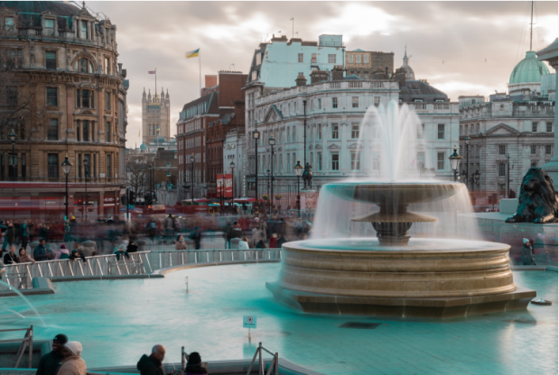
Let’s recap

Slide 12
Do you know any museums?

Slide 13
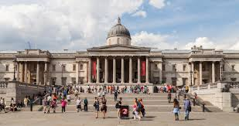
THE NATIONAL GALLERY

Slide 14
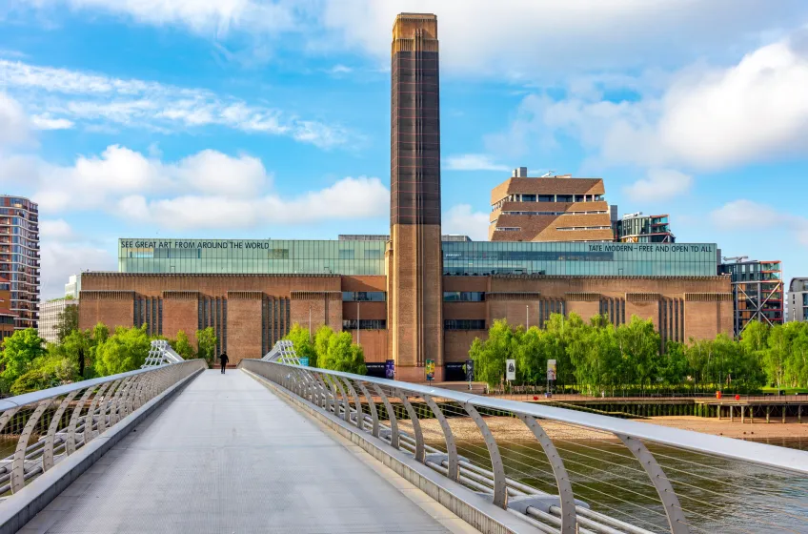
THE TATE MODERN

Slide 15
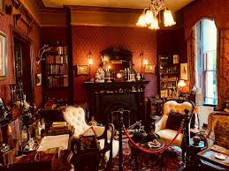
SHERLOCK HOLMES MUSEUM

Slide 16
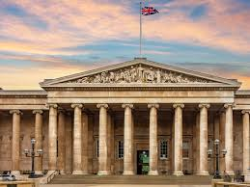
THE BRITISH MUSEUM

Slide 17
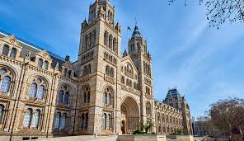
THE NATIONAL HISTORY MUSEUM

Slide 18
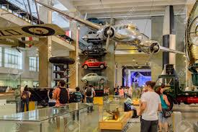
THE SCIENCE MUSEUM

Slide 19
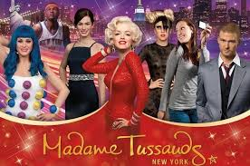
MADAME TUSSAUDS

Slide 20
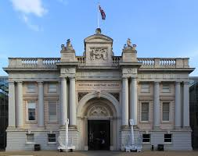
THE NATIONAL MARITIME MUSEUM

Slide 21
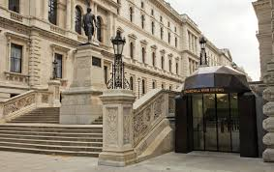
CHURCHILL WAR ROOMS

Slide 22

Let’s recap

Slide 23







Let’s recap

Slide 24
Let’s memorize

Slide 25
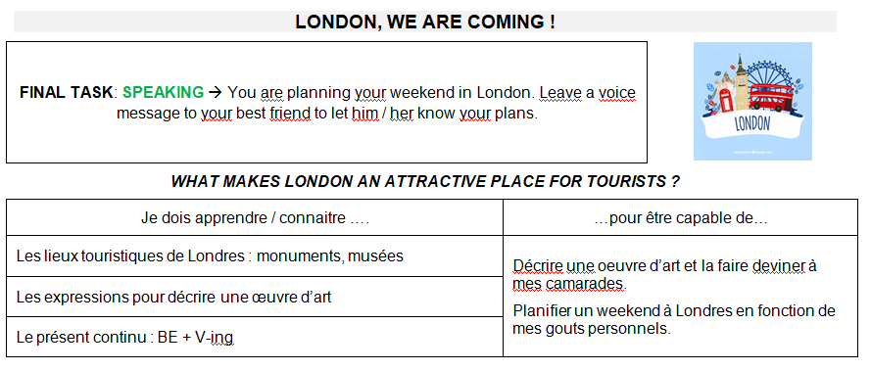
Let’s open your copybooks

Slide 26
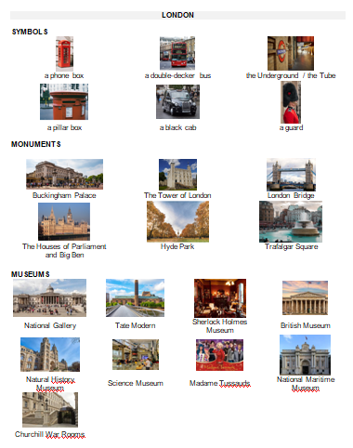
Let’s open your copybooks

Slide 27
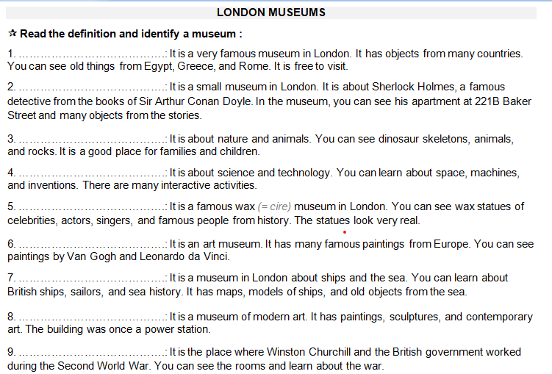
Let’s open your copybooks

Slide 28
………………………………….: It is a very famous museum in London. It has objects from many countries. You can see old things from Egypt, Greece, and Rome. It is free to visit.
2. ………………………………….: It is a small museum in London. It is about Sherlock Holmes, a famous detective from the books of Sir Arthur Conan Doyle. In the museum, you can see his apartment at 221B Baker Street and many objects from the stories.
3. ………………………………….: It is about nature and animals. You can see dinosaur skeletons, animals, and rocks. It is a good place for families and children.
THE BRISTISH MUSEUM
THE SHERLOCK HOLMES MUSEUM
THE NATIONAL HISTORY MUSEUM

Slide 29
4. ………………………………….: It is about science and technology. You can learn about space, machines, and inventions. There are many interactive activities.
5. ………………………………….: It is a famous wax (= cire) museum in London. You can see wax statues of celebrities, actors, singers, and famous people from history. The statues look very real.
6. ………………………………….: It is an art museum. It has many famous paintings from Europe. You can see paintings by Van Gogh and Leonardo da Vinci.
THE SCIENCE MUSEUM
MADAME TUSSAUDS
THE NATIONAL GALLERY

Slide 30
7. ………………………………….: It is a museum in London about ships and the sea. You can learn about British ships, sailors, and sea history. It has maps, models of ships, and old objects from the sea.
8. ………………………………….: It is a museum of modern art. It has paintings, sculptures, and contemporary art. The building was once a power station.
9. ………………………………….: It is the place where Winston Churchill and the British government worked during the Second World War. You can see the rooms and learn about the war.
THE BRISTISH MUSEUM
THE TATE MODERN
CHURCHILL WAR ROOMS

Slide 31
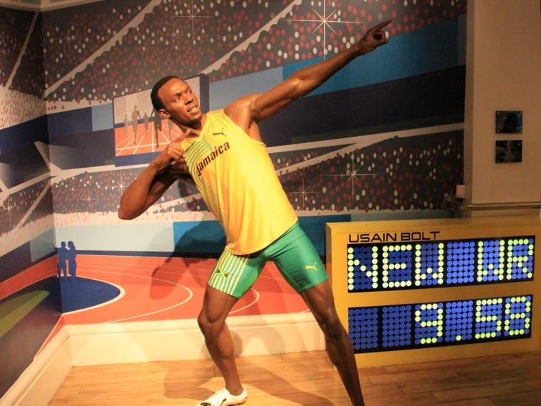
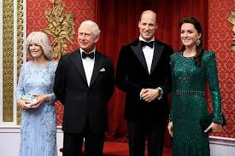

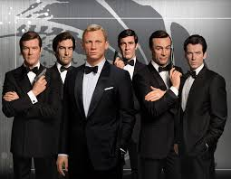

Slide 32
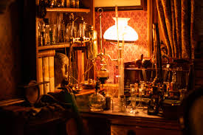
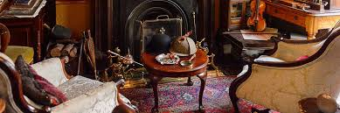
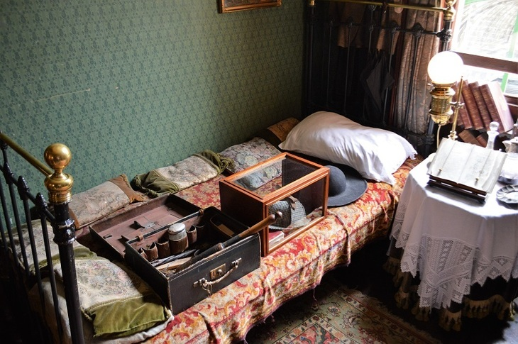
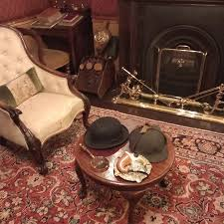

Slide 33
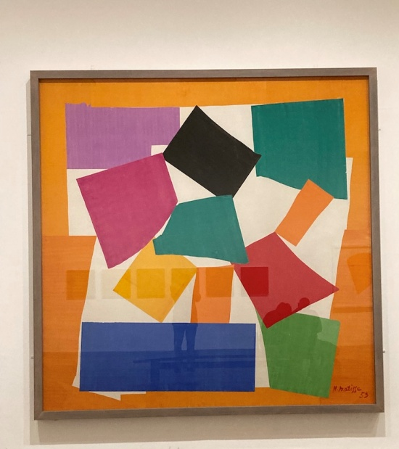
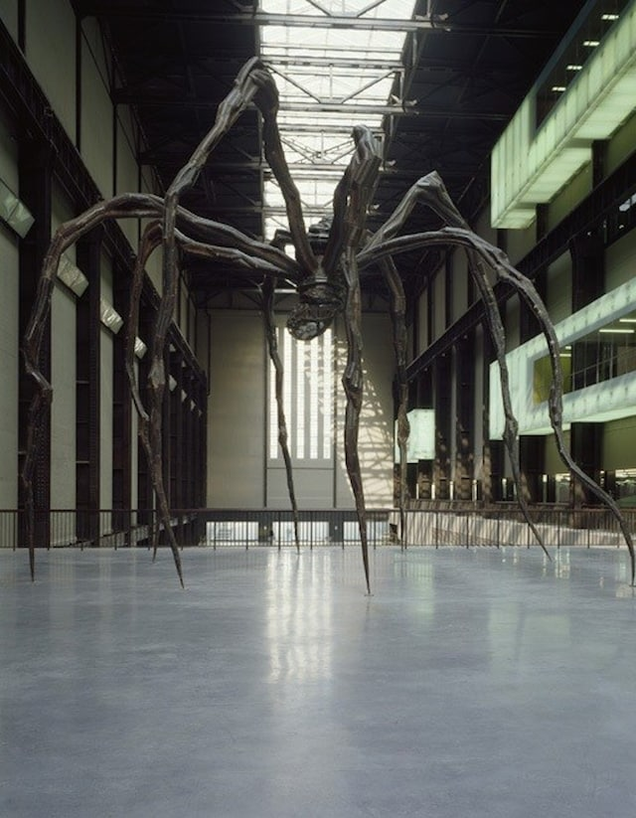
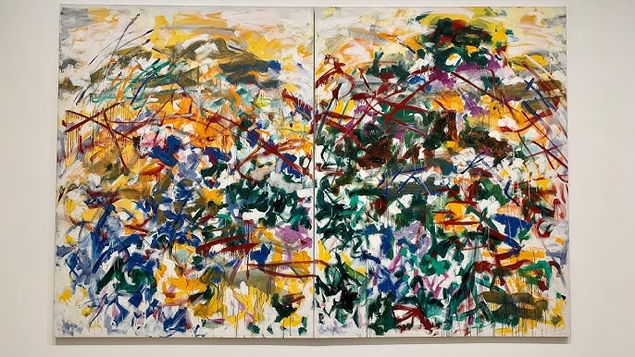
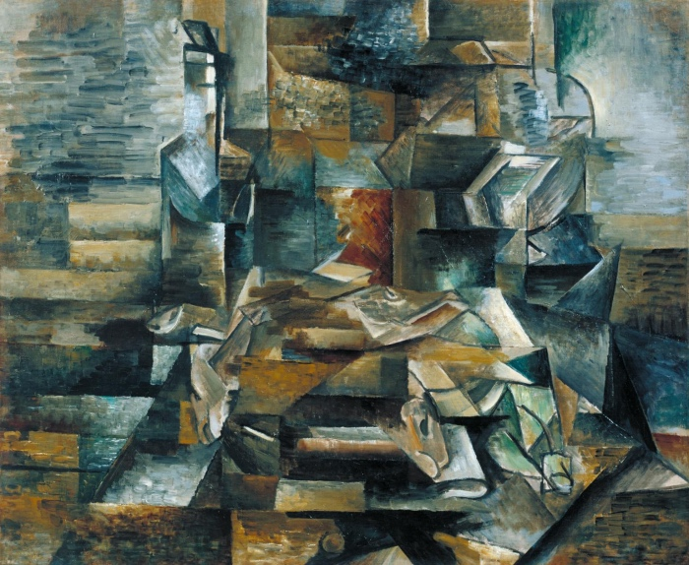

Slide 34
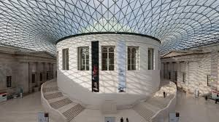
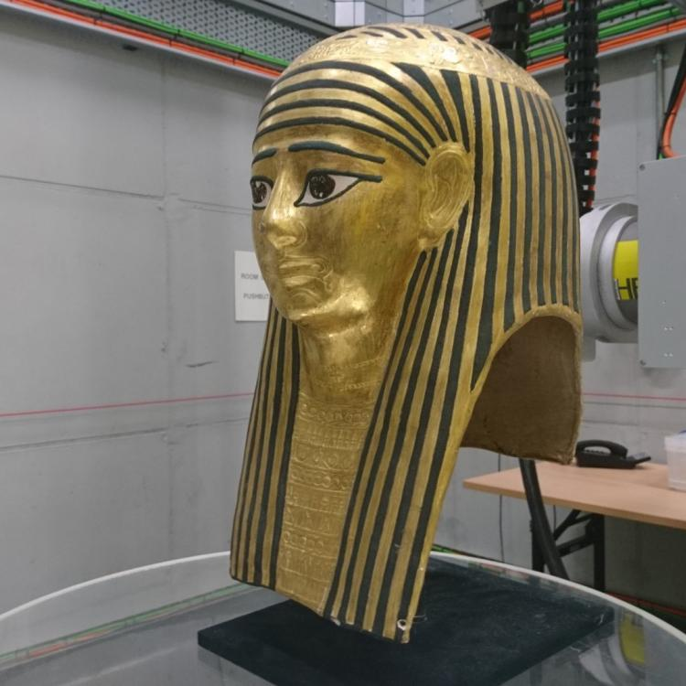
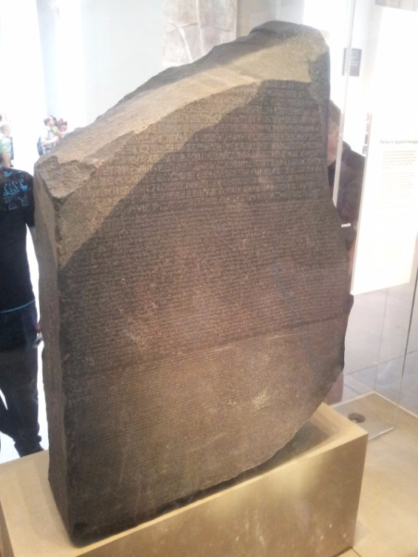
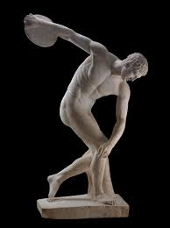
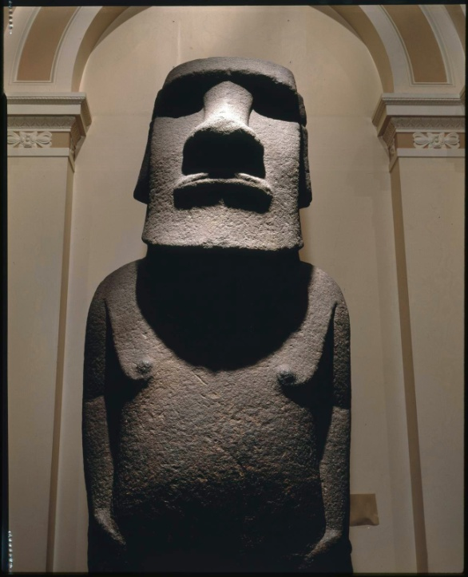

Slide 35
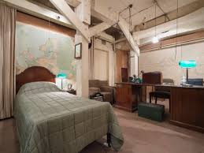
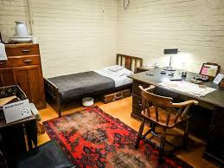
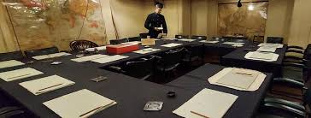
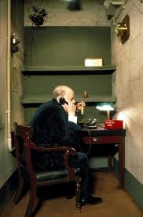
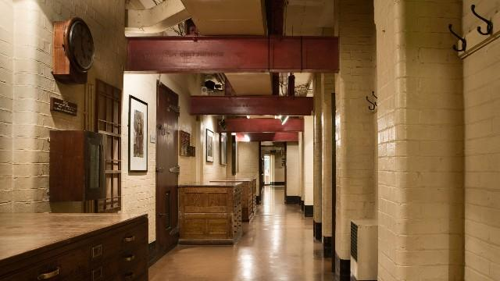

Slide 36
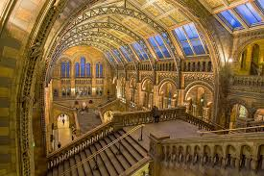
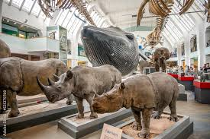
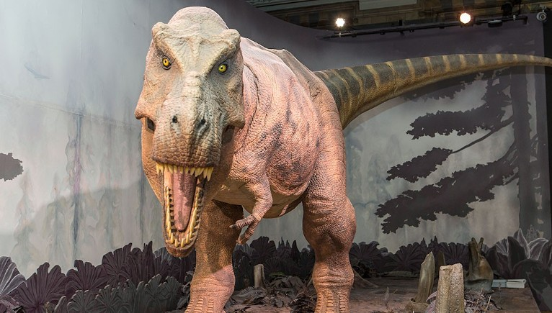
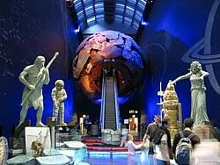


Slide 37






Slide 38





Slide 39






Slide 40

Highlight places and museums on the map

Slide 41
The Sherlock Holmes museum
Churchill War Rooms
The Tate Modern
→
The national history museum

