Slide 1


Let’s play a mime game!
Player 1:
Players 2,3,…:
- Pick a card
Mime an action
Answer questions
Ask questions
Are you ….ing?
Yes, I am.
No, I’m not.
Are you ….ing?

Slide 2


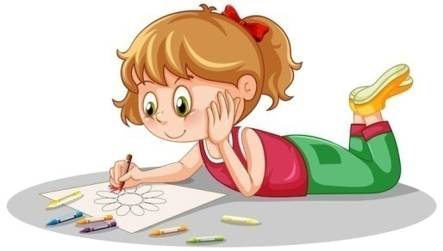



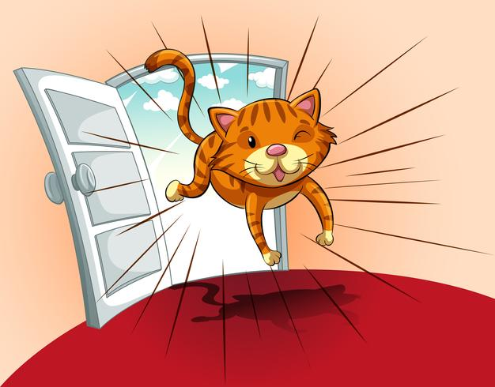

What are they doing ?
(Use the slates)
He is painting.
He …
She is drawing.
They …
She …
They are cooking.
You …
You are eating.
I am swimming.
I …
We are playing basketball.
We …
It is running.
It …
You are reading.
You …

Slide 3
Let’s describe a piece of art

Slide 4
Let’s describe a piece of art
at the top
In the top right-hand corner
In the top left-hand corner
at the bottom
on the left
in the middle
on the right
In the bottom
left-hand corner
In the bottom
right-hand corner
6
1
7
4
2
5
8
9
3

Slide 5
at the top
In the top right-hand corner
In the top left-hand corner
at the bottom
on the left
in the middle
In the bottom
right-hand corner
In the bottom
left-hand corner
on the right
6
1
7
4
2
5
8
9
3

Slide 6
TOOL WORKSHEET ➢ DESCRIBING A PIECE OF ART
1) INTRODUCTION
- identification - title - date - artist + nationality - place of exhibition - global description
- This piece of art is a picture / a painting / a sculpture …
- It is entitled …
- It was painted / made in (+date) by (name of artist).
He / she is / was a (nationality adj) painter / writer / sculptor…
- It is exhibited at (+name of museum) in (+city)
- It represents …
- It is exhibited at (+name of museum) in (+city)
- It is entitled …
- It represents …
He / she is / was a (nationality adj) painter / writer / sculptor…
- It was painted / made in (+date) by (name of artist).
- This piece of art is a picture / a painting / a sculpture …

Slide 7
TOOL WORKSHEET ➢ DESCRIBING A PIECE OF ART
2) DETAILED DESCRIPTION
- prepositions of place - present continuous - hypothesis - impression | - We can see … - There is / are … - I think / Maybe / Perhaps…

Slide 8
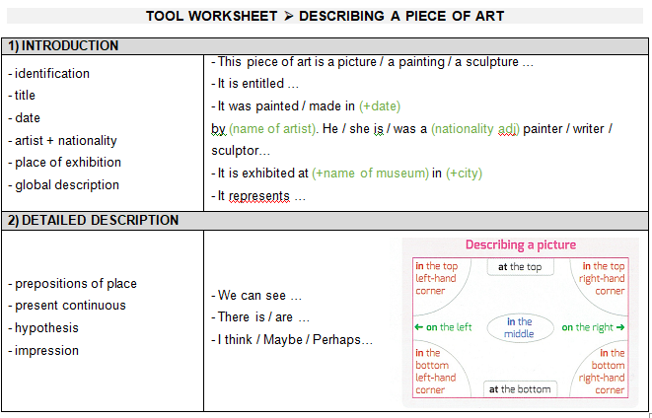
Let’s describe a piece of art

Slide 9
Let’s describe a piece of art
‘My parents’, David Hockney,1977. Tate Modern, London.

Slide 10
This piece of art
It is entitled
It was painted by .
He is a
It is exhibited at
It represents
is a painting.
‘My Parents’.
in 1977
David Hockney
British painter.
the Tate Modern in London.
a man and a woman.

Slide 11
They on a chair. The woman is and the man is . The woman is wearing
. She is looking at us.
The man a brown suit and black shoes. He something, perhaps a magazine.
there is a green table. There are books, and a small mirror on the table.
On the floor carpet.
are sitting
on the left
on the right
a blue dress
is wearing
is reading
In the middle
flowers
there is a

Slide 12
Maybe …..
Perhaps …..
I think …………..

Slide 13
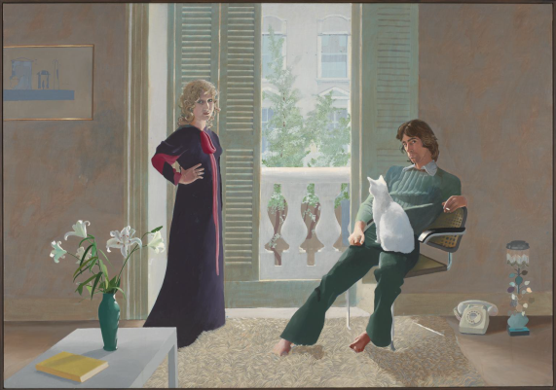
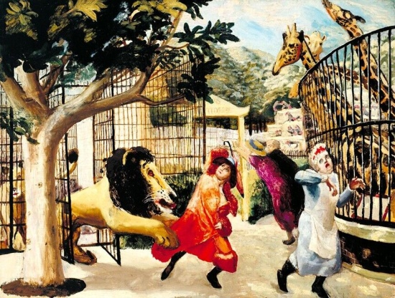
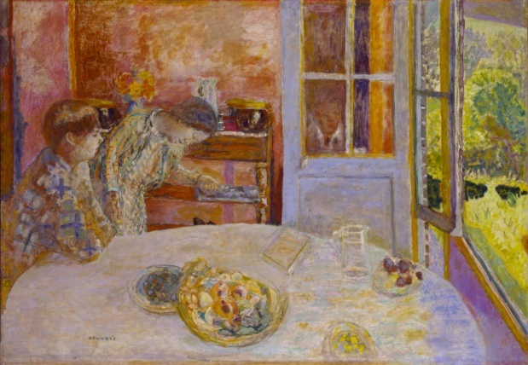
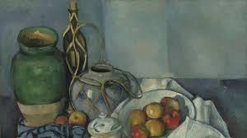
Guessing game : choose a piece of art, describe it and present it to the class.
David Hockney, ‘Mr and Mrs Clark and Percy’, 1971, Tate Modern .
Carel Weight, ‘Allegro Strepitoso’, 1932, Tate Modern .
Pierre Bonnard, ‘The Living Room’, 1925, Tate Modern .
Paul Cézanne,’ Still Life With Apples’, 1894, Tate Modern .

