Slide 1
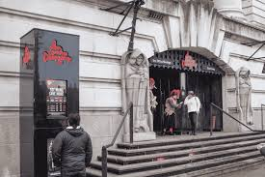
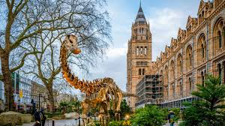
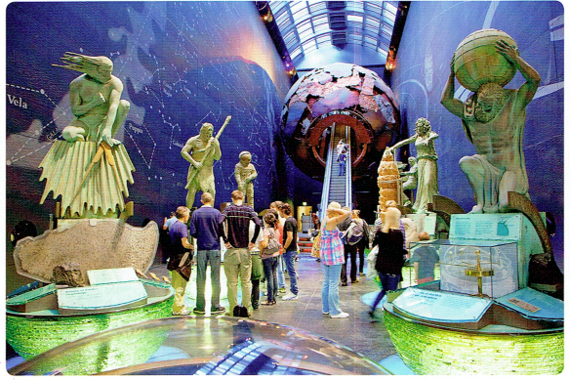
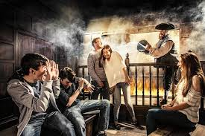
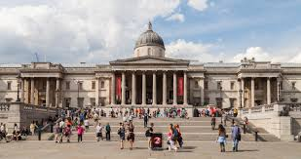
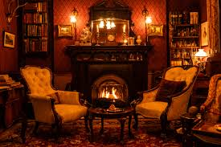
What do your remember?

Slide 2
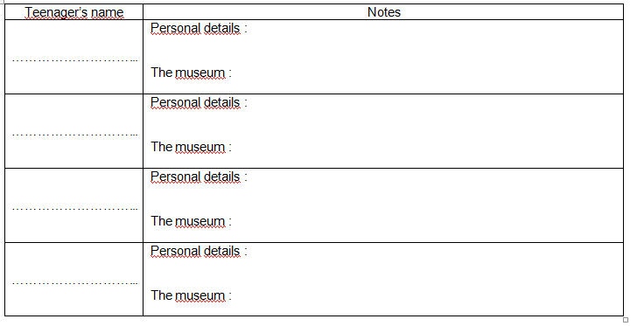
A WEEKEND IN LONDON
Listen and find information about the museum they are visiting next weekend.

Slide 3
Teenager’s name | Notes
………………… | Personal details : The museum :
………………… | Personal details : The museum :
fond of detective stories
lots of mystery books at home
ALEX
You can learn everything about a very famous detective
really interested in nature and animals
JESSICA
You can see a huge dinosaur gallery
You can explore the universe

Slide 4
Teenager’s name | Notes
………………… | Personal details : The museum :
………………… | Personal details : The museum :
a creative person / He’s into art
BRATT
All the paintings in this museum are great and a source of inspiration
An art and fashion lover
LINZY
There are lots of extraordinary clothes and jewels

Slide 5
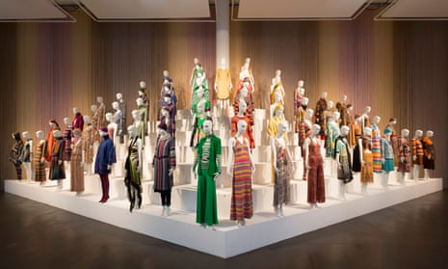
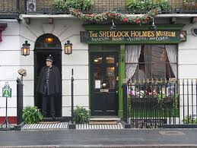
✰ Write the name of each teenager under the corresponding museum :
The Sherlock Holmes museum
The fashion and design museum
ALEX
LINZY
The Natural History museum
The National Gallery
JESSICA
BRATT

Slide 6
Let’s recap your notes :
Alex ............................................... so he’s going to visit the .................................................................................
Jessica ............................................... so ........................................................................................
Brad ............................................... so ..........................................................................................
Linzy ................................................................................
is fond of detective stories
Sherlock Holmes museum.
is really interested in nature and animals
so she’s going to visit the natural History museum.
is into art and he is creative so he is going to visit the National gallery or the Modern Tate.
is an art and fashion lover so she’s going to visit the Fashion and textile museum.

Slide 7
✰  What about you ? What museum would you like to visit ?Justify your answers.

Slide 8
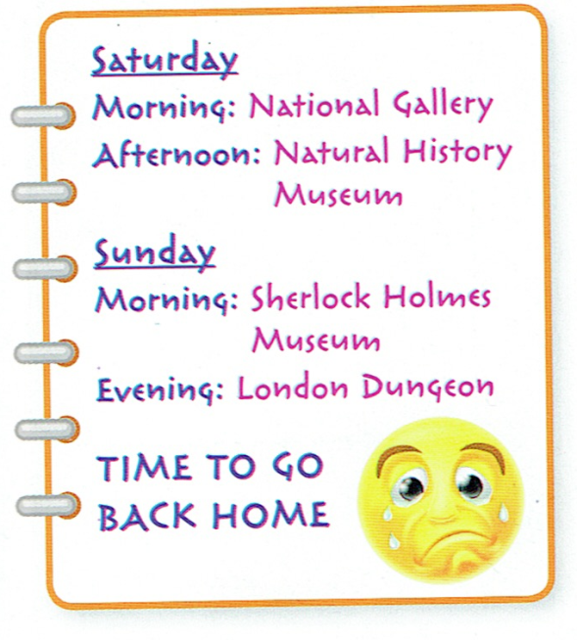
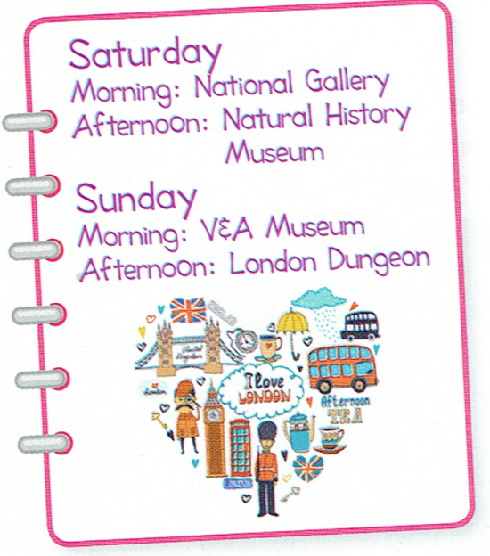
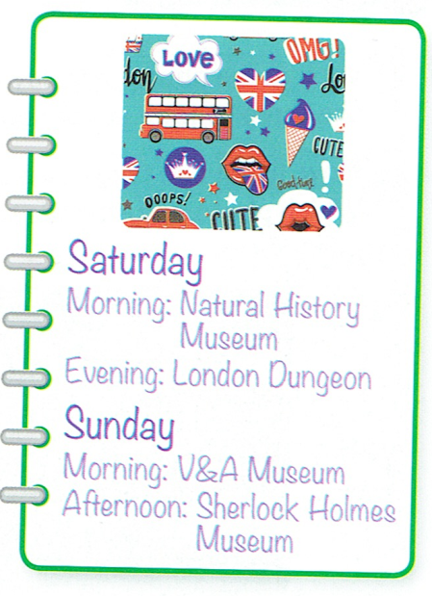
Jenny, Betty and Lucy are going to London next weekend.
Ask questions and guess who is doing what.
Jenny
Betty
Lucy
Is she visiting the National Gallery on Saturday?
Yes, she is. / No, she is not.

Slide 9
Choose your favourite weekend and answer your classmate’s questions.
Are you visiting the National Gallery on Saturday?
Yes, I am. / No, I am not.

